Slide 2
BW 4/16/2013
What kind of art could you make out of trash?
Did you remember to bring trash?
- If yes, what did you bring?
If no, what are you going to bring next class?
How many days of school are left?
Get ready for a presentation, then the library…

Slide 3
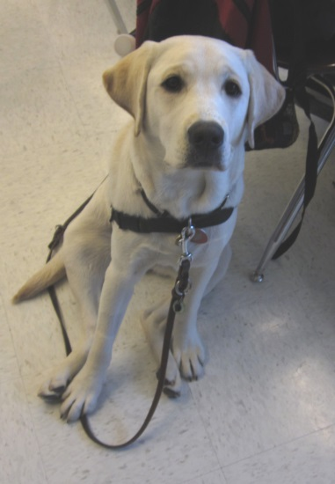
Library
Let’s go to the library first!
Feel free to take a piece of paper and a pencil to sketch with if you would like
Leave bags, water, etc. in the class, the door will be locked.

Slide 4
Bell Work 4/15/2013
Get ready for a presentation!
What have other people done with trash to make art?
Ready looks like…
Eyes on presenter
Voices off
Sitting attentively ready to watch the presentation

Slide 5
Vik Muniz
The author arranges all of the pieces carefully, photographs the collages, and then destroys them so that they only exist as photographs. Muniz also mixes junk with luxury goods such as caviar in his collages to make a statement about consumerism.

Slide 7
Bernard Pras
Pras creates tributes to celebrity portraits and other works of art through a process called anamorphosis, during which he stacks everyday objects on a photograph to form a collage.

Slide 9
Sarah-Jane van der Westhuizen
The art is created from old car parts, recycled metal pieces, and anything the artist could get her hands on. Van der Westhuizen has installed several of these trash sculptures all over Europe.

Slide 12
David Mach
Hundreds of used coathangers go into the sculpture work of David Mach, who uses other recycled materials to do larger-than-life sculptures. This gorilla is one of his most impressive examples.

Slide 14
Frank Russell
The shark piece below, Captain Crunch, was constructed from hubcaps, food packaging tins, and the leg of a male mannequin. The fins are copper and the teeth are soup cans. It is ten feet long. Russell specializes in these sculptures produced from found objects.

Slide 16
Tim Gaudreau
Gaudreau’s work combines photography, video, new-media, graphics, and sculpture with humor and irony to create collaborations that advocate for a greater awareness of eco-issues and empowerment. Gaudreau photographed everything he threw out every day for a year. The resulting collage was huge and filled a few rooms at the gallery it was exhibited in.

Slide 18
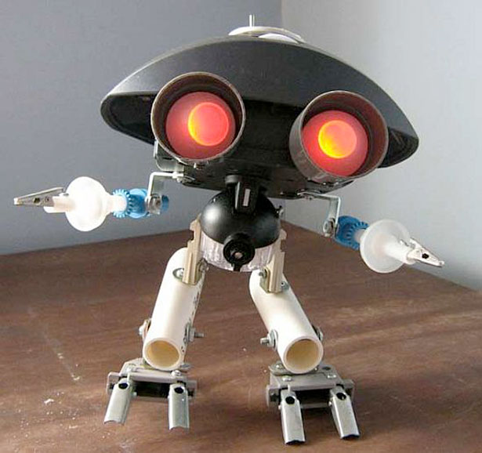
Mario Caicedo Langer
Langer creates sculpture from trash and broken gadgets.

Slide 21
Dave Hind
Dave is a Hamilton, Ontario artist who specializes in reclaimed metal and other found objects in his works. He also produces large-scale sculpture and functional artwork.

Slide 23
Jason Mercier
Mercier specializes in celebrity collages done with the celebrity’s own discarded objects. While Hello Kitty likely didn’t discard any objects, Donald Trump and Mariah Carey probably did.

Slide 27
Tom Deininger
Deininger is widely known as a famous artist who upcycles junk into fine art installations. He is also a highly regarded and collected visual artist.

Slide 30
Michelle Stitzlein
Stitzlein creates art from found materials such as piano keys, broken china, and other recycled items.

Slide 32
Kitty Wales
Wales has been created sculptures, designs, and installations for the last fifteen years that centre on her observations of the animal world. The material that she uses to created her various animal sculptures is salvaged from everyday domestic life.

Slide 34
Mark Langan
Langan creates art from reclaimed cardboard and other materials. Scream was created from corrugated cardboard and other recycled materials. Langan works with non-toxic glue, an exacto knife, and a lot of patience.

Slide 37
Robert Bradford
Bradford, a former psychotherapist, is best known for creating sculptures from toy parts. He screws the toy parts onto a wooden armature to create his 3D sculptures.

Slide 39
Subodh Gupta
Brass pots and eerie skulls from a mashup of metal parts are just part of what this skilled Indian artist has done.

Slide 41
Ha Schult
Schult is known for creating massive installations of people constructed from trash in major locations around the world. Here are just a few of them.

Slide 45
Tyree Guyton
Guyton created the Heidelburg Project as an urban renewal project, transforming a rundown section of Detroit from a place where people were afraid to walk to an art exhibition that people wanted to visit.

Slide 47
Elizabeth Lundberg Morisette
ClementineMom on Flickr, Morisette specializes in making art from items she purchases off of eBay or otherwise found objects.

Slide 49
Charles Kaufman
Kaufman’s crushed can art is done on crushed soda cans.

Slide 51
Chris Jordan
Jordan’s Running the Numbers series aims to display America’s relationship with consumerism. While he doesn’t physically make art from trash, he does showcase the wastefulness of a consumerist society eloquently. The first image, Plastic Bottles, is a shot of 2 million plastic bottles shows how many plastic bottles Americans go through in five minutes. The second, Packing Peanuts is a photograph of 166,000 packing peanuts, or the number of overnight packages shipped by air every hour. The third image, is a recreation of Seurat’s masterpiece, A Sunday Afternoon on the Island of Grand Jatte, done with 106,000 aluminum cans. A closeup of the work is immediately beneath it.

Slide 54
Gugger Petter
This artist creates two and three-dimensional collages from newspaper.

Slide 56
Ptolemy Elrington
While he built his reputation creating creatures from hubcaps, Elrington has since branched out into grocery cart parts and old pots and pans.

Slide 60
Nek Chand
About 40 years ago, Chand cleared some jungle to build a garden in his native India. He put together a few sculptures using found materials and old trash. Now, his “garden” covers 40 acres and includes numerous mosaics and sculptures made from reclaimed materials.

Slide 65
Carolien Adriaansche
A Dutch artist, Adriaansche creates colourful pieces that are put together from every day trash such as bottle caps, wire, sticks, and cleaning bottles.

Slide 69
Steven Siegel
Siegel creates large trash forms and places them in the middle of various landscapes. Electronic waste on the Stanford campus and newspapers with headlines about Hurricane Katrina feature prominently in the following installations.

Slide 72
Safety
Go to the back table
Quick safety chat

Slide 73
Trash Art
Be creative!

Slide 74
Ideas
Think outside the box

Slide 75
Make 3D or 2D Art
It’s up to you!
Make it 3D or 2D

Slide 76
Rubric and Studio Time
3 weeks
Students will vote on which art goes to the art show
Must be made out of garbage
All attached to each other

Slide 77
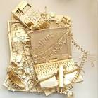
EP 4/16/2013
Make a list of the trash you want to find at home?
What do you want to make for your project? Draw a sketch
What will you need to connect your art work or paint your art with?
See you all next class!

Slide 78
Resources Found on…
http://www.webdesignerdepot.com/2009/12/non-trashy-recycled-and-trash-art/

