Slide 1
Sketches Become More
AP/Studio

Slide 2
Bell Work
1. What are steps that a person might take to complete a difficult task. ( ex. Building a bridge, completing college. )
2. Do you think an artist might handle a large problem differently than someone that doesn’t consider themselves creative?
3. Why or why not?

Slide 3
Talk in groups about why you bell work
Write down at least three steps that a person take to complete a difficult task. ( exp. Building a bridge, completing college. )

Slide 4
Goals
Setting Goals
Planning
Building a model
Tracking along the way

Slide 5
Agenda
Bell Work
Agenda
Goal sheet
Homework project
Exit pass

Slide 6
Goal Sheet
There will be a goal sheet handed out I want you to write down what you want to be able to accomplish with your next art project.

Slide 7
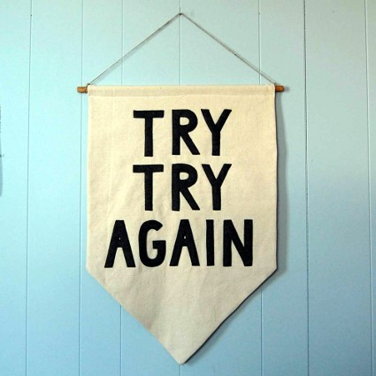
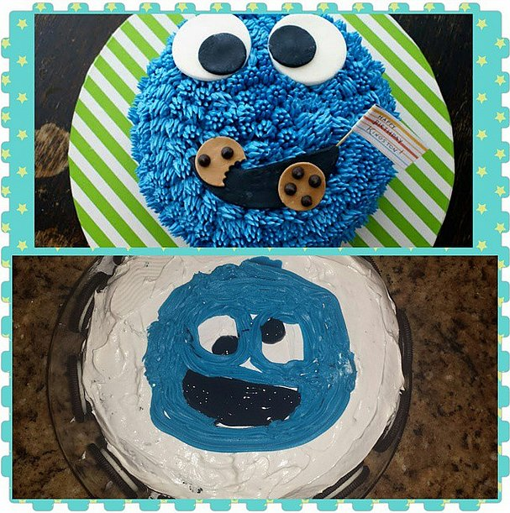
Have you ever said if I could redo that it would have been so much better?

Slide 8
Redo one of you homework pieces
Hopefully you are in the habit of drawing every night, maybe you even like some of what you have been working on. You are going to pick one of those and redo it.

Slide 9
Or you can redo
The twine project
The smooshed face selfie

Slide 10
You can use
Paint
Charcoal
Pen
Pencils
Have fun with the art supplies

Slide 11
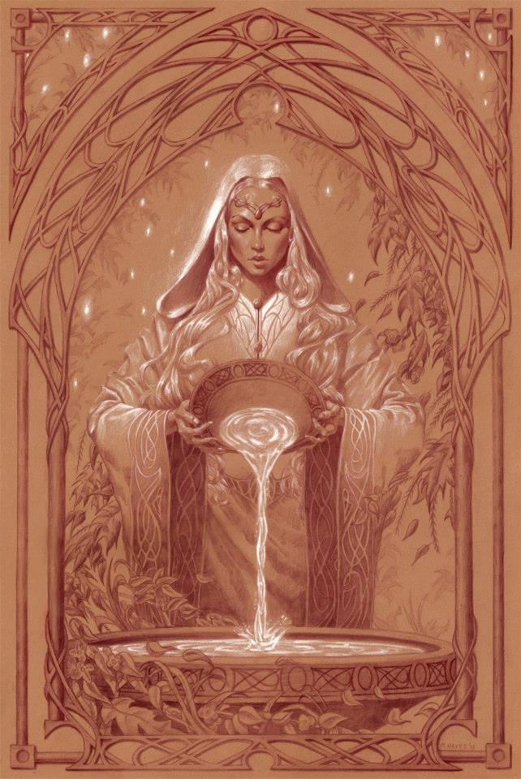
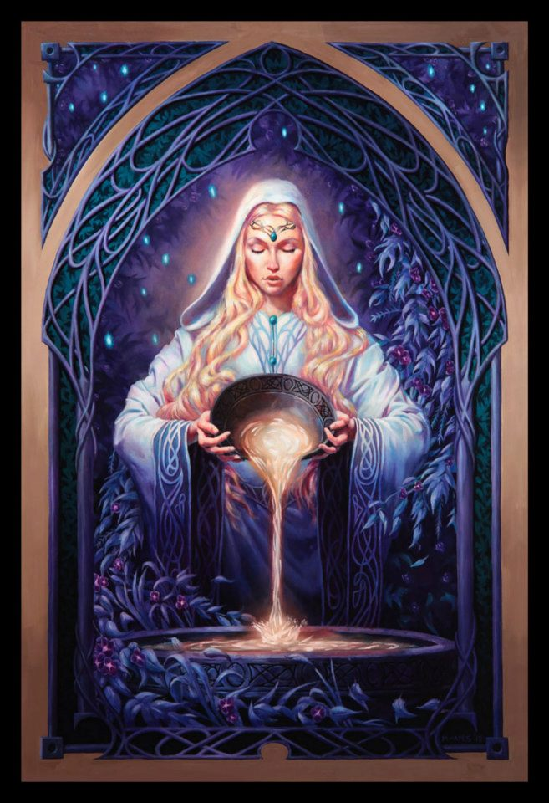
Michael Hayes
Take your work to the next level.
So…
Oh!

Slide 12
Next time
We will be working on this project as well

Slide 13
Exit pass
Did you find a piece you want to redo?
Do you know what medium you want to be working with? (ex. paint pen pencil)
Do you want lessons on how to use the medium you have chosen? ( maybe just tips?)

