Slide 1
Smushed Face Self-Portriats 2 Days
Studio
Mrs. Lyon
2016

Slide 2
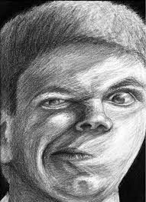
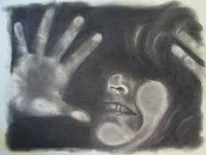
9.27.2016 Find your picture
Find your printed off image from a few classes ago
If you don’t have one, wait till after the mini-lecture and we’ll print off a picture for you

Slide 3
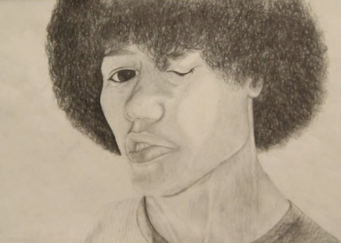
Self-Portriat Review
Eye
Ear
Nose
Mouth
Proportions of the Human Face

Slide 4
Eye

Slide 7
Ear 1

Slide 8
Ear 2

Slide 9
Ear 3

Slide 10
Mouth 3

Slide 15
Human Head Proportions

Slide 16
Proportions of the Face

Slide 20
Studio Time: Sketch your face
Using the printed off image
Draw your smushed face
Using shading pencils (if you want to challenge yourself you can use contrasting colors)
2 days to work on this
Focus on proportions and ratios
Having at least 5 tones of graphite
Reminder: please make sure to pay your art fee, when you do you get a sketch book in Studio

Slide 21
Clean-Up
Remember:
Table area must be cleaned before you can leaveAnything around the floor needs to be put away
All things put back where you found them

Slide 22
Citations
Art Factory
http://www.artyfactory.com/portraits/drawing_techniques/drawing_the_eye.htm
Found images on for slides about drawing eye, nose, ear, mouth, and face proportions

