Slide 1
Day 1 of 2 OTN Contest
E.Lyon

Slide 2
Bell Work
1) How was your Spring Break?
2) In a drawing or painting, when things are close to you they are:
Bigger – Or Smaller?
3) In a drawing or painting, when things are far away they are:
Clear –or- Blurry
4) In a drawing or painting, brighter more vibrant colors are:
Closure –or- further away?
5) What is atmospheric perspective?
6) What do you think a landscape needs to have to give it depth?

Slide 3
Agenda 4.10.2017
Bell Work
Agenda
Rest of the term and FYI ‘stuff’
Review Bell Work
Two day project
Find an image
Create background with chalk
Spray
Middle ground, pastel
Foreground, pencil – color or shading
Exit Pass

Slide 4
Rest of the Year/Term Info
Art Fees
If you haven’t paid it’s fine now
Make sure to pay so that you can get your art & I can sign our sign out sheet at the end of the year(concerns chat with me)
Recycled Art
Has not been graded yet
Will be by the end of this week
Please make sure to leave all recycled projects where they are do not move
Friday
We will be doing fused glass
It’s a one day project, so make sure to be here Friday
Those who have paid their fee by then, will get theirs fired, those that haven’t won’t ☹

Slide 5
Review Bell Work
1) How was your Spring Break?
2) In a drawing or painting, when things are close to you they are:
Bigger – Or Smaller?
3) In a drawing or painting, when things are far away they are:
Clear –or- Blurry
4) In a drawing or painting, brighter more vibrant colors are:
Closure –or- further away?

Slide 6
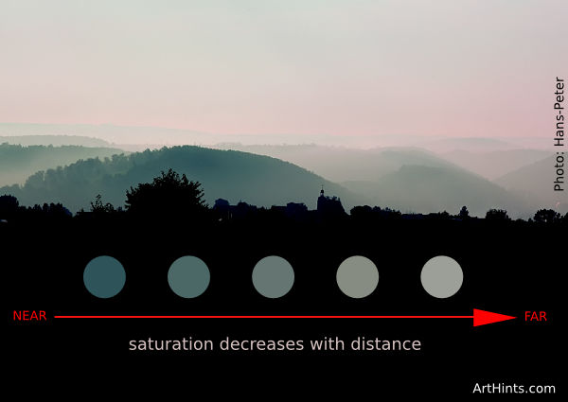
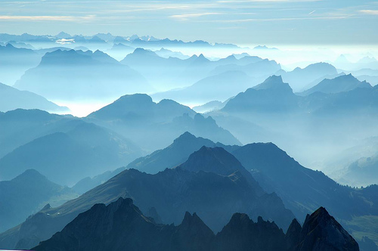
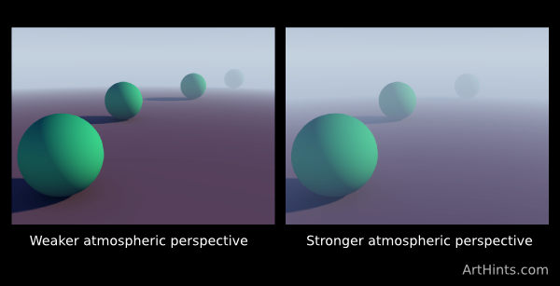
5) What is atmospheric perspective?
Aerial perspective, also called atmospheric perspective
method of creating the illusion of depth, or recession, in a painting or drawing by modulating color to simulate changes effected by the atmosphere on the colors of things seen at a distance

Slide 7
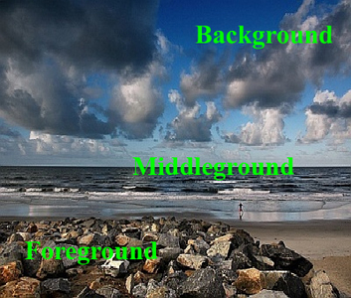
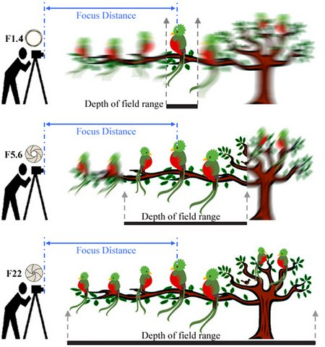
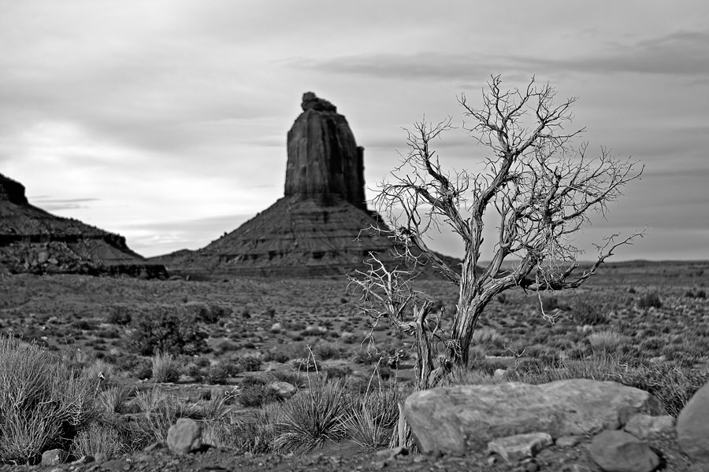
6) What do you think a landscape needs to have to give it depth?
depth of field
the distance between the nearest and the furthest objects that give an image judged to be in focus in a camera.
In photography this is used as a focal distance

Slide 8
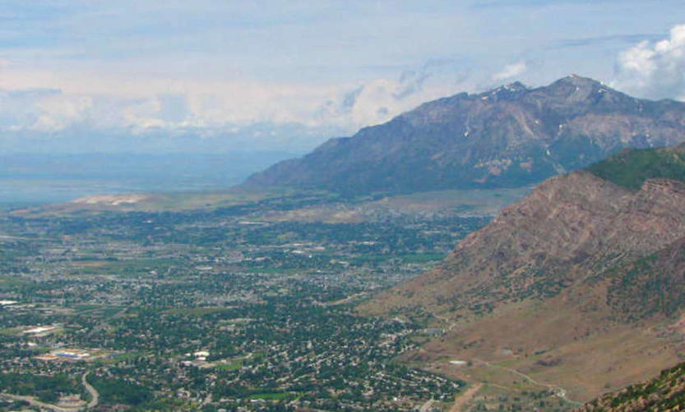
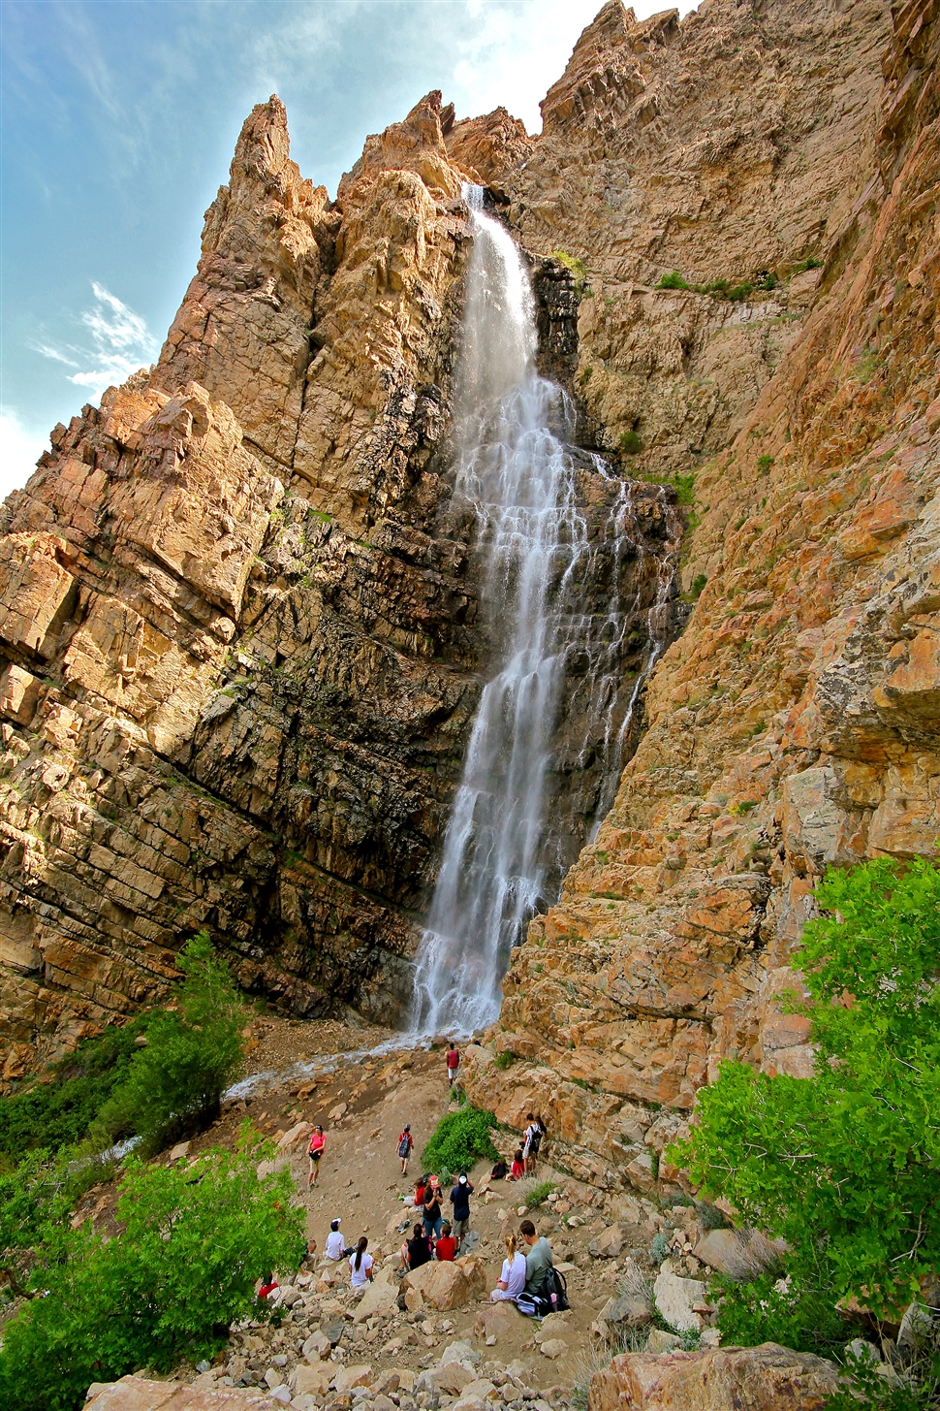
Ogden Trails Landscape
Find an image
Ogden Trails – trails on this side of the mountain
Sketch
When you are done sketching(lightly), get your image approved, get a large paper, add background with chalk

Slide 9
Project Expectations
Foreground, middle ground and background
Foreground – detail and brighter – pencil(colored or shading)
Middle ground – a little less detail and duller (pastel)
Background – dullest(atmospheric perspective) and the least amount of detail(calk and sprayed)
Ogden Trail
Try your best, have fun!
Due end of class Wednesday
Enter into contest – free t-shirt and prizes, 1st place $100-!

Slide 10
Exit Pass 4.10.2017
How are you creating atmosphere perspective in your art? If you are not, how could you add it?
How are you showing you have a fore ground, middle ground, and back ground in your work?
Next class this project is due at the end of class, what will you need to do in order to be done on time?

