Slide 1
Title Layout
Subtitle

Slide 2
9.28.2018 You will need:
Watercolor paper with masking fluid on it – leave it on there, don’t pick it off
Watercolor palette – either one
Water in a container
A sponge
Aqua Flow Brush
One of each – flat and round brush
Paper towel
Ready?

Slide 3
Masking Fluid!

Slide 4
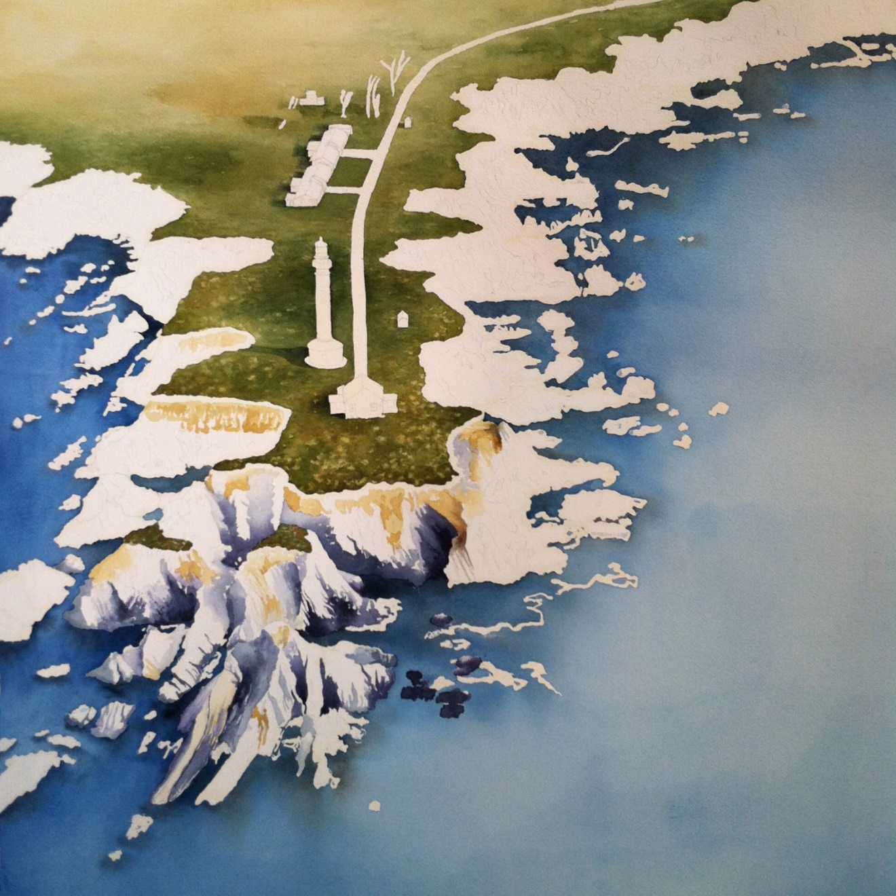
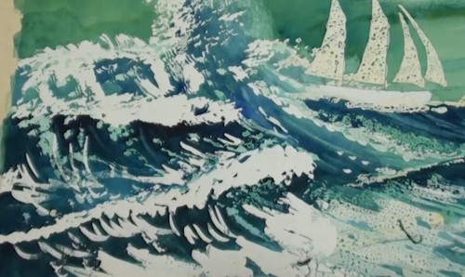
In process pieces

Slide 5
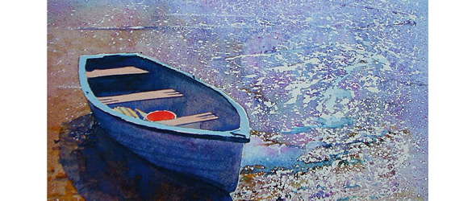
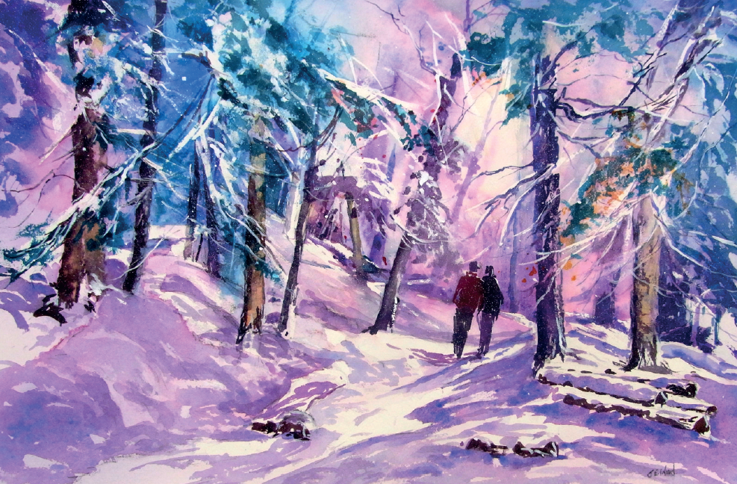
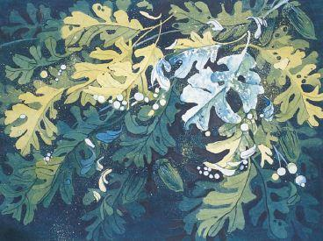
Finished pieces using masking fluid

Slide 6
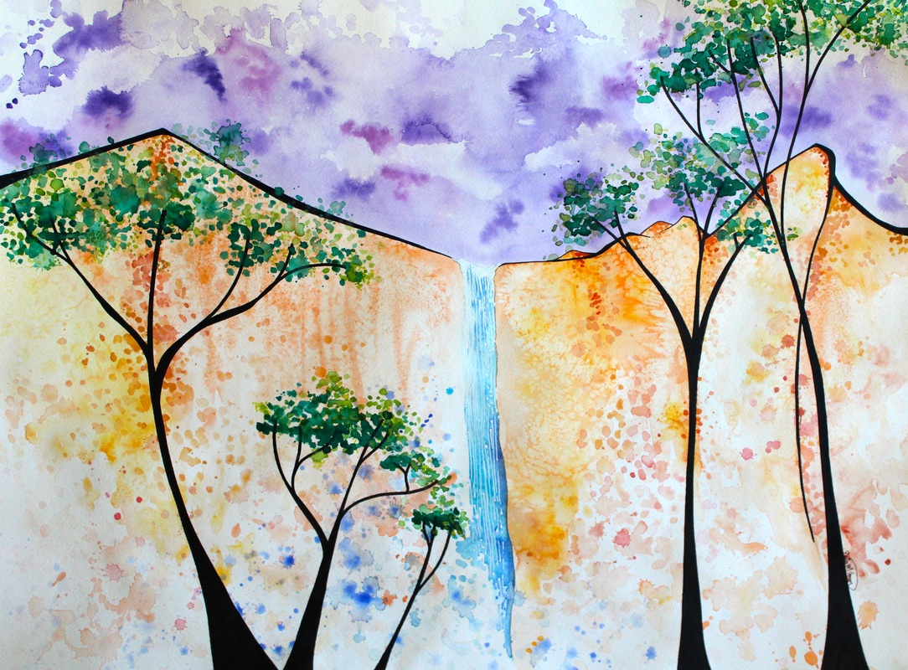
Finished Piece with Masking Fluid that I made

Slide 7
Add a Slide Title - 1

Slide 8
Add a Slide Title - 2

Slide 9
Add a Slide Title - 3

Slide 11
Add a Slide Title - 4

Slide 12
Add a Slide Title - 5

