Slide 2
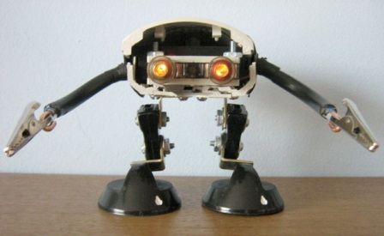
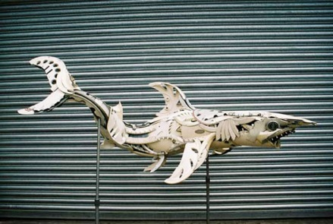
Studio Time Garbage Art Project #7
Continue to work on your project
If you don’t have any thing to work with, you can visit the cardboard recycling outside
Make sure you are working to earn your participation points for today

Slide 3
Projects Due Today!
Complete a rubric, turn it in the box
Attach a label to your art
You can sell it at the garbage art show or if you don’t want to sell it circle(NTF = not for sale)
When you are done, start thinking about what you want to do for the final project
You can do anything you want(keep it school appropriate) with the mediums we’ve work with so far

