Slide 1
Assignment #4 Self-Portraits
Art A
Mrs. Lyon
2010

Slide 2
Bell Work 11/20/2013
What is the most challenging thing for you to draw on the human face? ( Eyes, ears, lips, nose, chin, hair, etc.)
What is the easiest thing for you to draw on the human face?
What worries you the most when you think about drawing a self-portrait? Why is that?
If you finish with extra time, try to draw these things by themselves: eyes, nose, ears, etc.

Slide 3
Agenda
Review Bell Work
Talk in your table groups about your answers to your bell work
Does anyone have tricks to drawing the things that are challenging for you?
Be ready to present one of the tricks you learned in your table groups.
Sketching Practice today to help with self-portraits
Assignment #5 – Self-Portraits!
Rubric
Goals
Exit Pass

Slide 4
Review Bell Work
In your table groups talk about:
What is the most challenging thing for you to draw on the human face?
What is the easiest thing for you to draw on the human face?
What worries you the most when you think about drawing a self-portrait? Why is that?
Share technique ideas with group members that you have learned in the past about how to draw those things that are challenging for other people at your table group.
You will be presenting one of the technique ideas to the rest of the class, so pick one person to present. You will have the document camera to present with if you would like to demo your technique.

Slide 5
Pencil Portrait Realistic Portrait
http://www.artyfactory.com/portraits/pencil_portraits/pencil_portrait_slideshow.html

Slide 6
Sketching Practice Today
Eye
Ear
Nose
Mouth
Proportions of the Human Face

Slide 7
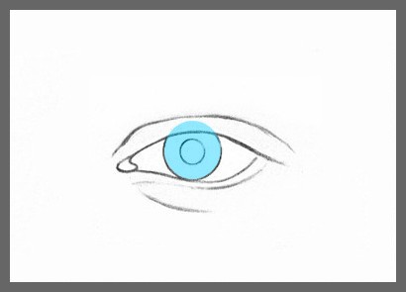
Eye

Slide 8
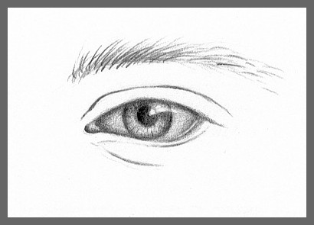

Slide 9
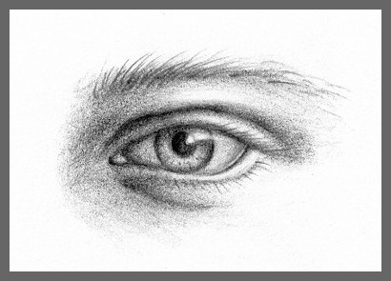

Slide 10
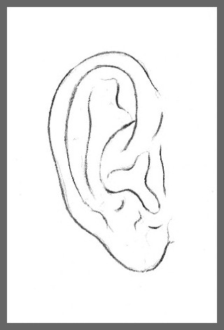
Ear 1

Slide 11
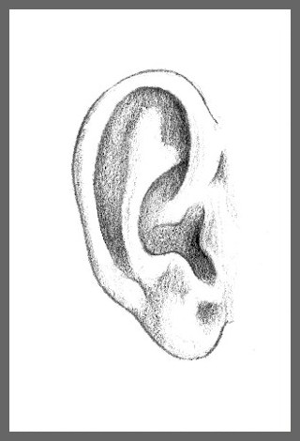
Ear 2

Slide 12
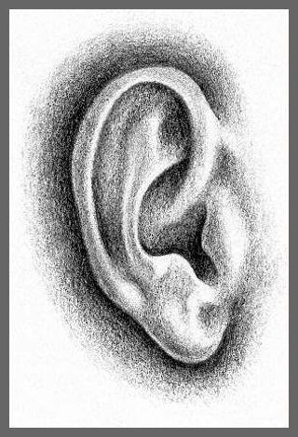
Ear 3

Slide 13
Nose 1

Slide 14
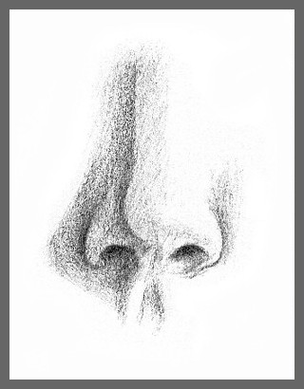
Nose 2

Slide 15
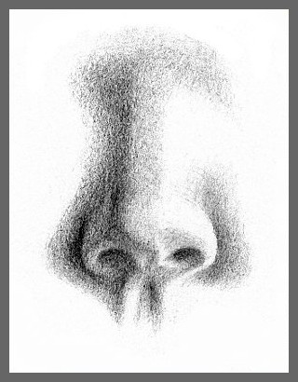
Nose 3

Slide 16
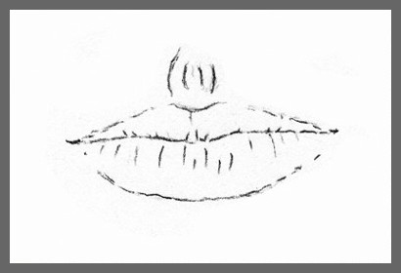
Mouth 1

Slide 17
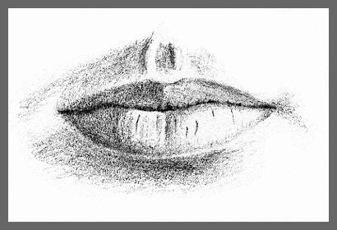
Mouth 2

Slide 18
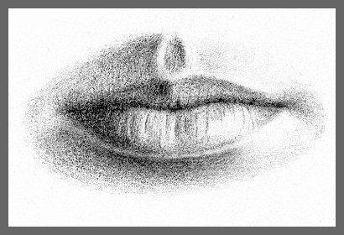
Mouth 3

Slide 19
2 questions before you go
What was the most challenging thing for you to draw today?
What was the easiest part of the face for you to draw?

Slide 20
At your table groups…
Complete the following worksheet at your table, there are two copies per table, share them with your neighbors
Answer true or false to the statements
Take a guess even if you aren’t sure about the answer
You will not get graded on if you are wrong or right, only if you try, we will all learn from our mistakes

Slide 21
Bell Work 12/18/2012 True or False?
The eyes on the face are 1/3 from the top of the head. True or False
The width is 2/3 the height of the face. True or False
The nose is 1/3 down the face from the eyes. True or False
From the top of the nose to the corner of the mouth forms a triangle. True or False
The space between the eyes, nose and mouth are all 1/6. True or False

Slide 22
Group Review of Bell Work
After everyone has come to their own answer in your group, circle the answer that you think is the correct answer with the whiteboard marker at your table
Make sure that you come to a group consensus on your decision
Each group will share their answers and then we will check our answers during a presentation
Try to come up with the correct answer if you think it is false

Slide 23
Why for today? 12/18/2012
Learn the face proportions so we can draw our face
Once you can draw realistically then you can abstract it (for the next self-portrait)
Complete a self-portrait sketch, so that you can pick either a realistic portrait or abstract for your final assignment for assignment #4
Questions?

Slide 24
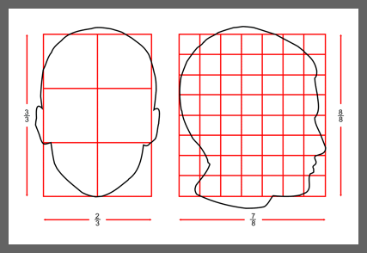
Human Head Proportions

Slide 25
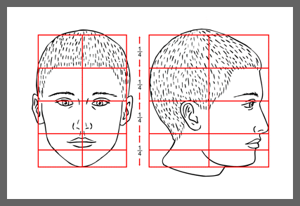
Proportions of the Face

Slide 26
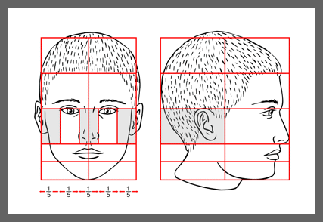

Slide 27
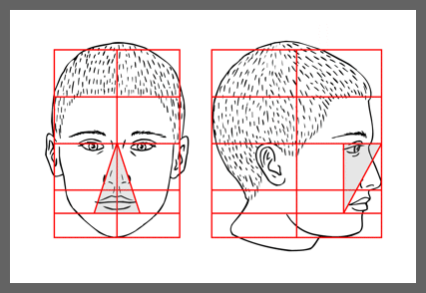

Slide 28
Bell Work 12/18/2012 True or False?
The eyes on the face are 1/3 from the top of the head. True or False = 2/4 or 1/2
The width is 2/3 the height of the face. True or False
The nose is 1/3 down the face from the eyes. True or False = 1/4
From the top of the nose to the corner of the mouth forms a triangle. True or False
The space between the eyes, nose and mouth are all 1/6. True or False = 1/5

Slide 29
Agenda 10/21/2010
Bell work
Correct our true/false statements
Work on self-portrait, looking in the mirror
Check grades
Talk about ‘U’s’
Missing assignments, what you can do to make them up
Questions?
Rough Draft of self-portrait is due at the end of class
Use your time wisely
Next class – abstract art, pick abstract or realistic
Next week(break), when we come back we will continue self-portraits
Exit Pass

Slide 30
Assignment
Realism
Abstraction
Self-Portraits
1st we will draw a realistic self-portrait
2nd an abstract portrait
Then, you will get to chose which one you turn into a final complete drawing

Slide 31
Studio Time: Sketch your face
Using mirror or picture
Make sure to get the proportions correct
Use your visual notes:
Add in detail and shading at the end`
25 points
Due at the end of class
During this time, grade checks

Slide 32
Realistic Self-Portrait Sketch Rubric
Student shows knowledge of face proportions 10 points
Student uses two types of shading techniques(stippling, cross-hatching, blending, etc.) 5 points
Student fills the page 10 points
Name and class period is printed on the back, student signed the front of the drawing with their signature 5 points
Total points possible 30 points

Slide 33
Clean-Up
Remember:
Table area must be cleaned before you can leave (4th period put up chairs)
Anything around the floor needs to be put away
All things put back where you found them
Folders in the shelves by the door

Slide 34
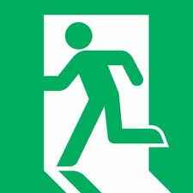
Exit Pass 12/18/2012
Exit Pass:
What was the most challenging part about drawing your face today?
What was the easiest part for you when you were drawing your face?
Is there anything you need help/review on in order to improve on your final self-portrait?
Remember:
Pay your art fees = sketch book & extra credit ☺
Don’t pay fees = no graduation, no year book ☹

Slide 35
Goals for 10.19.2010
Participate in table discussions about Bell Work
Earn full participation points(see post for reminders)
Participate in sketch practice
Work on Self-Portrait ( Assignment #4)
Turn in:
Bell work
Sketch practice
Exit Pass

Slide 36
Exit Pass
Remember:
Table area must be cleaned before you can leave (4th period put up chairs)
Anything around the floor needs to be put away
All things put back where you found them
Folders in the shelves by the door
What is the one drawing technique that helped you the most today?
Learning how to draw:
Face proportions
Eyes
Nose
Lips
Next class:
How to draw:
Ears
Hair
Neck

Slide 37
Citations
Art Factory
http://www.artyfactory.com/portraits/drawing_techniques/drawing_the_eye.htm
Found images on for slides about drawing eye, nose, ear, mouth, and face proportions

