Slide 2
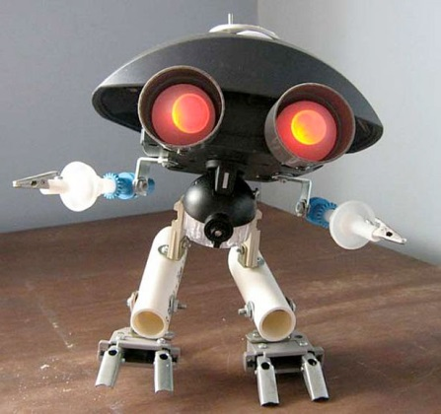
Bell Work 4/18/2013
1) Did you remember to bring trash for your art today? A) Yes –or- B) No
2a) If yes, how did you remember to bring it?
2b) If no, what can you do today in class to work on your project?
3) Review your bell work from last class, you made a list of things to bring and what you need to connect your trash, has that list changed, explain.

Slide 3
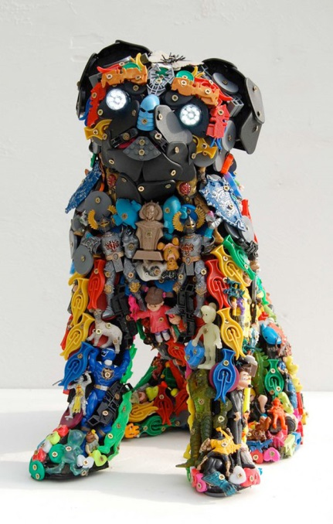
Agenda
BW
Review BW
Agenda
Studio Time – What it looks like & What happens if you don’t have any trash to make art out of =(
Clean-up
Exit Pass
Questions?

Slide 4
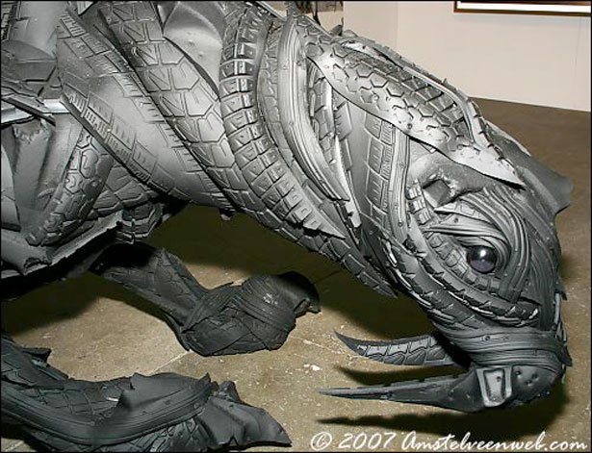
Garbage Art
Criteria, see website link….
Make sure everything is connected!
It’s made out of used stuff…that might have been thrown away if it wasn’t for you saving it and turning it into something beautiful!

Slide 5
Studio Time
Work on creating your Garbage/Trash Art Piece for the Eccles Art Show
If you are not working, you get to clean the art room to earn your participation points
Art show here at school next week, before the Festival of the Arts, which is at the end of this month!

Slide 6
Exit Pass 4/18/2013
What were you able to accomplish today on your project?
Do you need more trash for your project? If so, what are you going to bring from home?
FYI: After school today! Parent/Guardian Conferences with your Teachers! 3:30-7:30 pm Mrs. Lyon will be in this room, not the film room

