Slide 1
Day 1
Watercolor Silhouettes

Slide 2
10.31.2017 (Happy Halloween!) Bell Work:
In your Term 2 Sketchbooks respond to the following questions:
What is rhythm in art?
What is a silhouette?
On your watercolor paper,Fold into 8 even squares. Your paper should look similar to

Slide 3
Discussion:
At your table, discuss what you think rhythm in art is.
Discuss what you think a silhouette is.

Slide 4
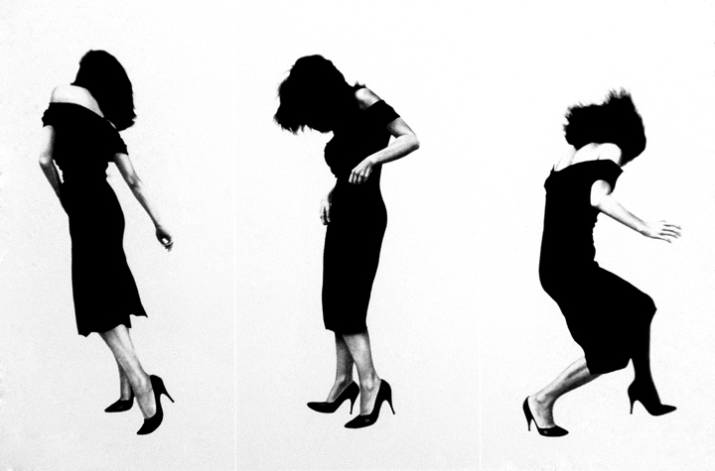
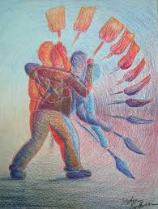
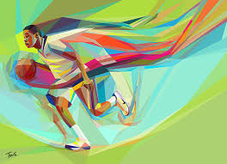
Rhythm:
Robert Longo
The principle of design that refers to a regular repetition of elements of art to produce the look and feel of movement. It is often achieved through the careful placement of repeated components which invite the viewer's eye to jump rapidly or glide smoothly from one to the next.

Slide 5
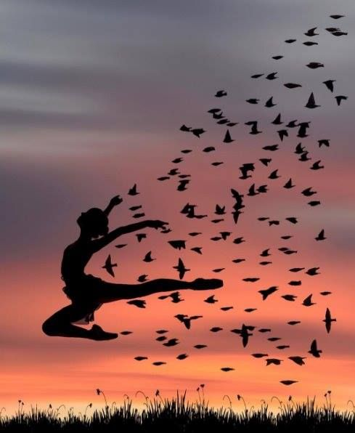
Silhouette:
Defined as an outline that appears dark against a light background. More specifically, it is where your subject is seen as a black shape without detail against a brighter background.
Notes:
I will give the students a brief description of their final project for this unit involving movement and silhouettes.

Slide 6
Quick Action
Make sure you put some rubber cement in one of your squares before we go out to take photos

Slide 7
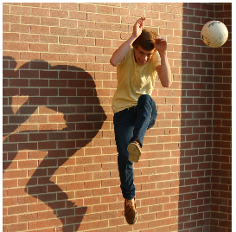
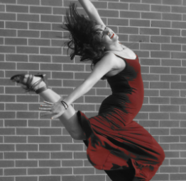
Movement Photographs
Get in groups of 4-5 (or your table). Each group needs to have at least one camera phone to email all the photos with.
Make sure to get full body shots
You can: dodge, catch, leap
Intent: make it a series of three different movements
Notes:
I will briefly discuss what function to use on their cell phones (rapid burst) to catch the movement, and a brief instruction on framing.

Slide 8
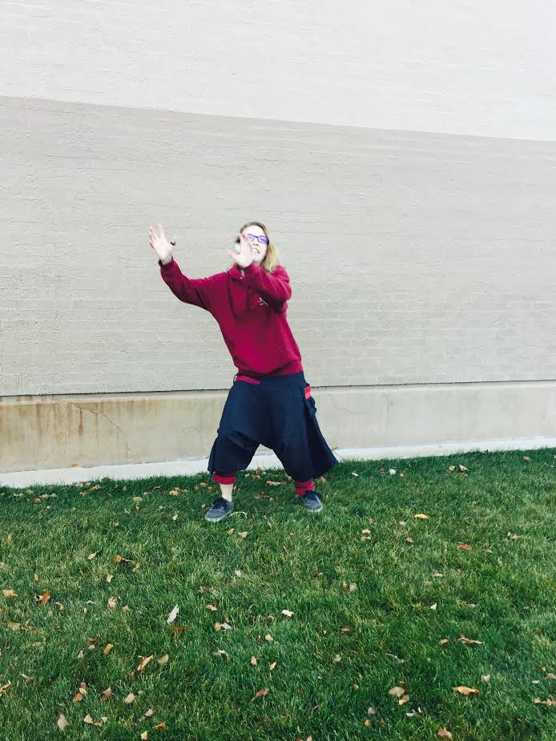
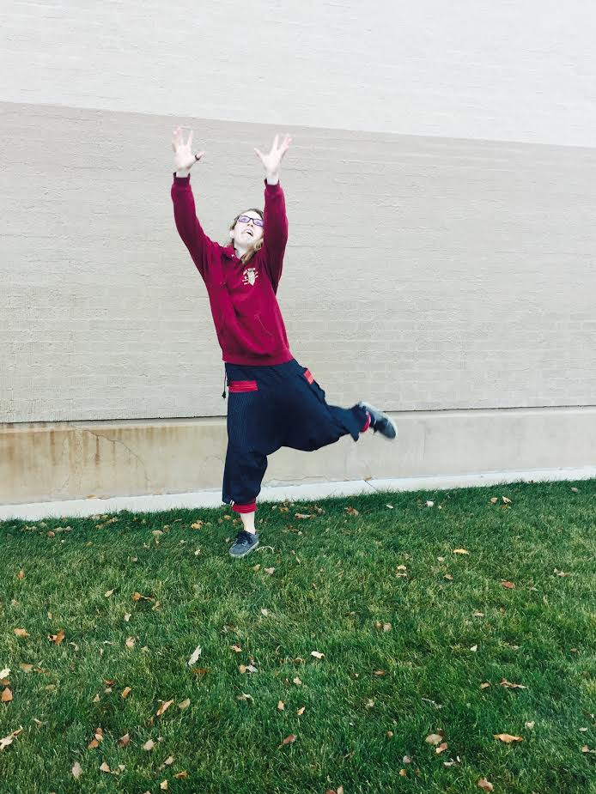
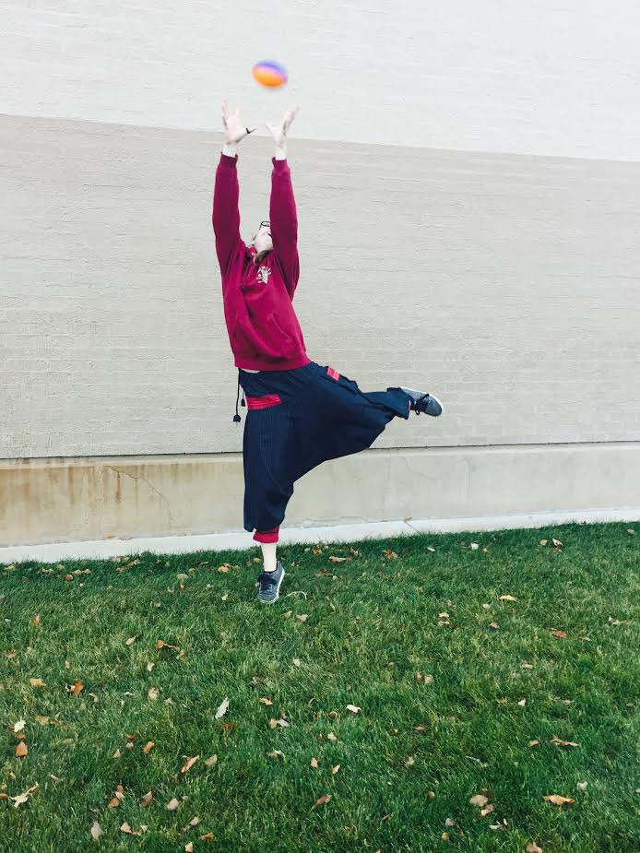
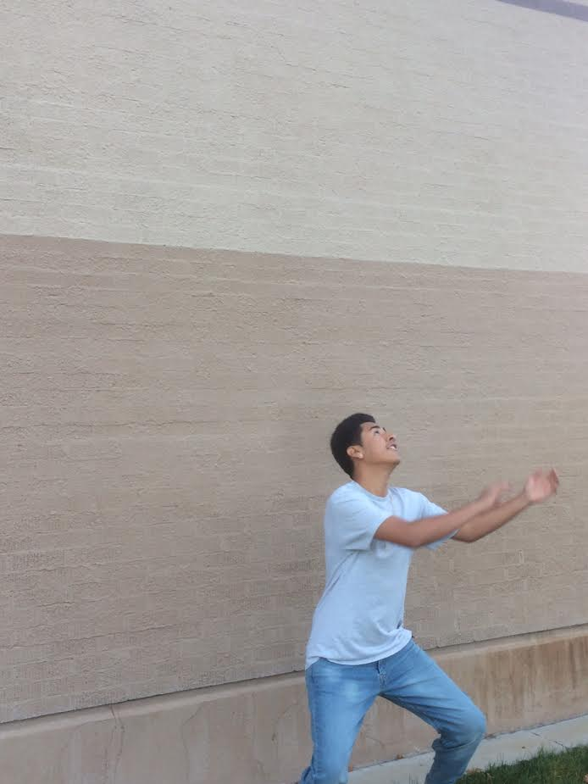
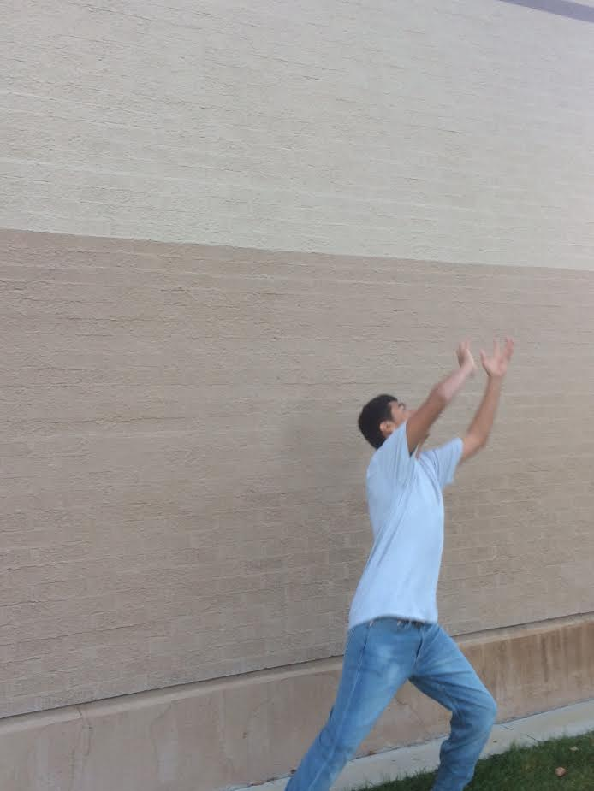
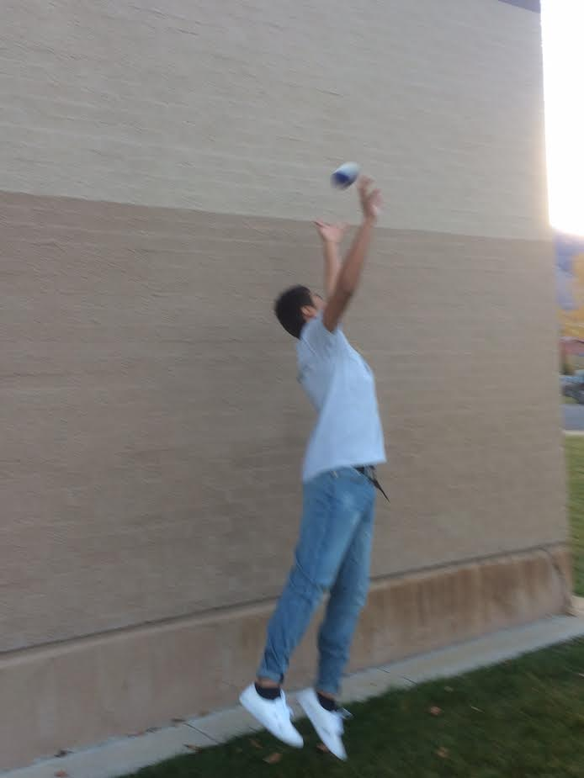
Examples:
Email your 3 photos to: lyone@ogdensd.org

Slide 9
Watercolor Stations
lyone@ogdensd.org
You will need the following materials:
Watercolor paper from the bell work
Watercolor Experiment Document Form
Pencil
At each station:
1 minute to write your inferences -timed
5 minutes to experiment – timed
1 minute to write what actually happened – timed
SWITCH STATIONS

Slide 10
Clean-Up Bring Everything to the back counter - Water containers – Brushes –Salt -Paper Towels -Straws ETC. Put your watercolor papers under the window with your name on them – thanks!

Slide 11
Write your exit pass under your bell work in your sketchbook Exit Pass 10.31.2017 1) What was your favorite part of class today? 2) What are you looking forward to with this new project? Thank you! Enjoy your Halloween and see you on Friday!

