Slide 1
First Day Painting 1
1.13.2020

Slide 2
Welcome to Painting 1.13.2020
At the door you will need to pick up:
3 different printed on papers
Disclosure
Survey
BL Mountain Reflection
3 piece of watercolor paper
Two brushes
One flat and One round
Please be ready with all your supplies for instructions when the bell rings
Please START filling out your survey – thank you!

Slide 3
Ready
Looks like:
Eyes forward
Materials picked up and in front of you
Phone away(preferably in your bag so the vibration doesn’t distract you)
Sounds like:
Lecture environment to start so that we all can hear instructions
Questions, please ask, someone else probably has the same question as you

Slide 4
Agenda
Gather supplies at the door
Reminder of what being ready in class looks like and sounds like
Who’s Mrs. Lyon
Quick FYIs about the class
Disclosure
Class Routine
Start first painting! -reflection
Dem & visual notes
Second painting - reflection
Class survey
Exit Ticket
Questions about today?

Slide 5
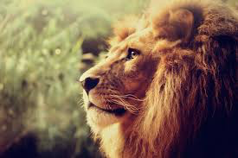
Who is Mrs. Lyon?

Slide 6
Professional Artist

Slide 7
www.ericalyonart.com
Art Shows
in Ogden
Café Mercantile – 26th St. & S. Ogden
Level 9 Sports– 12th and Harrison
Gear30 – on Wall Street
Local Artisan Collective – downtown by the Junction
A & Co. Salon & Spa – 22nd and Washington

Slide 8
Lived in Ghana, West Africa for 2 years teaching art to Deaf students

Slide 9
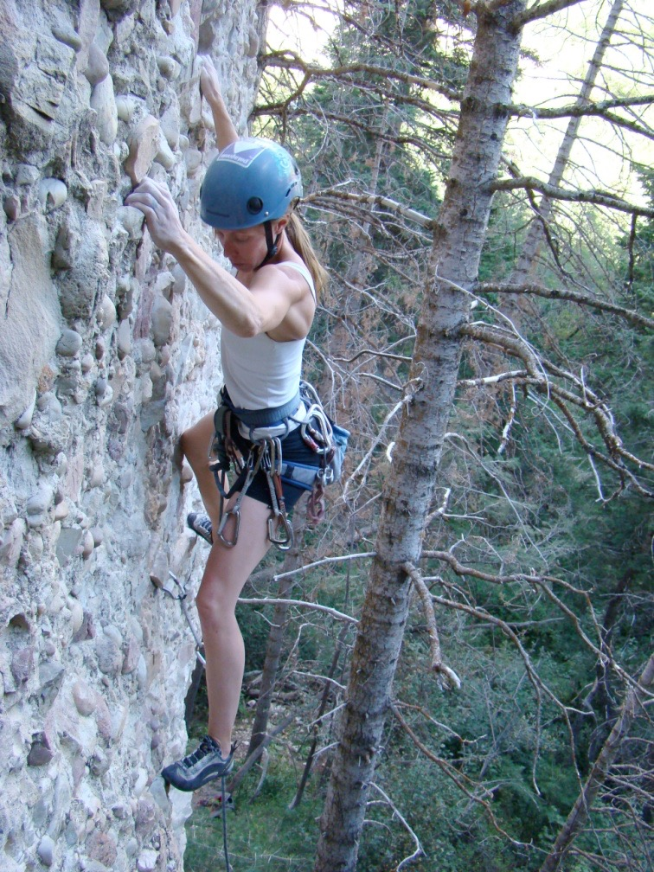
Climbing!

Slide 10
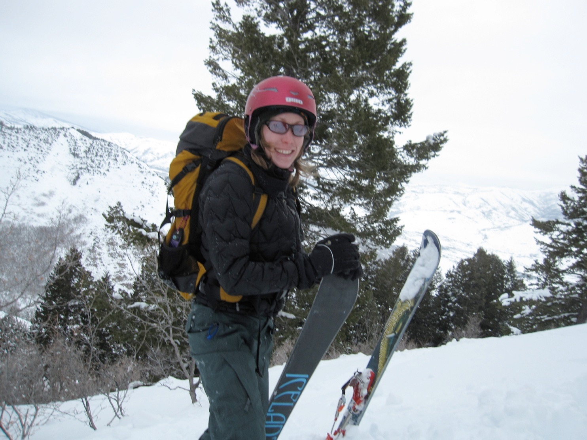
Backcountry Skiing

Slide 11
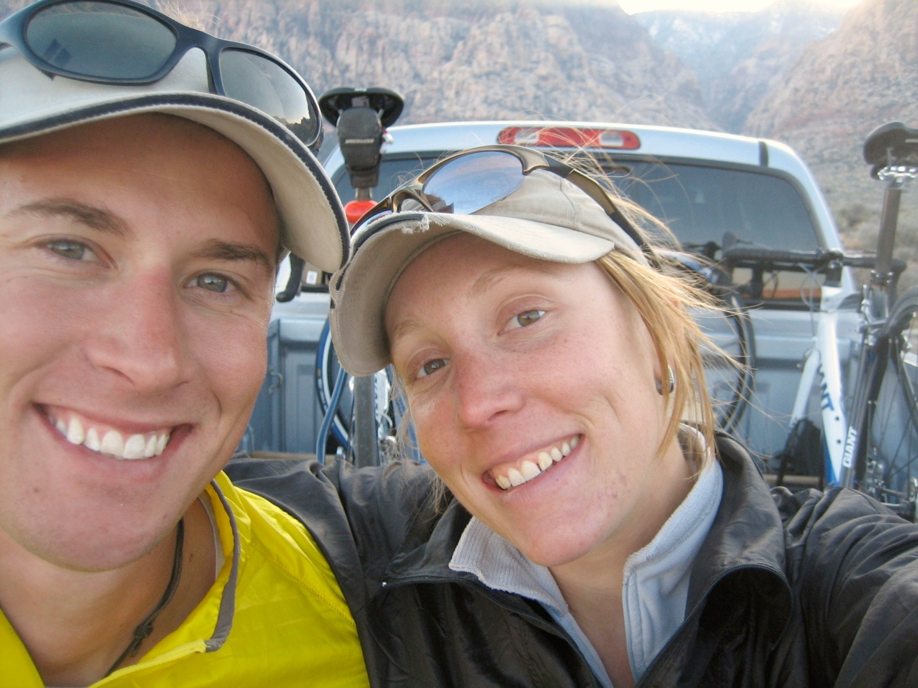
3 Ironman's completed!
2.4 mile swim, 112 mile bike, and 26.2 mile run

Slide 12
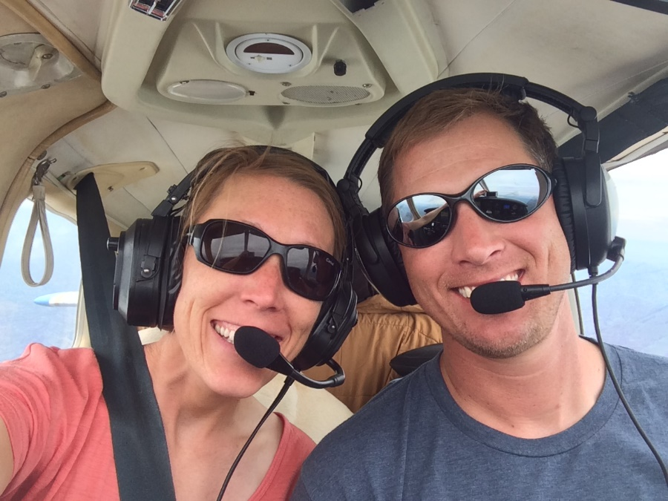
Love of my life!

Slide 13
Mrs. Lyon’s Teaching Thoughts about Art Class
Learning needs to be fun, challenging, and applied
Everyone and thing has value, treat it as such
Self-awareness is crucial in art, being able to take risks, and challenge yourself is key

Slide 14
Lyon’s faults
It’s challenging for me to spell
It take me a few months to memorize names

Slide 15
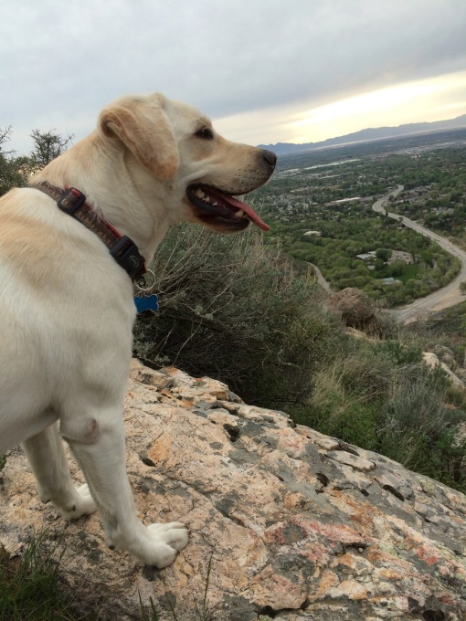
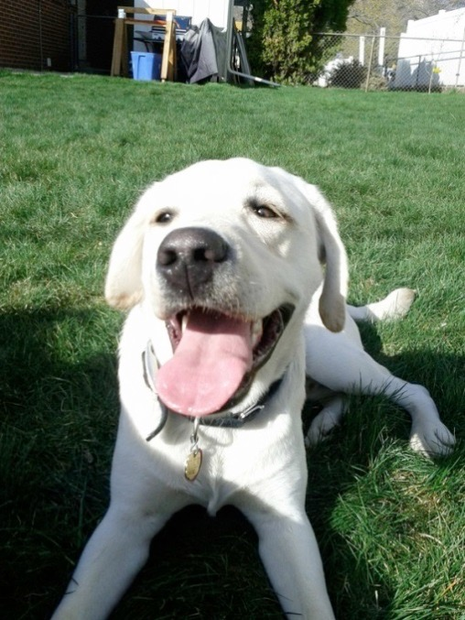
Griffin
Therapy dog ☺
No food, candy, or drinks in class
Let him chill on his matt in the back
During studio time he will be walking around
Greeting people at the door daily
No whistling or calling his name - thanks

Slide 16
Quick FYIs
Disclosures - get signed and bring back = extra credit
Recycling, sink, trash, paper towels, band aids
All art supplies you need for class will either be at your table, at the door to pick up or on the back counter
Everyone will have a file folder for all their papers
Tables and chairs - we move, they move
Art work will stay in your class folder
Daily SCOTS Points – based on class expectations SCOTS
Hall Pass – you will get three, they will be printed on a paper that can fit in your binder
Not during lecture, critique, or demo time, only studio time
Not during the 1st 10 min. or last 10 min. of class
Only 3 per term, must sign back of planner
Website! – www.classwithlyon.com
Questions?

Slide 17
Art Competitions 2019-20
First Friday Art Stroll – in the process of scheduling
Ogden Trails Network 4th Annual Art Competition Oct.
Utah State Senate Art Contest TBA
Utah State Art Show mid-Jan. 2019
Weber County Health Department Art Competition February/March of 2019
HOPE Art Competition around February or March of 2019
Art Gala in the commons at BL
Festival of Arts - April 2020 at Eccles Art Center
Recycled Art Competition Beginning of May 2020 at Eccles Art Center
Painting Competition at Eccles Art Center for more information: http://www.ogden4arts.org/competitions/

Slide 18
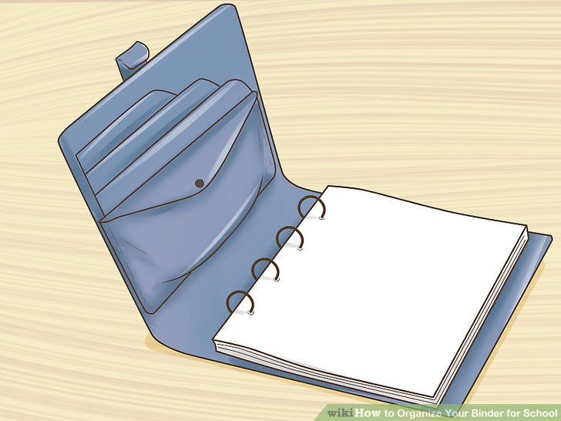
Disclosure
Review Disclosure together

Slide 19
Class Routine Each Day
Bell Work - BW
Agenda, reminders, review last class
Lesson – demos, mini lectures, etc.
Studio Time! - Creating your art!
Review – what’s going to happen next class
Exit Pass

Slide 20
Basic Watercolor Techniques
E.Lyon Painting

Slide 21
Painting BL peak
Think of this like a pre-assessment for me to see where everyone is at with watercolor painting
Try your best and it’s okay to make mistakes
We are here to learn
It’s school
We will make mistakes
It’s what you do with those mistakes when you make them

Slide 22
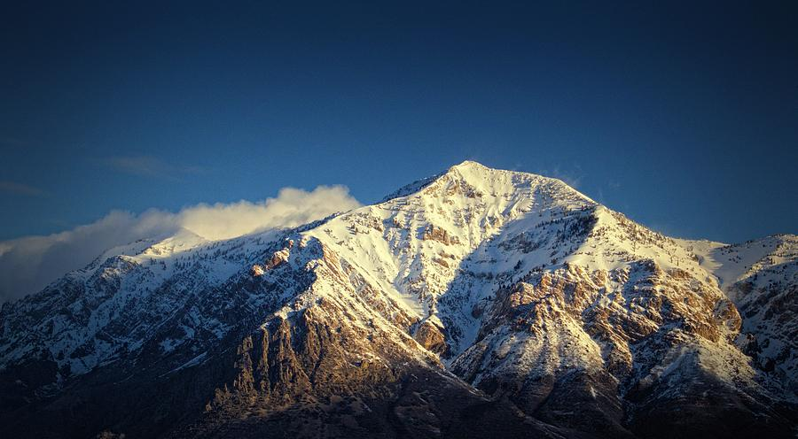

Slide 23
Self-Reflection 1.13.2020
What do you like most about you painting(make sure to describe it)?
What do you like least about your painting and why?
What was the easiest part about doing this painting and why?
What was your greatest frustration and why?
Hint: When you see why questions make sure to justify, explain, give examples to your answers.

Slide 24
Basic Watercolor Techniques
Dry brushing
Wet on wet painting
Washes
Brushes
Paper
Water and paint ratios

Slide 25
Paint the mountain again now that we know more
Apply at least one of the techniques we just talked about
Based on your reflection: do what you liked and what worked last time and see if you can change what you didn’t like and what didn’t work

Slide 27
Final Reflection 1.13.2020
Look at both your paintings:
What do you like most about your 2nd painting(make sure to describe it)?
What do you like least about your 2nd painting and why?
What was the easiest part about doing this 2nd painting and why?
Which painting do you like more and why?(the 1st or 2nd)
What did you think of not having instruction about painting and then getting instruction? Did that work for you? would you rather just have instruction first-or- did you like the opportunity to experience first and then learn some techniques?

