Slide 1
First Day Drawing 2
8.19.2019

Slide 2
Welcome to Drawing 2 8.19.2019
At the door you will need to pick up:
Class survey
Disclosure
Please be ready with all your supplies for instructions when the bell rings
Thank you!
This is a level 2 class so you should have had drawing 1 in high school and passed with an A or B to be in this class, if you don’t feel like you belong in here, let’s chat about a class that would fit you better.

Slide 3
Ready
Looks like:
Eyes forward
Materials picked up and in front of you
Phone away(preferably in your bag so the vibration doesn’t distract you)
Sounds like:
Lecture environment to start so that we all can hear instructions
Questions, please ask, someone else probably has the same question as you

Slide 4
Agenda
Gather supplies at the door
Class survey complete
Reminder of what being ready in class looks like and sounds like
Who’s Mrs. Lyon
Quick FYIs about the class
Disclosure
Class Routine
String Drawing – pre-assessment
Questions about today?

Slide 5
Who is Mrs. Lyon?

Slide 6
Professional Artist

Slide 7
www.ericalyonart.com
Art Shows
in Ogden
Café Mercantile – 26th St. & S. Ogden
Second Track Sports – 12th and Harrison
Gear30 – on Wall Street
Local Artisan Collective – downtown by the Junction
A & Co. Salon & Spa – 22nd and Washington

Slide 8
Lived in Ghana, West Africa for 2 years teaching art to Deaf students

Slide 9
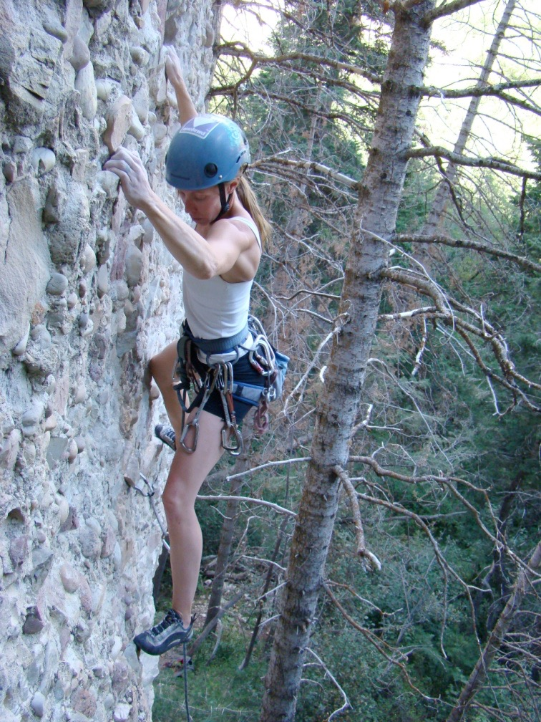
Climbing!

Slide 10
Backcountry Skiing

Slide 11
3 Ironman's completed!
2.4 mile swim, 112 mile bike, and 26.2 mile run

Slide 12
Love of my life!

Slide 13
Mrs. Lyon’s Teaching Thoughts about Art Class
Learning needs to be fun, challenging, and applied
Everyone and thing has value, treat it as such
Self-awareness is crucial in art, being able to take risks, and challenge yourself is key

Slide 14
Lyon’s faults
It’s challenging for me to spell
It take me a few months to memorize names

Slide 15
Griffin
Therapy dog ☺
No food, candy, or drinks in class
Let him chill on his matt in the back
During studio time he will be walking around
Greeting people at the door daily
No whistling or calling his name - thanks

Slide 16
Quick FYIs
Disclosures - get signed and bring back = extra credit
Recycling, sink, trash, paper towels, band aids
All art supplies you need for class will either be at your table, at the door to pick up or on the back counter
Everyone will have a file folder for all their papers
Tables and chairs - we move, they move
Art work will stay in your class folder
Daily SCOTS Points – based on class expectations SCOTS
Hall Pass – you will get three, they will be printed on a paper that can fit in your binder
Not during lecture, critique, or demo time, only studio time
Not during the 1st 10 min. or last 10 min. of class
Only 3 per term, must sign back of planner
Website! – www.classwithlyon.com
Questions?

Slide 17
Art Shows
Art Competitions 2019-20
First Friday Art Stroll – in the process of scheduling
Ogden Trails Network 4th Annual Art Competition Oct.
Winter Art Show & Music Concert in the Commons at BLHS December
Scholastic Art Competition due Dec. for more information go to: https://www.artandwriting.org/what-we-do/the-awards/categories/
Senior Show and Portfolio Review at ECAC – Nov./Dec.
Eccles Petite Impressions (under 8x8”) at Eccles Art Center in Dec. For more info visit: http://www.ogden4arts.org/competitions/
Utah State Senate Art Contest TBA
Utah State Art Show mid-Jan. 2019
Weber County Health Department Art Competition February/March of 2019
HOPE Art Competition around February or March of 2019
Art Gala in the commons at BL
Festival of Arts - April 2020 at Eccles Art Center
Recycled Art Competition Beginning of May 2020 at Eccles Art Center
Painting Competition at Eccles Art Center for more information: http://www.ogden4arts.org/competitions/

Slide 18
Disclosure
Review Disclosure together

Slide 19
Class Routine Each Day
Bell Work - BW
Agenda, reminders, review last class
Lesson – demos, mini lectures, etc.
Studio Time! - Creating your art!
Review – what’s going to happen next class
Exit Pass

Slide 20
Goal for Today’s Class
Complete a drawing
More info about it in a second
Learn about an artist who wrapped objects and tied with string

Slide 21
Explore an Artist Christo and Jeanne-Claude

Slide 22
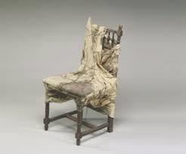

Slide 27
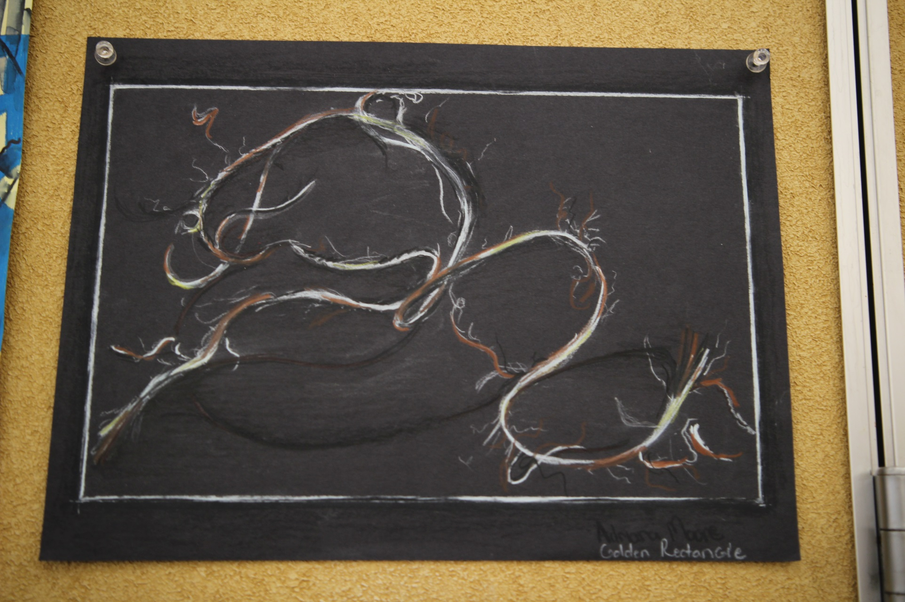

Slide 38
Studio Time
Draw an object that is being strangled, tangled or tied in string
This could be an object you have or one you find in the room
I’d take a picture of the object and change the image to B&W to get better contrast
If it’s easier for you to just draw the string, then do that instead of adding another object to it.
This is due by the end of class

Slide 39
Next Class 8.28.2019
Hand Drawings
Don’t worry we will learn some ways to ‘cheat’ to make it easier to draw hands

Slide 40
Exit Pass
Clean up after yourself
Make sure all your pencils and tools are back in their bags

