Slide 1
Advisory Sign-In on iPad
Let’s head outside, fire drill
We’ll review stuff in the field about drills

Slide 2
AP/Studio Day 2
E.Lyon

Slide 3
Bell Work 8.31.2015
Have you completed your Thursday and Friday drawings in your book?
If yes, how did it go?
If no, why not?
Take out your paper that has the list of things you are drawing each day on it, let’s write the date that you need to do that drawing for
We have class calendars to help with this
Reminder, you don’t have assignments to draw on the weekends only Monday - Fridat

Slide 4
Agenda 8.31.2015
Bell Work
Agenda
Last Class
Goal for Today
Explore an artist
Studio time – string wrapped art
Next class
Exit Pass

Slide 5
Review Bell Work
Chat and share at tabls
Have you completed your Thursday and Friday drawings in your book?
If yes, how did it go?
If no, why not?
Take out your paper that has the list of things you are drawing each day on it, let’s write the date that you need to do that drawing for
We have class calendars to help with this

Slide 6
Last Class 8.27.2015
Everyone got a sketchbook
Bring that everyday to class!
Started in sketchbooks by drawing 7 deadly sins in a group
Received our 31 day homework assignment
During studio time, if you have questions about the assignment chat with Lyon or Dodds

Slide 7
Goal for Today’s Class
Complete a drawing
More info about it in a second
Get ready for Wed.
Smash face selfies
Learn about an artist who wrapped objects and tied with string

Slide 8
Explore an Artist Christo and Jeanne-Claude

Slide 9
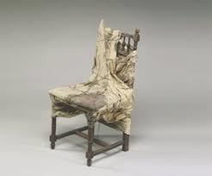

Slide 14
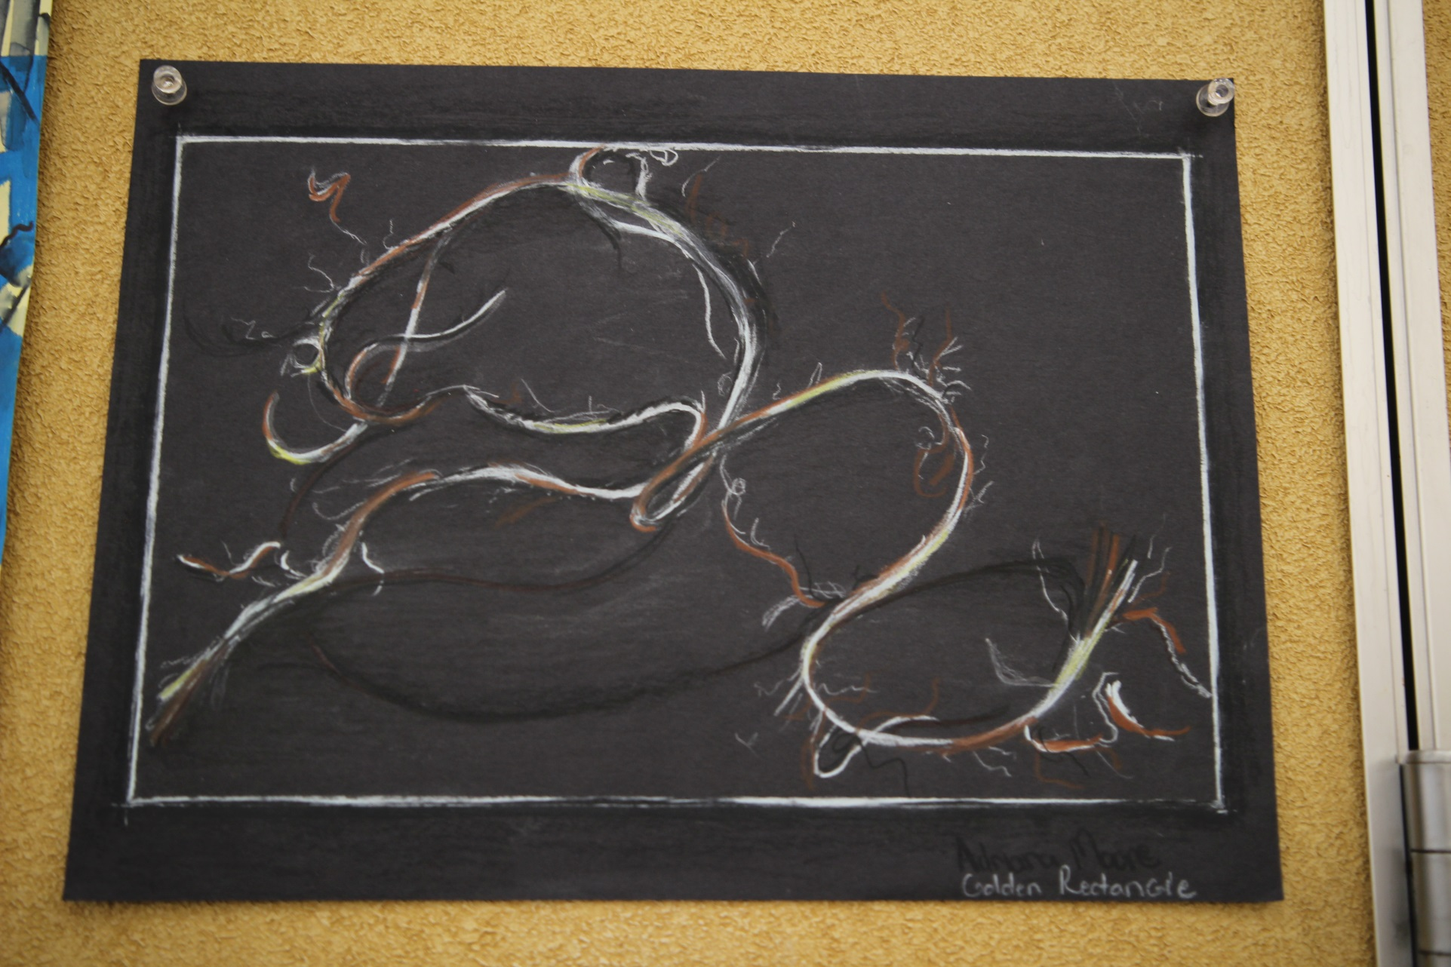

Slide 25
Studio Time
Draw an object that is being strangled, tangled or tied in string
This could be an object you have or one you find in the room
I’d take a picture of the object and change the image to B&W to get better contrast
This is due by the end of class
We will be taking smash face photos to have next class

Slide 26
Next Class
Smashed face Selfies
Friday – we will do some abstract art

Slide 27
Exit Pass
Clean up after yourself
Make sure all your pencils and tools are back in their bags
Be ready for next class by bring your sketchbook everyday!

