Slide 1
Welcome to AP
You have been chosen to be in this class
You have worked countless hours on our art and showing your skill
Now it’s time to take it to the next level!

Slide 2
AP Art
24 pieces
12 – concentration
12 – breadth
Out of that or extra 5 for quality your best work

Slide 3
Who is Mrs. Lyon?

Slide 4
Professional Artist

Slide 5
Professional Artist
www.ericalyonart.com
Art shows up right now:
in Ogden
The Front – climbing gym
Café Mercantile – 26th St.
Second Track Sports – 12th and Harrison
Blooming Lotus Café – 25th Street

Slide 6
Lived in Ghana, West Africa for 2 years teaching art to Deaf students

Slide 7
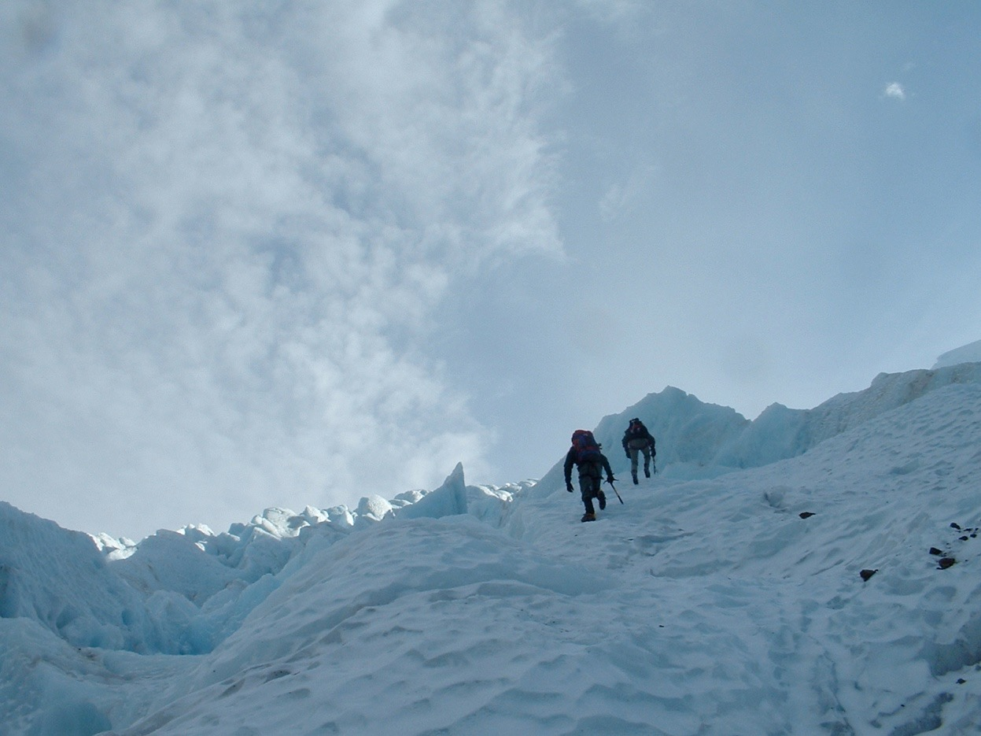
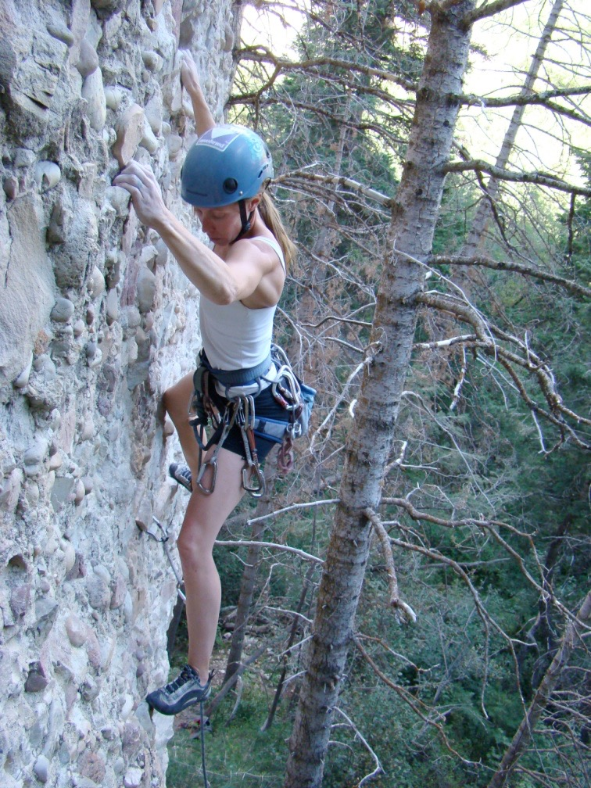
Climbing!

Slide 8
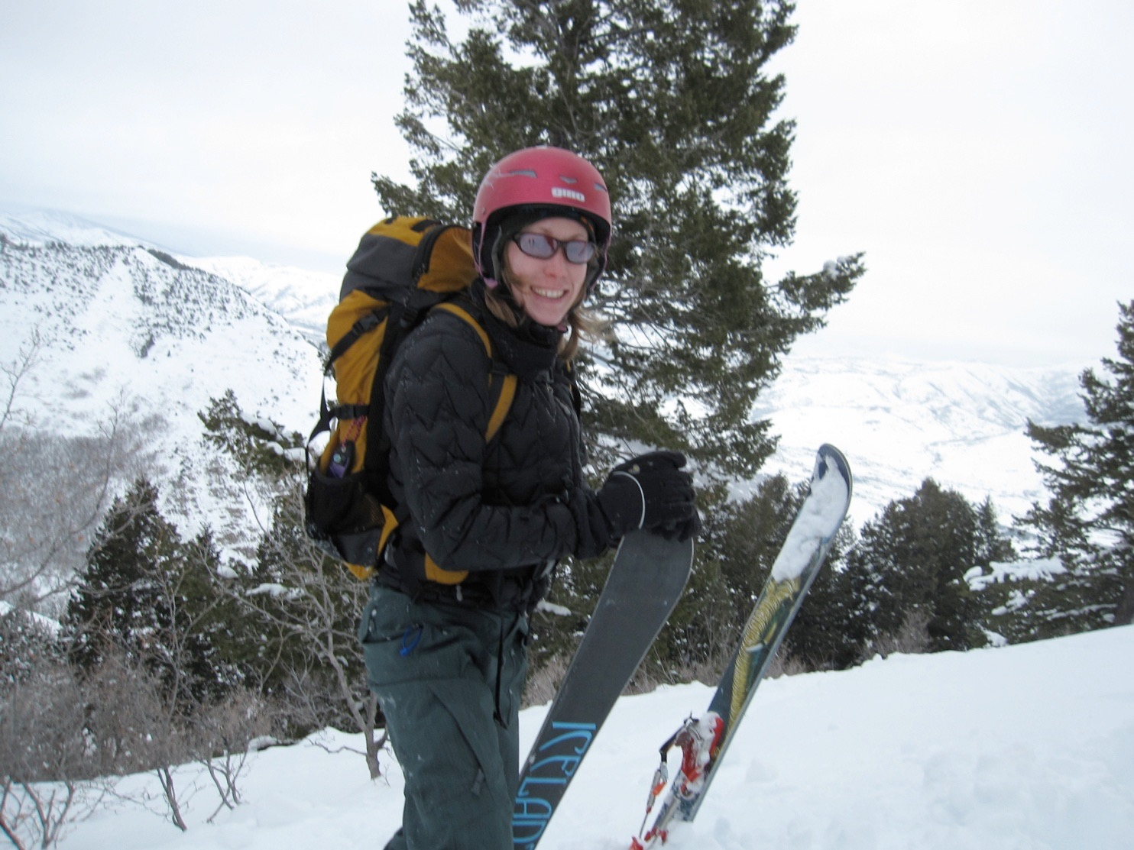
Backcountry Skiing

Slide 9
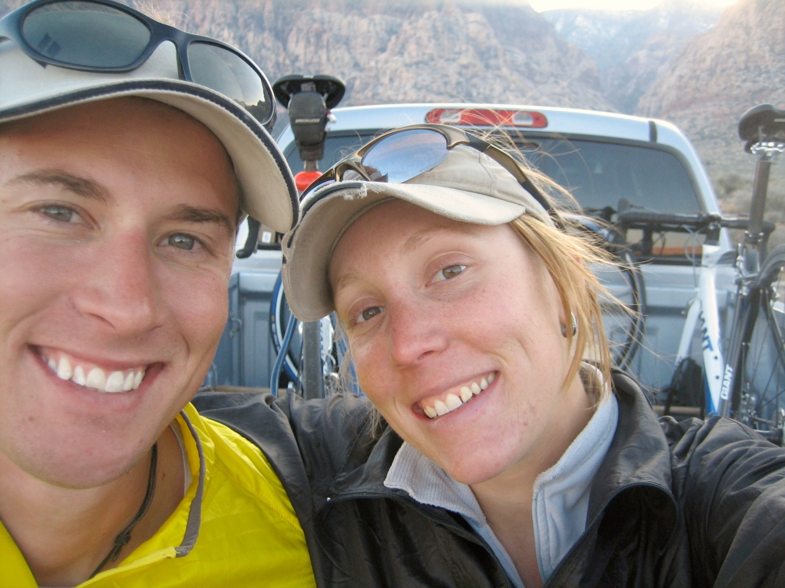
3 Ironman's completed!
2.4 mile swim, 112 mile bike, and 26.2 mile run

Slide 10
Mrs. Lyon’s Teaching Thoughts about art class
Learning needs to be fun, challenging, and applied
Everyone and thing has value, treat it as such
Self-awareness is crucial in art, being able to take risks, and challenge yourself is key

Slide 11
Lyon’s faults
It’s challenging for me to spell
It take me a few months to memorize names
I am a driven person and want the best for all of you, so I care too much

Slide 12
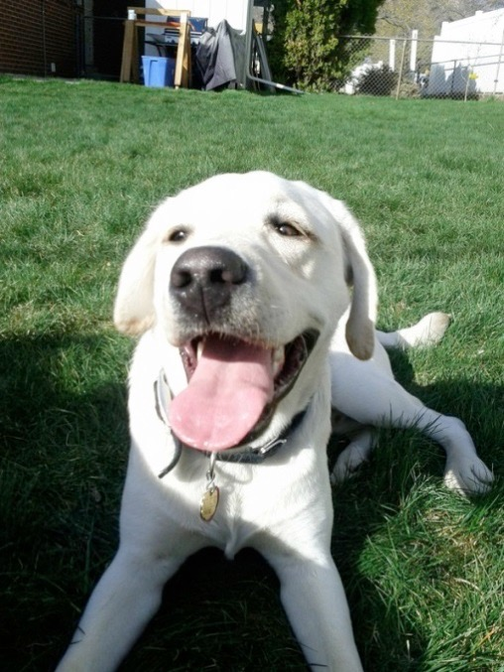
Griffin
Therapy dog ☺
No food, candy, or drinks in class
Let him chill on his matt in the back
During studio time he will be walking around
Greeting people at the door daily
No whistling or calling his name - thanks

Slide 13
Who are all of you?
Share your responses on the bell work
Talk to each other or we can do this as a class
This is a small group so let’s make sure everyone knows each other

Slide 14
Quick FYIs
Disclosures - get signed and bring back = extra credit
Recycling, sink, trash, paper towels, band aids
All art supplies will be in your boxes, we will go through those next class
Everyone will have a file folder for all their papers
Tables and chairs - we move, they move
Art work will stay in your folder
Hall Pass – use it when you need it, but don’t abuse it
Website! – www.classwithlyon.com & Remind app(sign-up)
Questions?

Slide 15
Fun things
Field Trip to WSU – only those with A/B can go so keep your grade up
AP – portfolio review day(TBA)
State Art Show – typically Studio and AP go, so keep taking art and get in studio next year
Face Painting Fundraiser – help AP pay for their exam and work at the football games painting faces for donations
Art Shows ! – Winter Art Show(Dec. 15th) and Art Gala(TBA)
Festival of Arts – district wide art show!!! Spring Cash prizes and scholarship!
Lots of other art contests throughout the year!

Slide 16
Class Routine Each Day
Bell Work – BW - maybe
Essential Question - on the board
Agenda, reminders, review last class
Lesson – demos, mini lectures, etc. – as needed
Studio Time! - Creating your art! – most of the time!
Review – what’s going to happen next class
Exit Pass - maybe

Slide 17
Last few Minuets of Class 8.23.20166
Exit Pass(to get out of class)
Name, Class Period, Date
What was your favorite thing we did today?
What are you most excited about so far in this class?
On a sticky note
Slap it on the door on your way out
Remember to take: Disclosure to Parents/Guardians to sign and bring back next class

