Slide 1
Skulls Day 2
E. Lyon

Slide 2
Review last class
Skull & Spirit Creature
Draw half or full, a skull to scale using the grid method(or free hand)
  If you need a review on the grid method there will be a lesson in the back of the room
Found out spirit creatures

Slide 3
Examples
A few examples

Slide 4
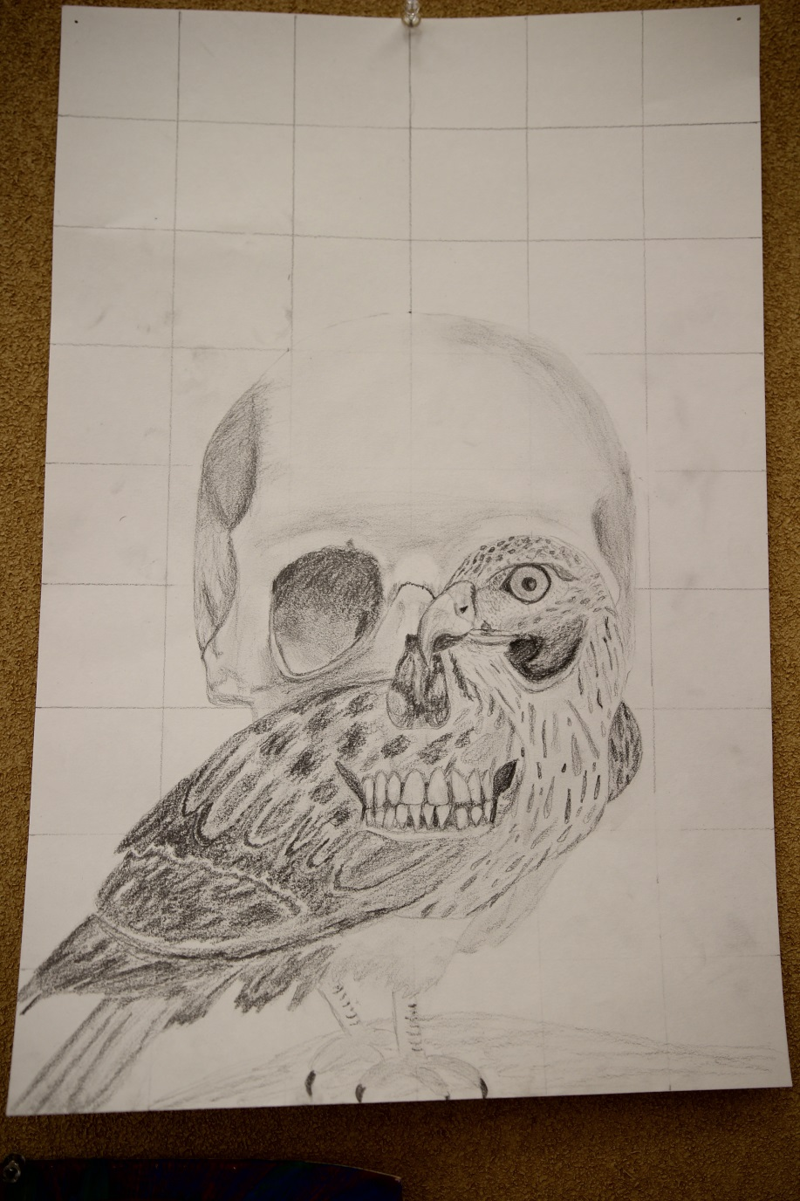

Slide 5
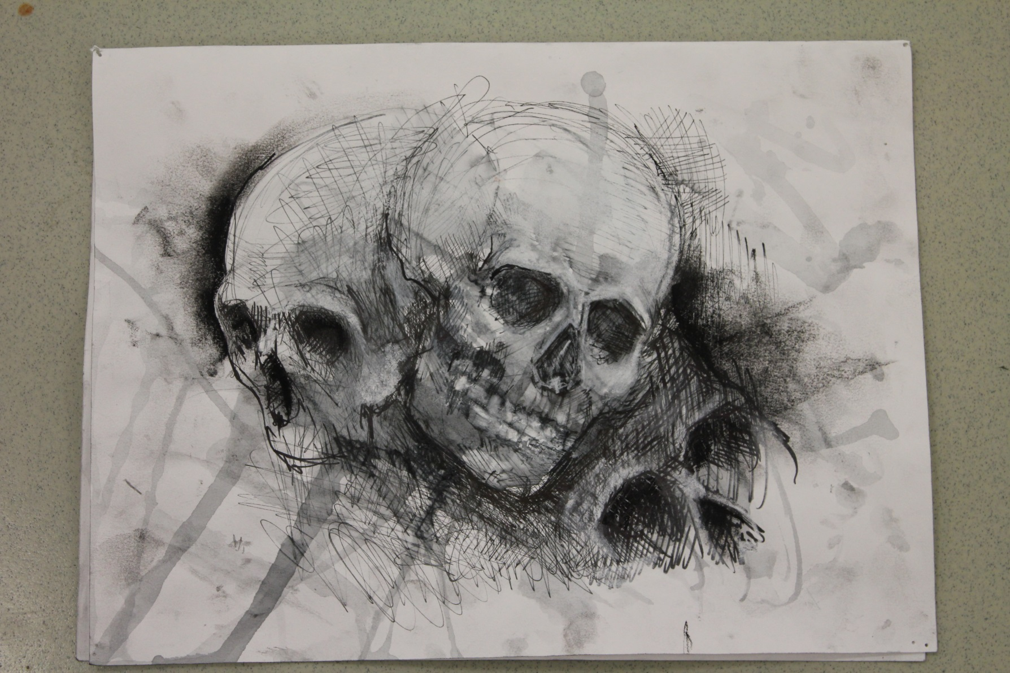

Slide 6
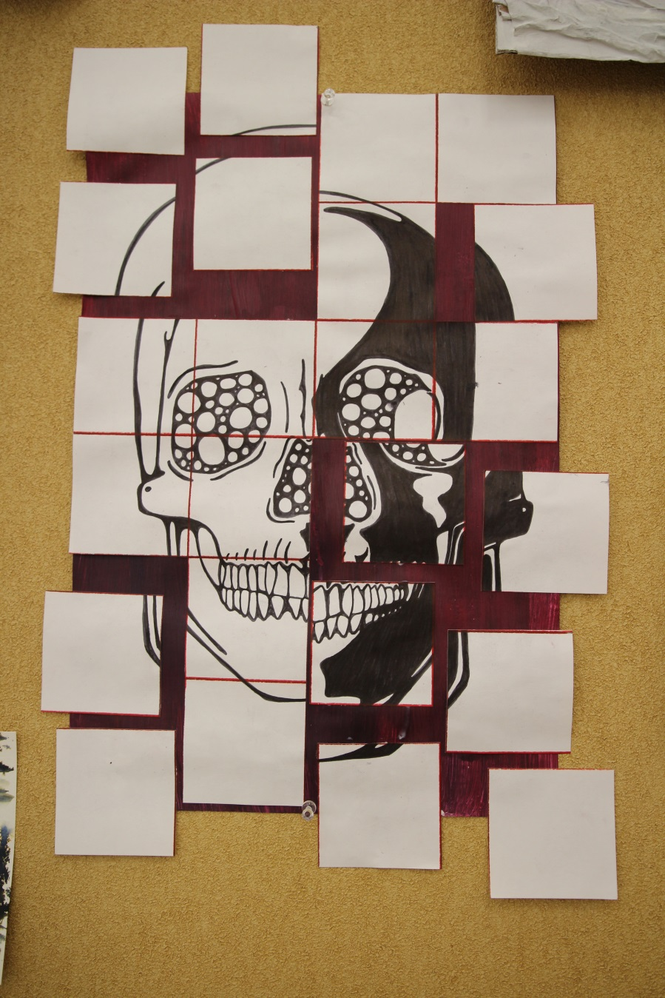

Slide 7
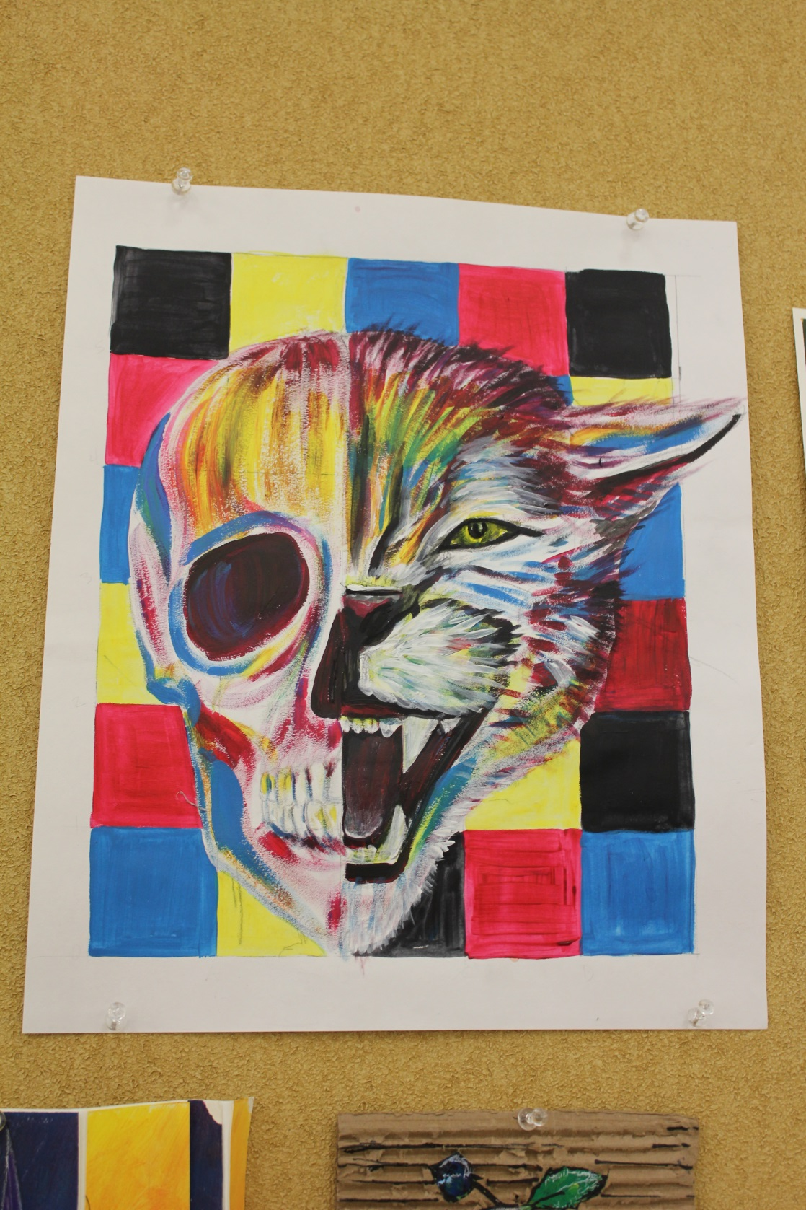

Slide 8
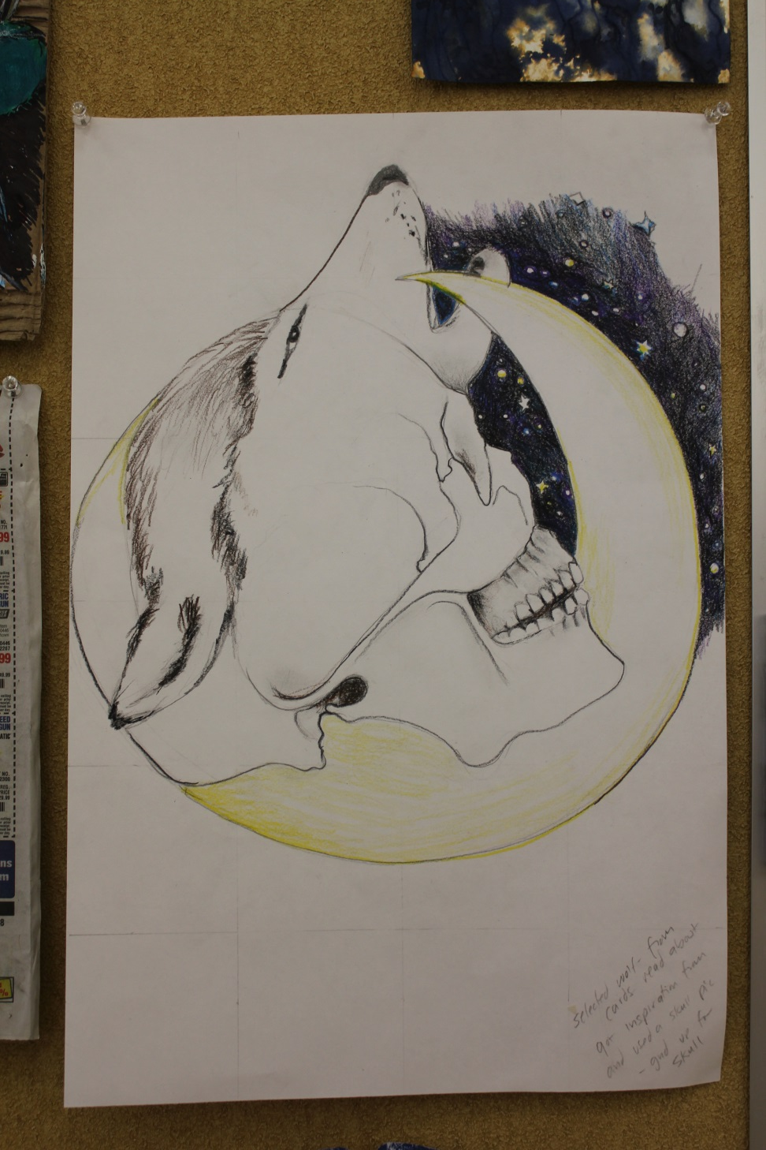

Slide 9
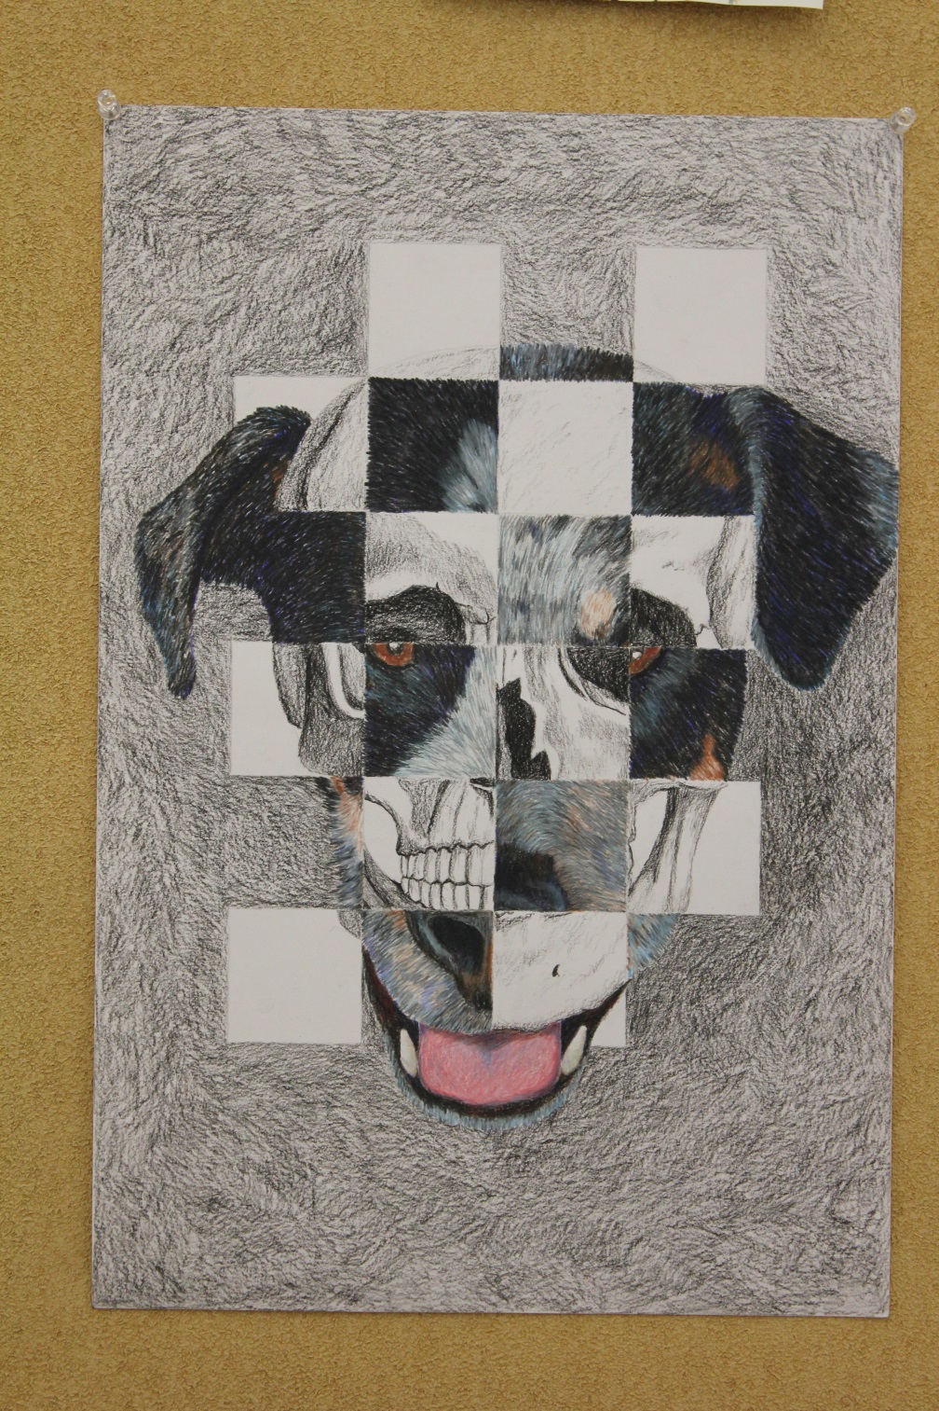

Slide 10
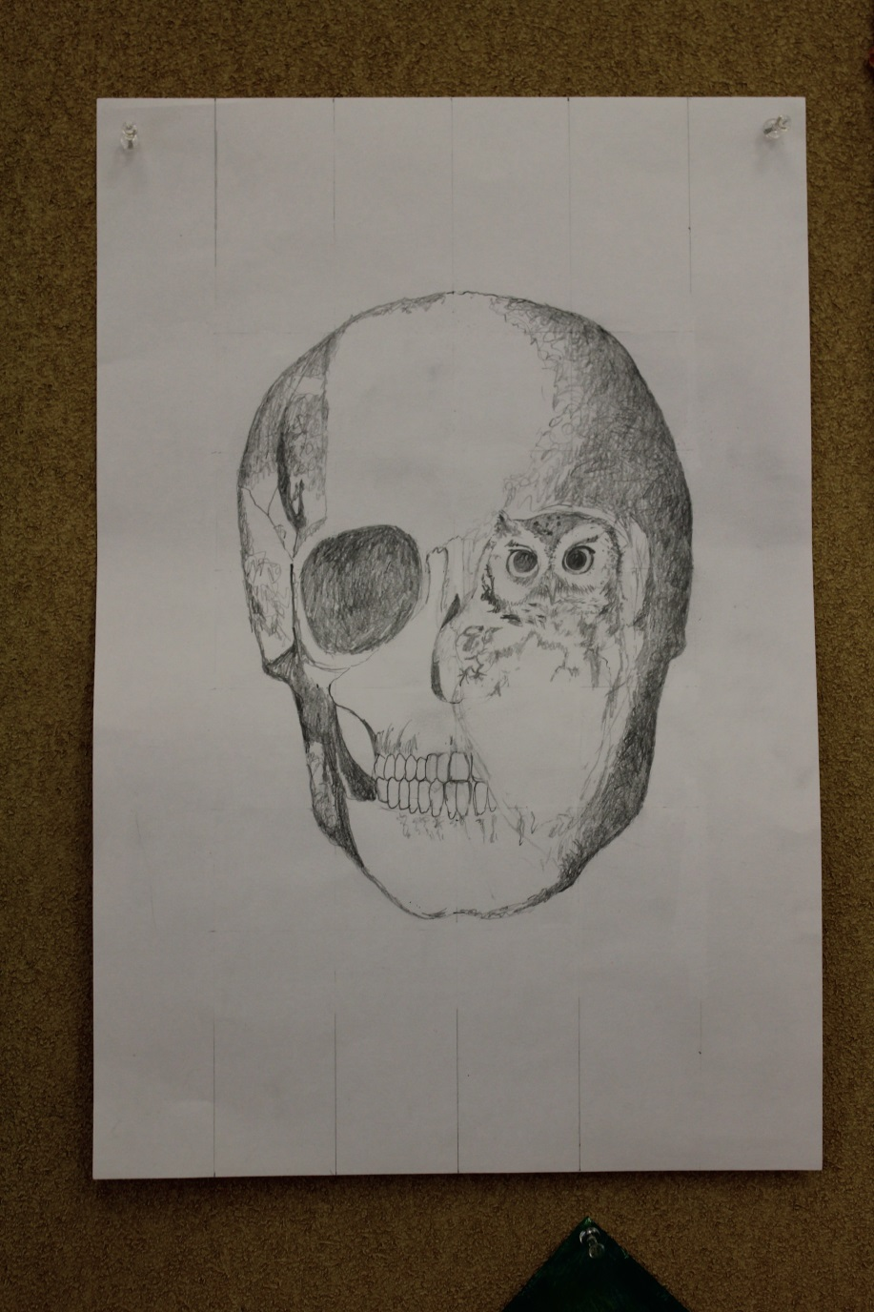

Slide 11
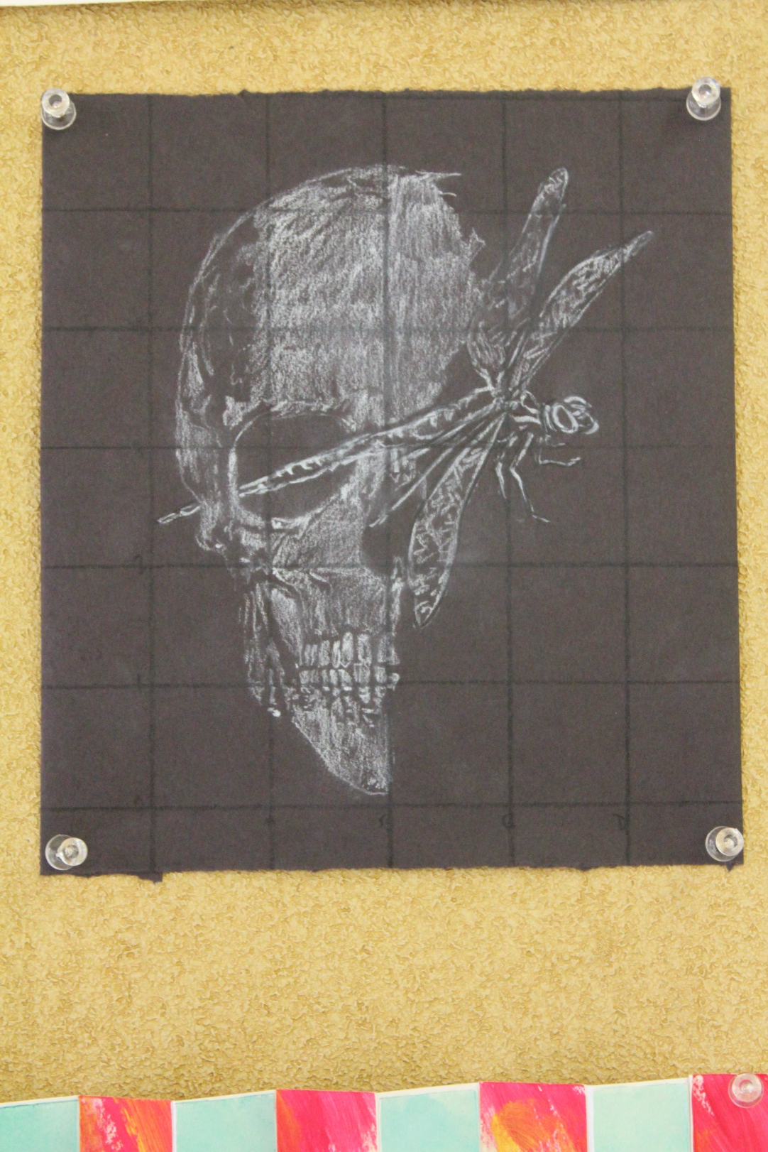

Slide 12
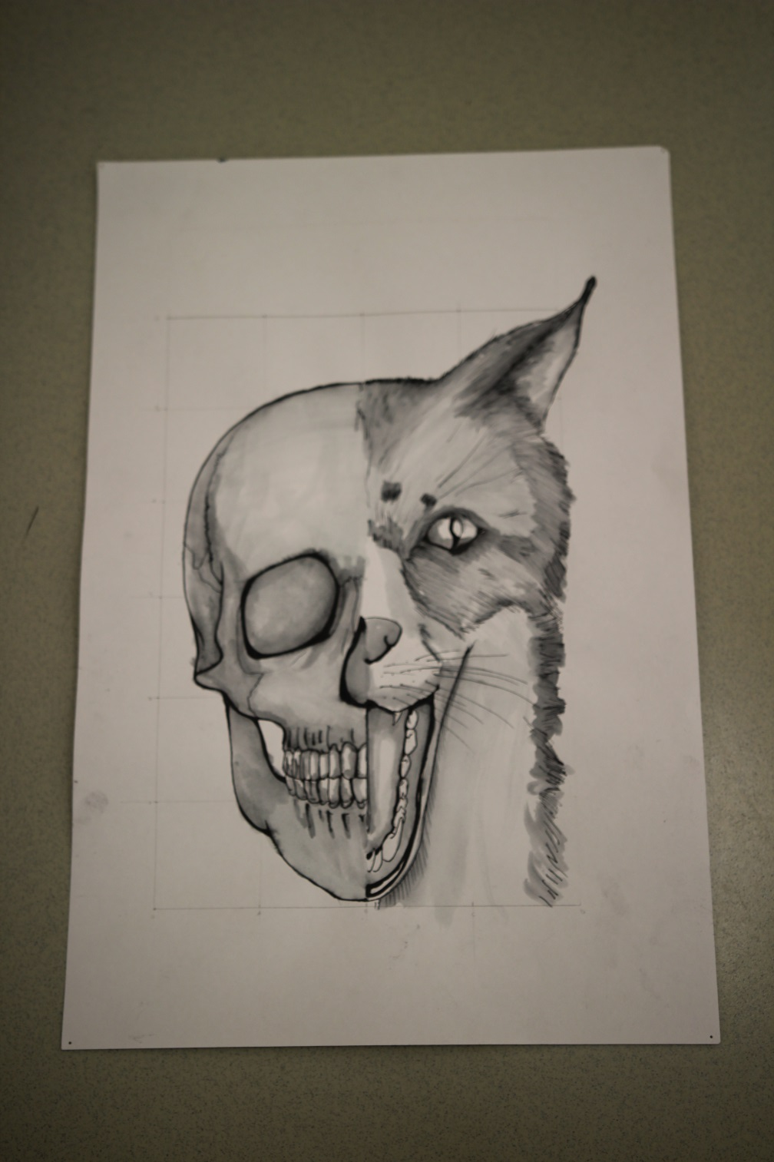

Slide 13
Spirit Creature Determined by your birthday
Jan 20th – Feb 18th = Otter
Feb 19th – Mar. 20th = Wolf
Mar. 21st – Apr. 19th = Falcon
Apr. 20th – May 20th = Beaver
May 21st – Jun. 20th = Deer
Jun. 21st – Jul. 21 = Woodpecker
Jul. 22nd – Aug 21st = Salmon
Aug. 22nd – Sep. 21st = Bear

Slide 14
More birthdays
Sep. 22nd – Oct. 22nd = Raven
Oct. 23rd – Nov. 22nd = Snake
Nov. 23rd – Dec. 21st = Owl
Dec. 22nd – Jan 19th = Goose

Slide 15
9.30.14
Work on drawing your skull to scale (in pencil)
Figure out where you want your spirit creature to come out of your skull
DUE Sept. 30th – can take home for home work this weekend
Final Drawing in charcoal, colored pencil or shading pencils

