Slide 1
Day 2 of 3 Storyboards Silent Film
9.25.2014

Slide 2
Bell Work 9.25.2014
Answer the essential question:
What tools can we use, besides our voice, to share our ideas in film?

Slide 3
Agenda
New Film Groups
Storyboard with whiteboards
Start storyboarding out your film
Storyboards will be due Monday next week

Slide 4
Films we will watch
Charlie Chaplin
https://www.youtube.com/watch?v=79i84xYelZI&index=51&list=WL
How to Spot a Liar
https://www.youtube.com/watch?v=P_6vDLq64gE
The little clues to body language

Slide 5
Video Reflections
Let’s chat about what we saw in the films
Write as we go along

Slide 6
Extra Credit
Movie posters = make your movie about something
Question the norm
Challenge people to think different
Change the world in a positive way

Slide 7
Example Videos Ideas
How you could reshape the world:
https://www.youtube.com/watch?v=XjJQBjWYDTs
Gender stereotypes and the words & actions we use to reinforce them
https://www.youtube.com/watch?v=m5yCOSHeYn4
Positive things we can do and say
https://www.youtube.com/watch?v=Bq3Dgy3Wx_0
The way you use your words is important

Slide 8
Rubric Film 2
Transfer your ideas from the whiteboard to a storyboard paper.
Rubric: Silent Film
No sounds coming out of your mouth, only sound effects, music or silence (5-10 different ones)
At least 5 shot styles
Everyone is in the film
Title page, credits, everyone edits
Beginning, middle, and end – the story needs to make sense this time

Slide 9
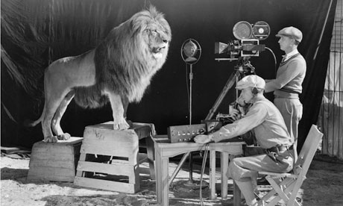
Exit Pass 9.25.2014
1)What did you enjoy most in class today?
2)What is one thing you learning during class?
3)What are you excited about for next class?
Next class…
Storyboards DUE

Slide 10
Extra slides to save for later

Slide 11
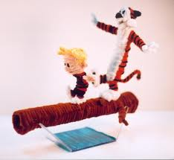
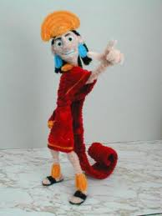
Storyboard Activity
Pipe cleaners!
Make a character that will represent you out of pipe cleaners
5 minutes

Slide 12
Writing the storyboard in class
Storyline
Map out the diagram of a storyline

Slide 13
Sticky notes
Now write ideas down on sticky notes about a story
Use one sticky note to write a beginning
Use another to write a middle
And another to write an ending
Don’t forget to write ideas for transitioning scences from one to the next

Slide 14
Productions Class
Conner – download and edit footage from the burning of the ‘O’ and Powder Puff Game
Make a highlight reel for the announcements of each
We will do announcements again on Monday
Double check & grade everyone’s events & announcements for the term thus far
Study skills video – work on
Filming?
Tonight – Francisco – girl’s soccer
Tomorrow – Iron Horse – Raymond & Auston
Assembly in the filed tomorrow ? – who wants to film?

