Slide 1
Squished face selfie
9.2.2015

Slide 2
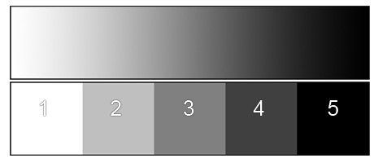
Bell work 9.2.2015
Disclosures will need to be turned in. Do you have yours ready
Past classes graded homework will be handed back. You should be able to check your grades online.
Draw a quick value scale that includes 5 shades of light.
Name one thing you like about art
Name one thing you like about yourself

Slide 3
Agenda
Review last time
Talk about the 5 shades of light
Self assess
Goal sheet
Studio time
Exit pass

Slide 4
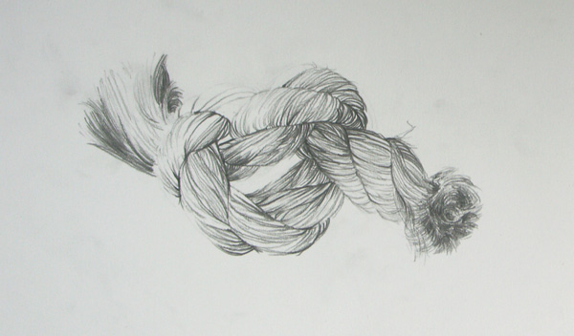
Last time
We drew string in one form or another ( A.P. wrapped an object)
We clarified and checked in on homework
We talked about class procedures for hall passes and participation points
We took pictures for the squished faced selfies

Slide 5
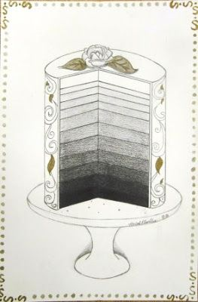
Value scale
Value scales show a gradation from light to dark.

Slide 6
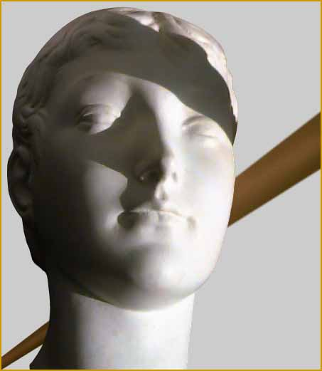
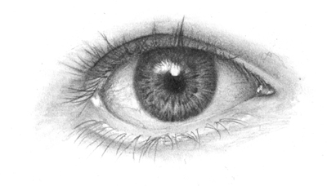
Don’t forget all the shades
Highlight - the lightest value in the picture
Helps the viewer know where the light is coming from.

Slide 7
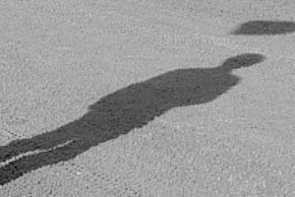
Cast shadow
Every thing has a shadow did your string drawing have a shadow ?

Slide 8
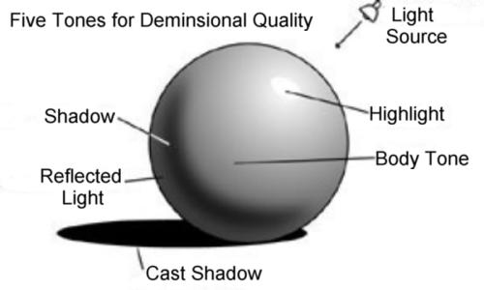
Reflected light- is when light bounces off of the surface its resting on.

Slide 9
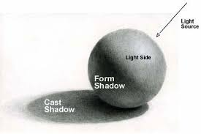
The tones in between light and dark are called mid- tones

Slide 10
Self assess
Work from last time(twine sketched) will be handed back
There will be a work sheet handed out that will ask you to answer some questions about your work
This is not punitive it is for you to see where you are at as an artist

Slide 11
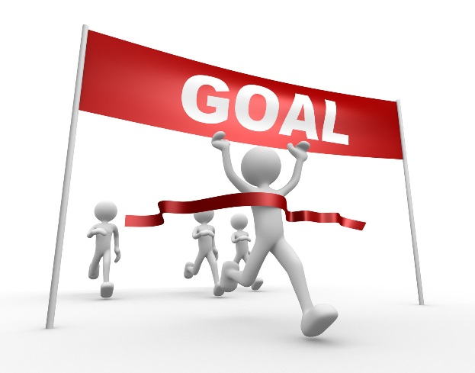
Goal sheet
What are your goals for this class and what are your goals for progressing your skill in art?
83% of the population does not have goals
14% have a plan in mind, but are unwritten goals
3% have goals written down
A study done by Forbes magazine found that the 14% who have goals are 10 times more successful than those without goals. The 3% with written goals are 3 times more successful than the 14% with unwritten goals.

Slide 14
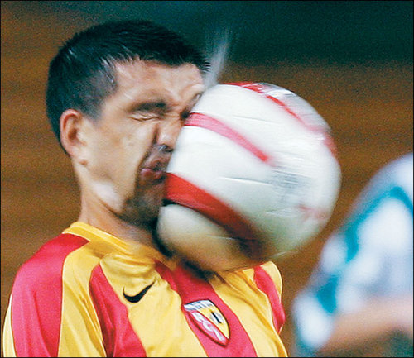
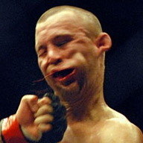

Slide 17
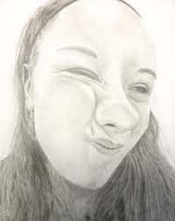
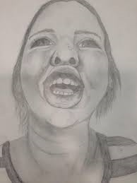
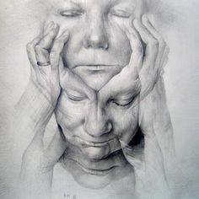
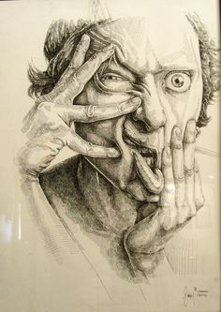
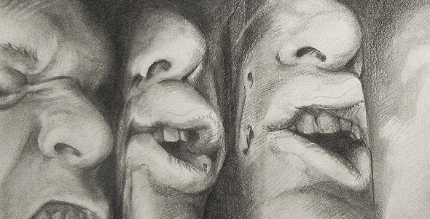
Studio time
Your picture(Smoooshed Selfie) from last time will be handed back
Try to include at least 5 types of light.

Slide 18
Exit pass 9.2.2015
Clean up
5 home work sketches done after today
Next class we will have a story time outside feel free to bring a snack for story time
Next class sketchbook home work checks for 31 days

Slide 19
Advisory
We are going to the auditorium

