Slide 1
9.18.2018 Painting 1 Leaf & Glue in Techniques 4.0
Lyon

Slide 2
Pick Up at the Door
Sketchbook
Techniques from last class – 4.0
Sponge
Straw
Saran Wrap
Free paint – applying one of the 4.0 techniques to a painting
Paper describing each techniques

Slide 3
Last Class
We completed 4.0 watercolor techniques
If you missed it the video will be posted in a few days –or- you can stop by after school on Monday, Wednesday or Friday to get help with it

Slide 4
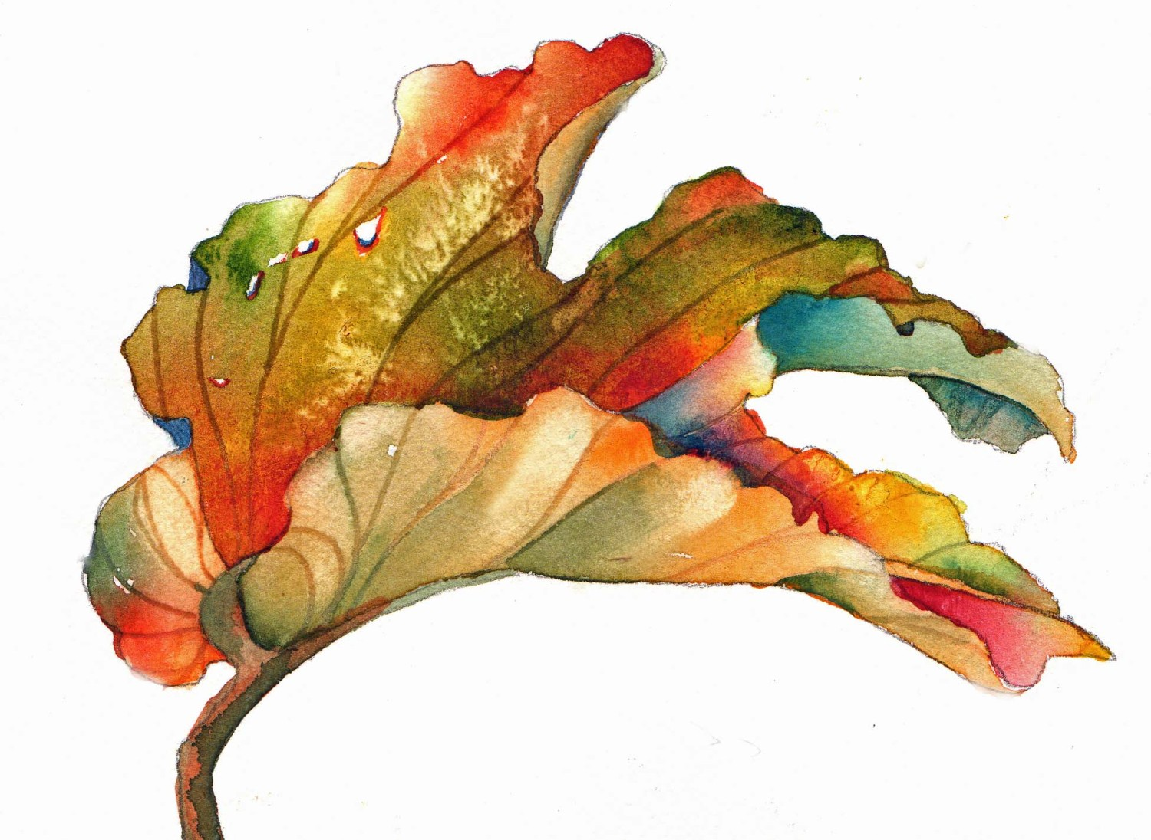
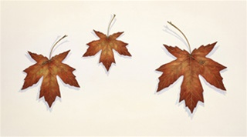
Reminders
Art fees need to be paid to Mrs. O’Grady in the bookstore by the end of the semester in order to take your paintings home
We will be entering work into a few different contest and art shows, so wait to take stuff home
First art show/contest at The Local Artisan Collective – if you’d like you can sell your leaf painting at that event!

Slide 5
Agenda 9.18.2018 & Studio Time
Fall leaf painting – leaf, shadow, more than one tone of each color
Once you are done you can complete any paintings you need to finish up or do another leaf painting
Hold onto your brushes till the end of class, we are going to use our brushes as an exit pass(make sure it’s clean)

Slide 6
Clean-Up
Brushes are your exit pass
Let’s give the tables a wipe down
Watercolors left on your table
Thanks!

