Slide 1
Last Day Filming! Film 1
E.Lyon 2014

Slide 2
Last day filming! 9.15.2015
Before you go…
Let’s chat about our essential question
Where are you filming today?
Bring your folder to Mrs. Lyon and head out to film

Slide 3
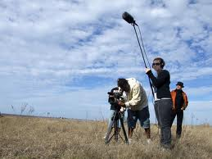
How do you know….
….when you are done filming?

Slide 4
Some ideas….
Did you get the footage you wanted?
Double check your storyboard?
Any other ideas?

Slide 5
When to be back…
1st period – be back by 9:00
4th period – be back by 2:30
To complete the exit pass

Slide 6
Exit Pass 9.16.15
1)Rate yourself on double checking your film footage to make sure you had it all
2)Explain why you gave yourself that rating
3)Rate your group on completing all the filming on time
4)Explain why you gave your group that rating
Be ready to edit next class!

Slide 7
Productions Class 9.16.16

