Slide 1
Drawing/Painting 3

Slide 2
Drawing/ Painting 3 9.12.2018
Start you self-portrait or continue(finish by Friday)
You can use any media you want for the self-portrait or even combine media(art materials & tools)
Please try to pay your art fee by the end of this month

Slide 3
Applied Techniques Painting Day 2
9/12/2018

Slide 4
Applied Techniques Painting Day 2 9.12.2018
You will need:
Paints (back drawer by the sink)
A water container with water in it(cupboard by the sink)
A few paint brushes
A paper towel(from the dispenser or on the table by it)

Slide 5
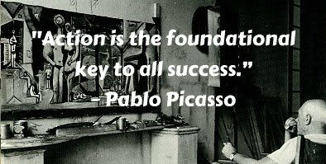
9.12.2018 Watercolor Painting Project 1: Applying 2-3 watercolor techniques thus far
You get to make your own painting!
Make sure you will include at least 2-3 of the techniques we have learned in class
Turn in your painting to your class period drying rack and the reflection to your class period turn in basket
Thank you!

