Slide 1
Art A Day 2
Symbolic Graffiti art.

Slide 2
Bell Work/Starter 8.28.2017
Please do this on the next available page in your sketchbook(page 4).
Do you have your disclosure statement to turn in today?
If not what can you do to make sure you get it next time.
If yes turn in now.
What is the difference between Graffiti art & tagging?
Write a word(school appropriate) in a creative way that symbolizes you.

Slide 3
Agenda 8.28.2017
Go over what is the difference between graffiti art and tagging.
Go over as a group how to turn block letters into graffiti letters.
Pick a word that represents you to go along with the symbols you created last class to be your graffiti letters
Exit pass

Slide 4
Last Time
We started our symbols
If you were not here last time it is your responsibility to talk to the teachers and check the class website:
www.classwithlyon.com
Complete missing work in your sketchbook on the page it says to complete that day on
If you have questions ask three before me

Slide 5
Participation Points – how it works
Everyday you have 5 participation points when you walk in the door
If you curse, do something disrespectful, don’t clean-up after yourself -1 for each offense ☹
If you do something awesome, are nice to someone, helpful during clean-up time by helping others clean their area, etc. you can earn back any minus points ☺
Any questions?

Slide 6
Reminder about - Hall Passes 8.28.2017
Once you have your planner, we will sign the backs of planners for hall passes
You must have your planner to go
Only 3 hall passes per term

Slide 7
Graffiti Art
What is the difference between tagging & graffiti art?

Slide 8
Tagging
Tagging is putting your name on something.
Legality does not determine whether something is a tag or graffiti art.
A tag is your name or nickname done in one color to make a mark.
It usually is only black with the use of line.
It usually is very fast and sloppy.
Most people do not consider a tag art because it is lacking in art elements.

Slide 9
Graffiti Art or street art
Graffiti art, also known as street art comes in all shapes and sizes.
Types of street art mediums
Spray paint with stencils
Spray paint free hand
Yarn
Chalk
Stickers
Posters and glue
Street art involves meaning using words or symbols.

Slide 10
Term – Tagging, Graffiti
Write your own definition for tagging and graffiti on your terms page

Slide 11
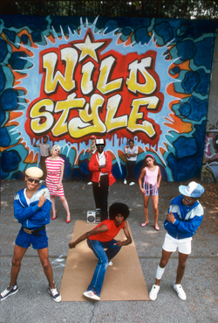
History time
The first modern graffiti writer is widely considered to be Cornbread, a high school student from Philadelphia, who in 1967 started tagging city walls to get the attention of a girl. But it was only in the 1980s that galleries began to showcase graffiti as artwork.

Slide 12
Letter types
Not only are there different types of graffiti; there are also plenty of different lettering styles used by graffiti writers.
Many of them were designed by graffiti writers in the beginning years of urban graffiti, in the 1970s and 1980s. They’ve been imitated expanded, adapted and changed by graffiti artists all over the world.

Slide 13
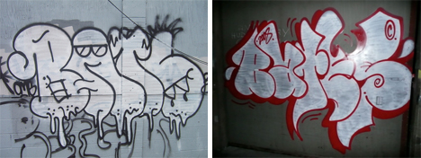
Bubble letters
The simplest form of graffiti letters. They are letters blown up like a balloon or a bubble.

Slide 14
Block Letters
Block letters are basically the same as bubble, but without the fat rounded appearance.
Shadow letters are commonly found on throw-ups and in more complicated pieces. They use either block letters or bubble letters and feature a shadow behind each letter, making the lettering appear slightly 3D.

Slide 15
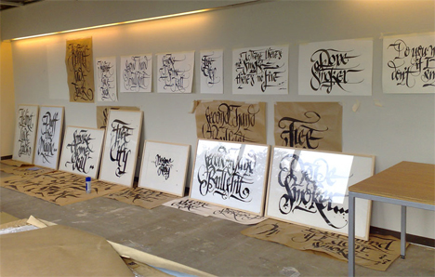
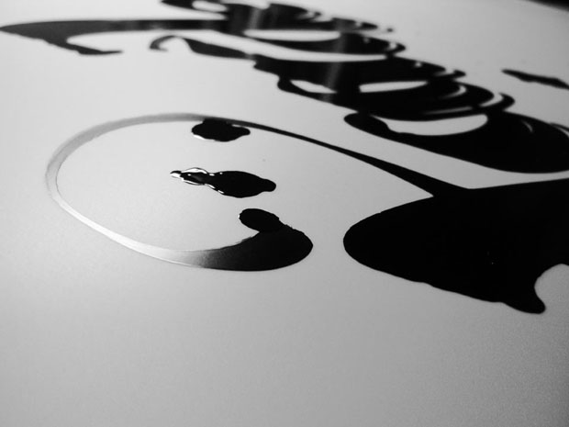
Calligraffiti
Calligraffiti is a combination of calligraphy and graffiti invented by Amsterdam graffiti artist Shoe. It’s a somewhat stylized but still easy-to-read lettering style. It brings together the best parts of calligraphy and graffiti by putting beautiful and artful letters into an urban setting.

Slide 16
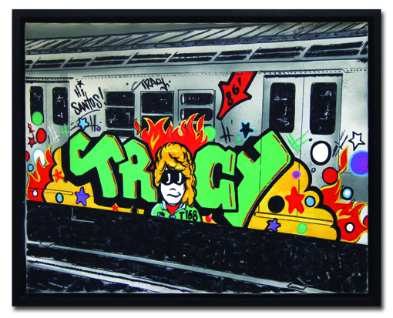
Wildstyle
First thought up and practiced by Tracy 168 and Stay High 149 in New York.
Wildstyle graffiti is complex and often difficult to read for people who aren’t familiar with graffiti lettering. The style has taken off all over the world and has evolved as it’s been passed from continent to continent.
There is a lot of linking and over lapping of letters.

Slide 17
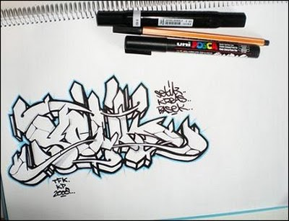

Slide 18
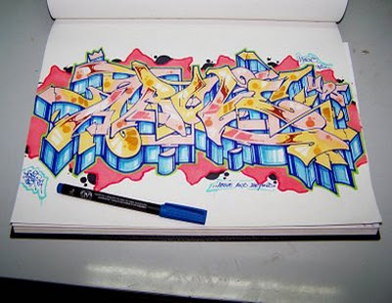

Slide 19
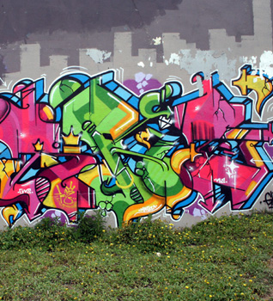

Slide 20
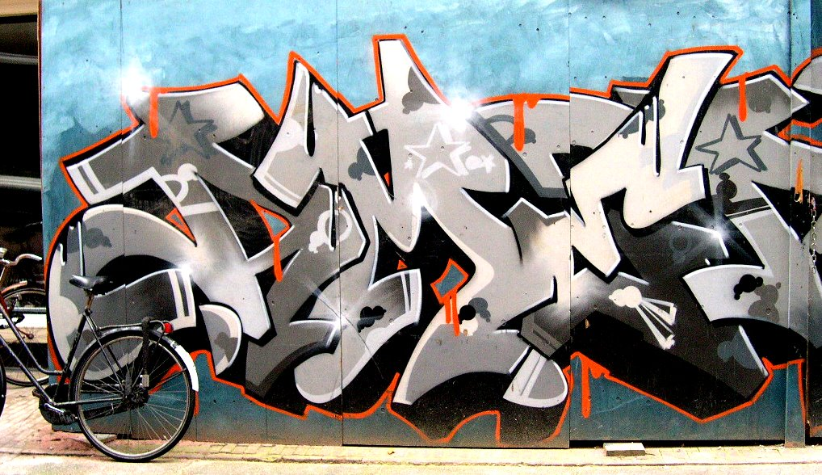

Slide 21
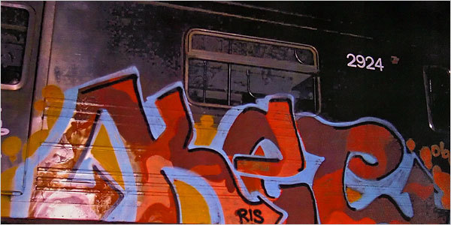

Slide 22
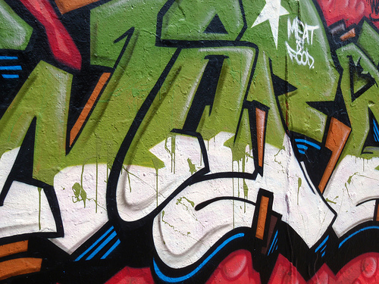

Slide 23
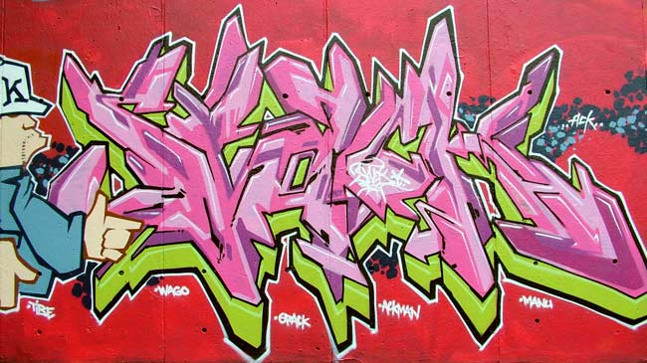

Slide 24
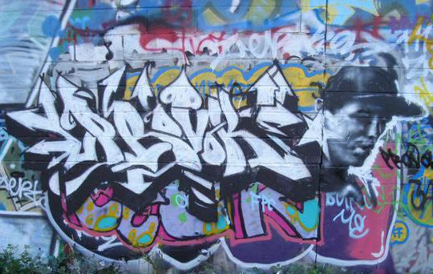

Slide 25
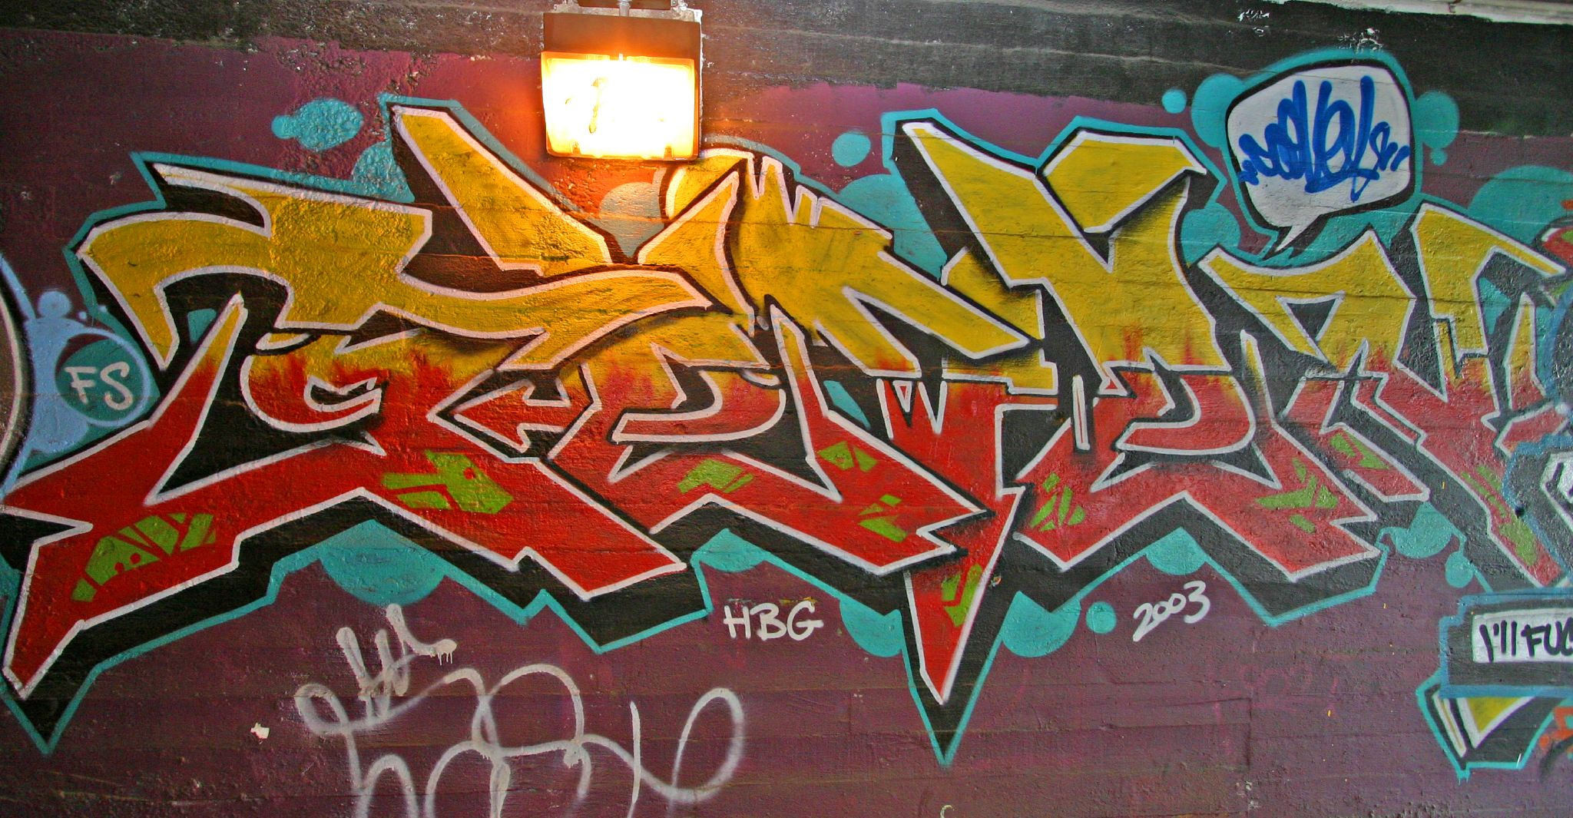

Slide 26
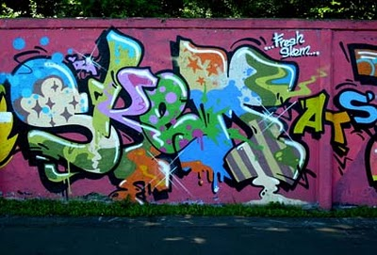

Slide 27
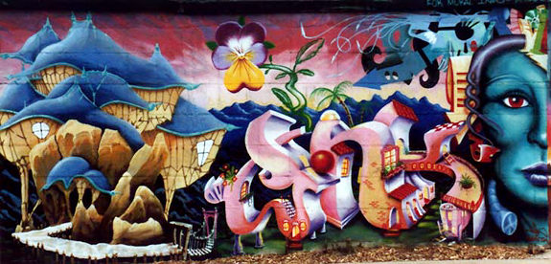

Slide 28
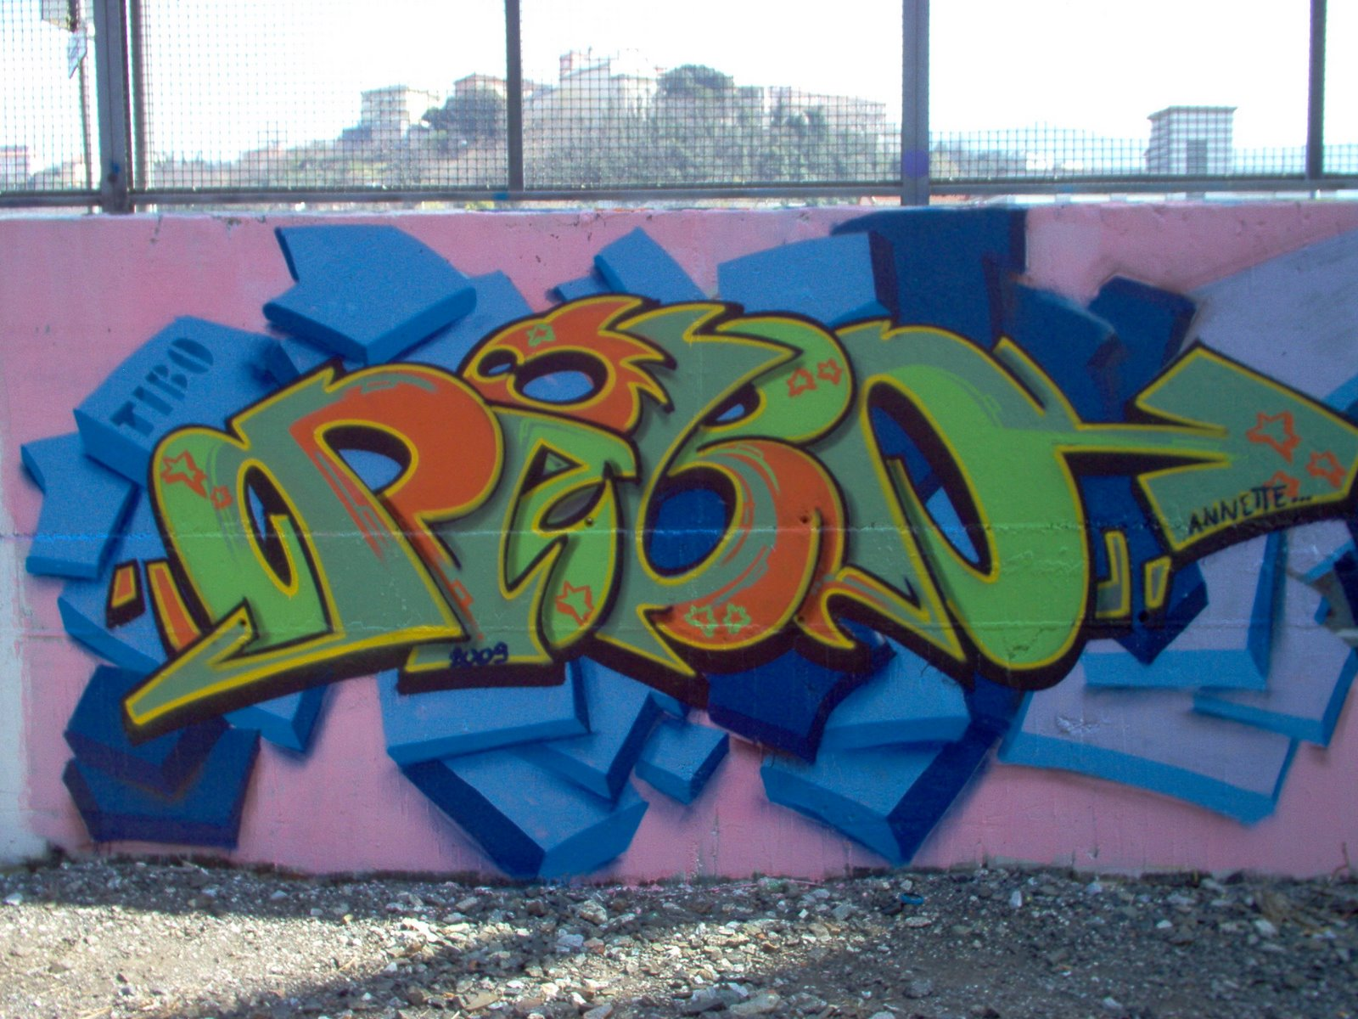

Slide 29
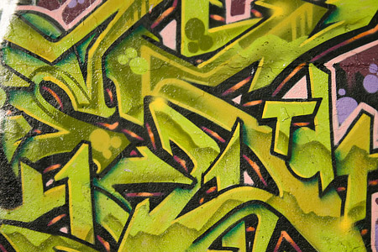

Slide 31
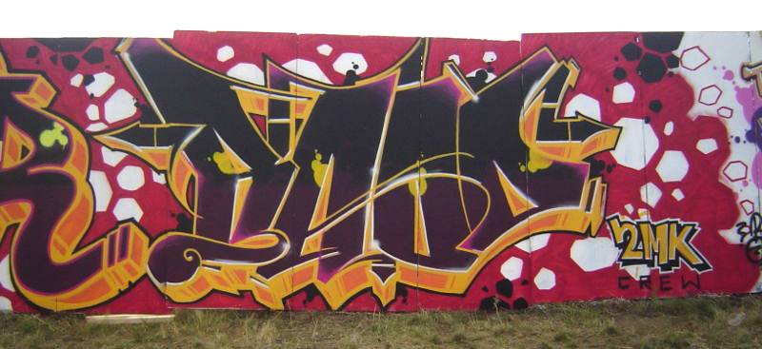

Slide 32
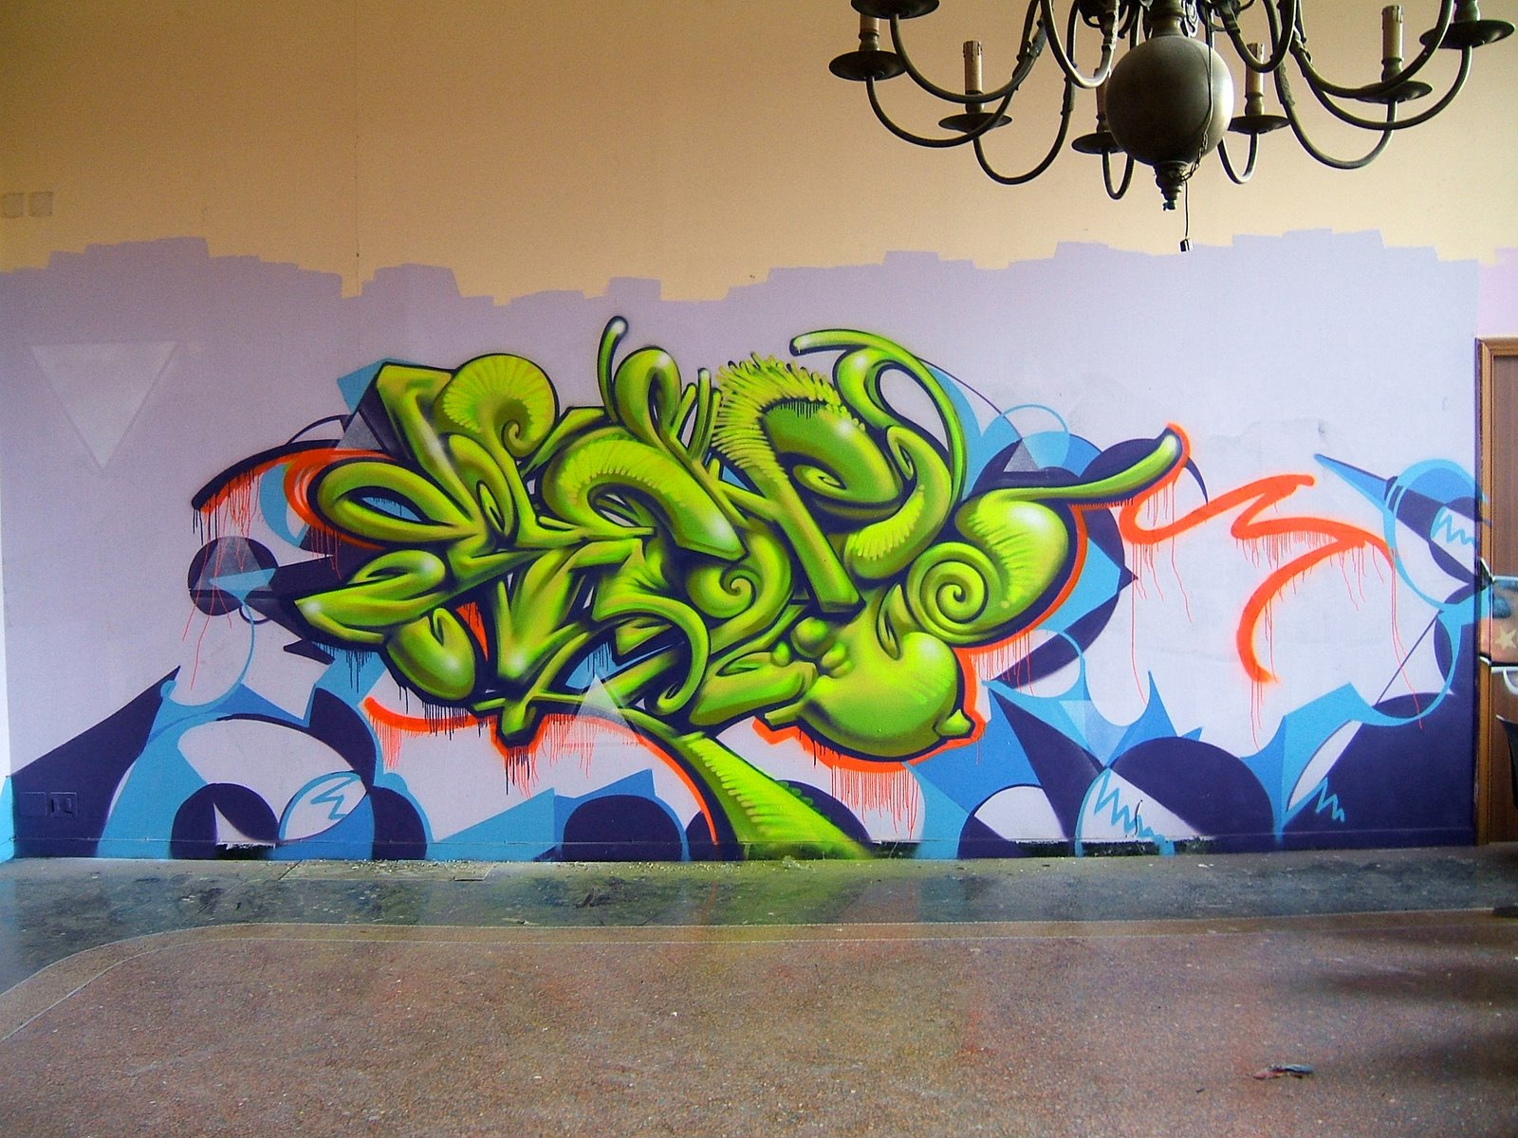

Slide 33
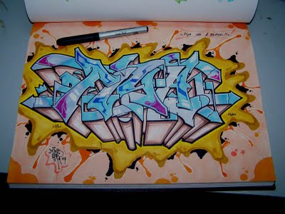

Slide 35
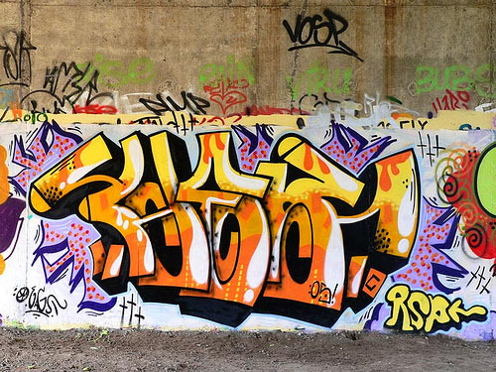

Slide 36
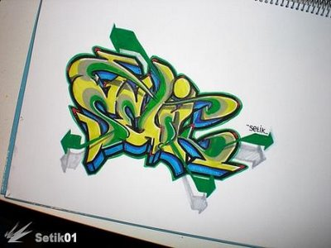

Slide 38
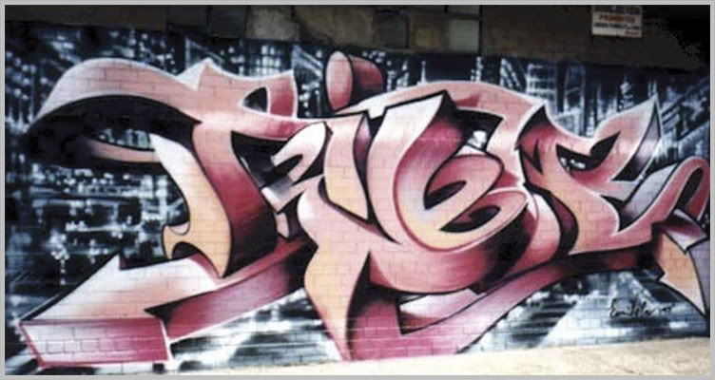

Slide 40
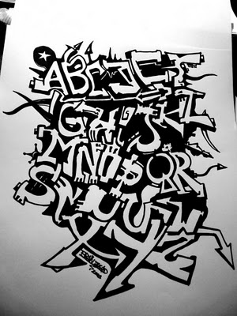

Slide 42
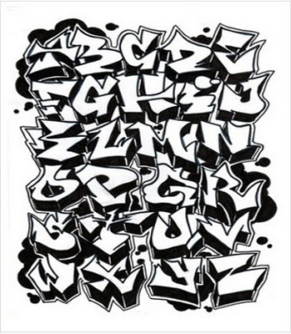

Slide 44
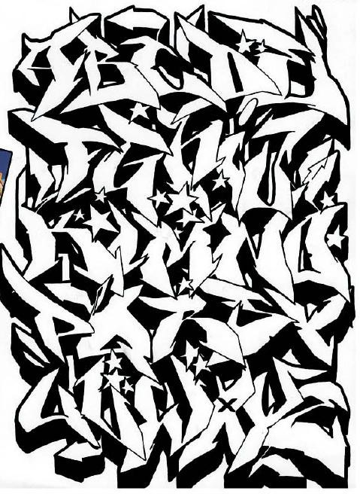

Slide 45
If it’s NOT yours DON’T touch it.
Some of the specific penalties for vandalism for minors can include the following:
Repairing the damaged property
Paying for someone else to repair the damaged property
Fines (often of $500 or more)
Expulsion from school
Counseling
Detention in a Juvenile Facility
Community service
Up to 3 years of probation
In some cases, even time in jail
In Utah the average vandalism fine is $1000, 6 months in jail, 2 years probation and community service.
(http://www.criminaldefenselawyer.com/crime-penalties/juvenile/vandalism.htm)

Slide 46
Graffiti Letters
You need to have your word sketched out by the end of class – on page 5 in your sketchbook
Next class we will combine your symbols with your graffiti word

Slide 47
Exit Pass 8.28.2017
Next class, we will be combining our graffiti word with our symbols
You will receive the rubric in which you will grade yourself by
Exit Pass – under your bell work on page 4 in your sketchbook
What is one thing you learned about graffiti today?
What are you most excited about for next class?
When will this final project be due?

