Slide 1
Watercolor 8.24.2017
E.Lyon

Slide 2
Starter 8.24.2017
Tape four piece of watercolor paper to a board
Get water, two brushes, a paper towel, and paints, wait for instructions
Let’s go over some more advanced techniques for watercolor
Sunset
Clouds – blended into the sky
Masking with rubber cement
Free painting space

Slide 3
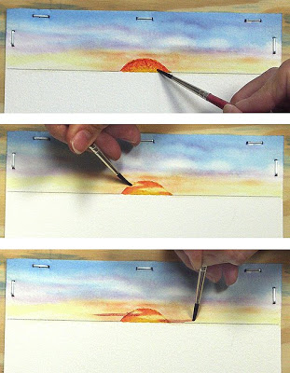
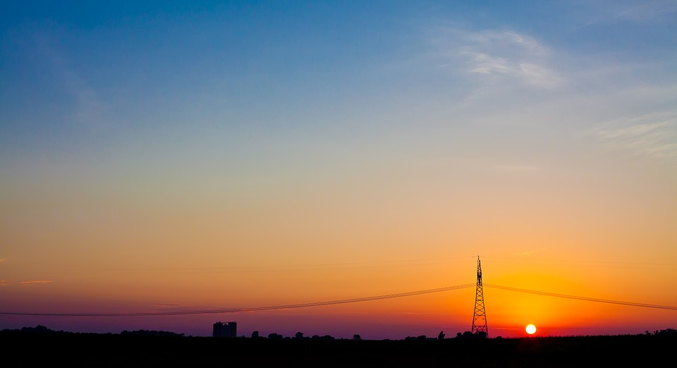
Sunset

Slide 4
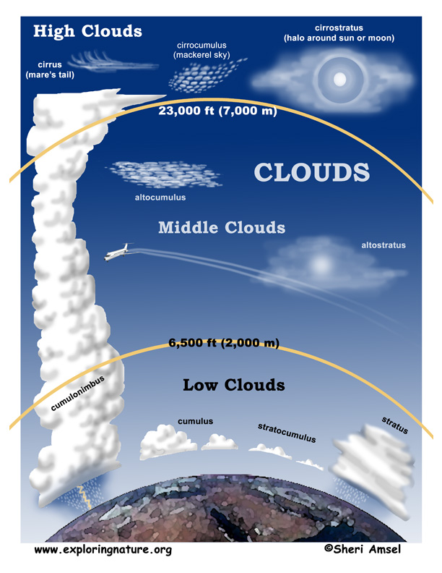
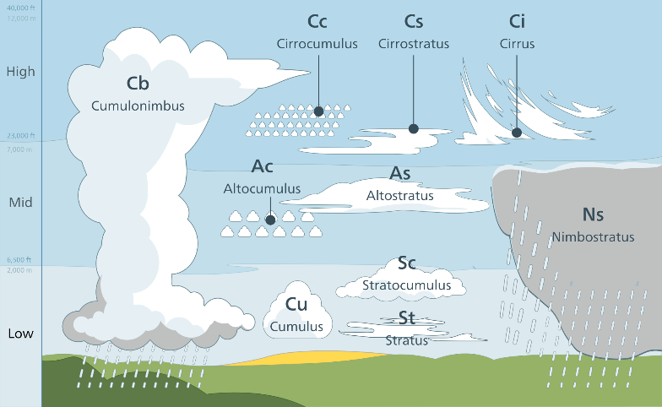
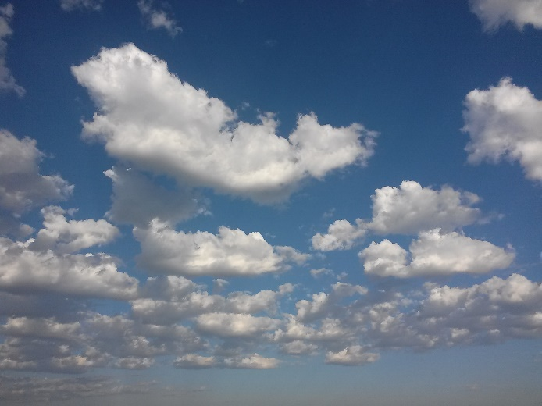
Clouds – lines with pigment on wet paper

Slide 5
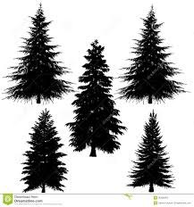
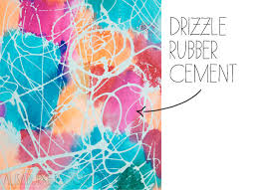
Masking with rubber cement

Slide 6
Free paint Apply one of the technique we learned today

Slide 7
Next Class We will work on a final painting of your choice, we will have two days on it in class. Please make sure to pay your class fee, $15- to the bookstore, thanks! Then we will move onto acrylics!

Slide 8
Stick Note Reflection
Put a sticky note next to your favorite piece and explain in at least one to two sentences why this one is your favorite.
Put a sticky note on a piece that you feel you achieved the technique you learned in class today. Explain how you achieved that technique.
Put a sticky note on a piece that you feel didn’t go well. Explain what you think wasn’t working for you or what your struggle was.
Leave your paintings out to dry, I will collect them and grade them at the end of the day.
On your way out, turn your supplies back in, make sure you brushes are clean and that you turn them in on the way out – thank you!

