Slide 1
Linoleum Block Prints
Art B
Day 3
Mrs. Lyon

Slide 2
Bell Work 2.6.2017
How do you transfer your sketch onto your lino block?
If you break a gauge tip what should you do?
What did you need to do in order to earn your lino block last class(hint: two things)?
What is an indicator to know you are carving too deep into your block?
How do you know your gauge blade is sharp?
What is one way to keep track of your gauge blades?

Slide 3
Agenda 2.6.2017
Bell Work
Review
Carving! & Test Prints
Next Class
Clean-Up
Exit Pass

Slide 4
Review Bell Work
How do you transfer your sketch onto your lino block? – put your sketch side down on your block, rub it till the whole image you drew shows on your block
If you break a gauge tip what should you do? – tell Lyon
What did you need to do in order to earn your lino block last class(hint: two things)? – 3 sketches and perfect score on safety quiz
What is an indicator to know you are carving too deep into your block? – go through or tips of your gauge can’t be seen while cutting your block
How do you know your gauge blade is sharp? – it doesn’t drag, clean cut lines
What is one way to keep track of your gauge blades? – keep them in the storage handle

Slide 5
Carving and Test Prints
Review carving
Intro to test prints!

Slide 6
Please Clean-up All Shavings

Slide 7
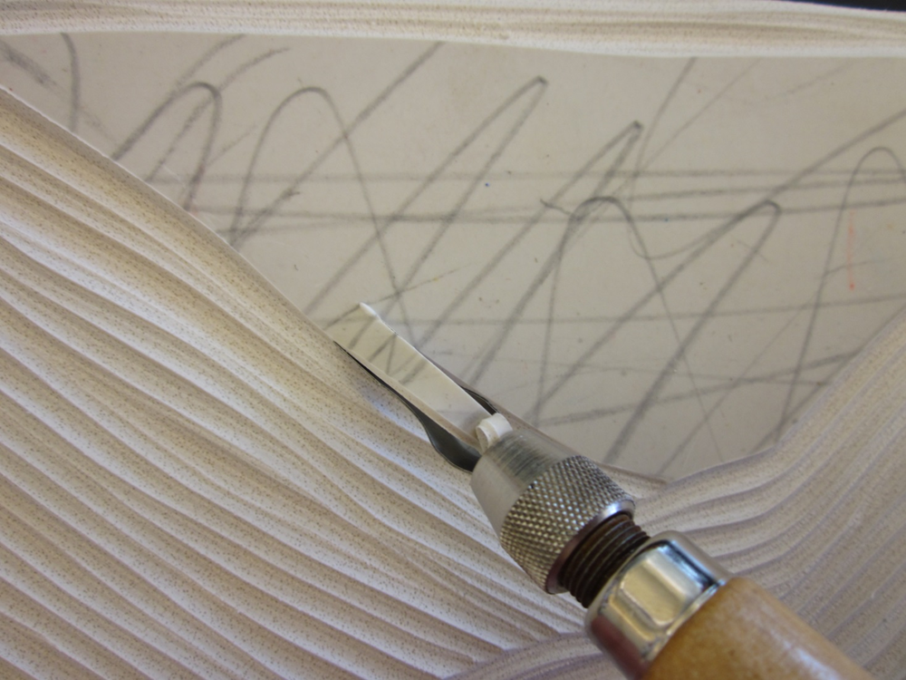
Carving Your Block

Slide 8
Think about the direction you carve your line to give it shape

Slide 9
Carving Demo -Review
Cutting too deep into the block with a blade
Clean cut lines
Direction you cut your block

Slide 10
Choose & complete one of the following:
Finalize Lino. Block Sketch
Transfer Sketch to Block
Start Carving your Block
Test prints - start

Slide 11
Negative Positive Space Switch

Slide 12
One Image on top of the other = 2 blocks to print from

Slide 13
Front and Back of your block

Slide 14
Another idea you could add to any of the three choices… double print and/or painted background

Slide 15
Test Printing!

Slide 17
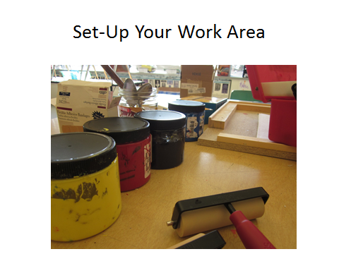

Slide 21
Lino Block Cleaning & Reprinting

Slide 22
Studio Time 2.6.2017
Your Goal for Today:
Transfer your sketch
Start & Finish Carving
Begin Printing
All 10 prints - Carved Lino Block & All Prints Due Feb. 16th(Thursday next week)

Slide 23
Exit Pass 2.6.2017
No exit pass
Clean-Up
Cold water to clean off lino blocks
Those that need to dry, leave on the counter face down on a paper towel
Turn in blocks, carving tools, etc.
Make sure tables are cleared of lino shavings and thrown in the trash(not the recycle)
Thank you!

Slide 24
Quiz and sketch
For those who missed the safety quiz last class

Slide 25
Safety Test
What direction do you cut your lino-block?

Slide 26
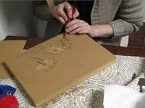
Away from you
And away from other people

Slide 27
What tool other than a gouge do you use when cutting your lino-block?

Slide 28
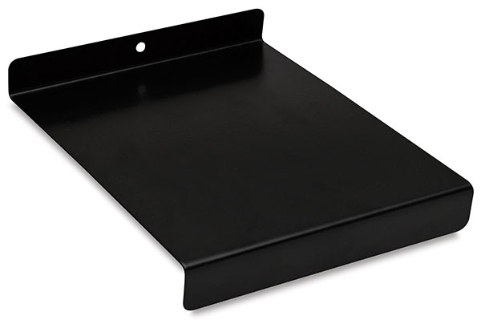
Bench plate
You always have to have a bench plate under what you are cutting

Slide 29
If you get cut, what should you do?

Slide 30
Put pressure on the cut
Walk over to the sink
Rinse it off with water
Put a paper towel over it
Get a Band-Aid from the back counter
Please tell Mrs. Lyon if you cut yourself

Slide 31
If you break a gouge tip, what should you do?

Slide 32
Accidence happen,
Tell Mrs. Lyon and she will give you a new gouge tip
If people break more than a few gouge tips, then we will wonder if it’s not an accident

Slide 33
What do you have to do to earn your lino-block?

Slide 34
You need to get a perfect score on this test & have your sketch for your design turned in.
You can take the test as many times as you need to in order to pass

Slide 35
How many lino-blocks do you get for this project?

Slide 36
Everyone gets only one lino-block

Slide 37
Quiz Questions…
What direction do you cut your lino-block?
What tool other than a gouge do you use when cutting your lino-block?
If you get cut, what should you do?
If you break a gouge tip, what should you do?
What do you have to do to earn your lino-block?
How many lino-blocks do you get for this project?

Slide 38
What’s next?
Once you pass your test
3 Sketches(turn in to get lino block)

