Slide 1
Project 3 Day 1
Art B
Mrs. Lyon
Project 3: Two Point Perspective

Slide 2
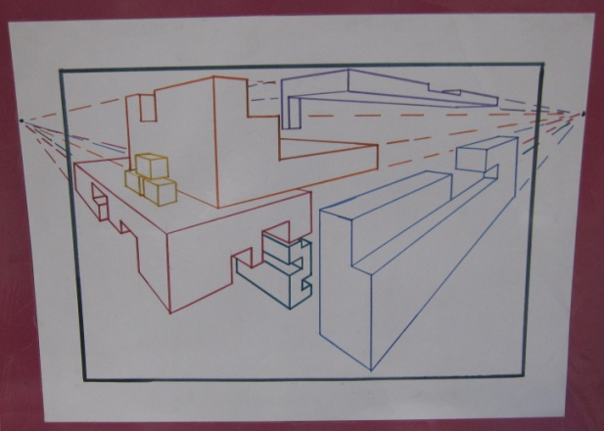
Bell Work 2.21.2017
What is space in a drawing?
What is the difference between form and shape?
How can you make something look 3D if you are drawing it on flat paper? (Describe what you could do to make it look 3D)

Slide 3
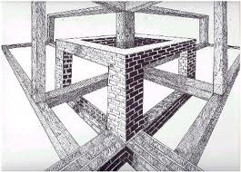
Bell Work Review
Space
Form and a shape
compare
How to make something look 3D, not 2D

Slide 4
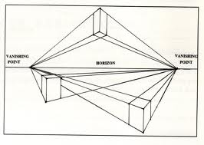
What we are doing today!
Starting Project 3 by….
Creating 8 to 10 forms using 2 point perspective

Slide 5
Review of One Point Perspective &…
….Intro. to Two Point Perspective

Slide 6
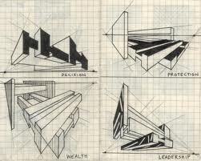
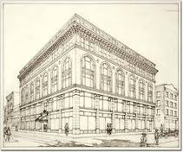
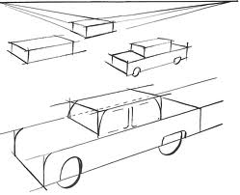
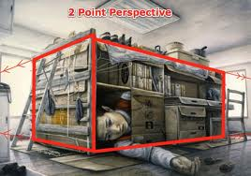
Images of Two Point Perspective

Slide 7
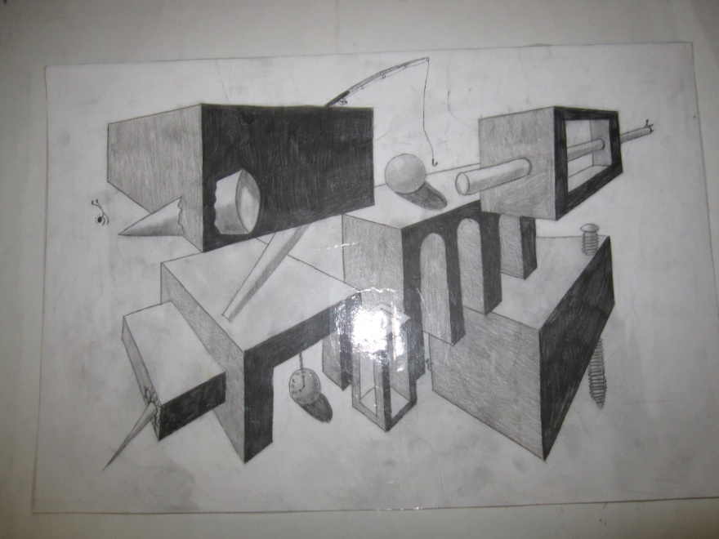
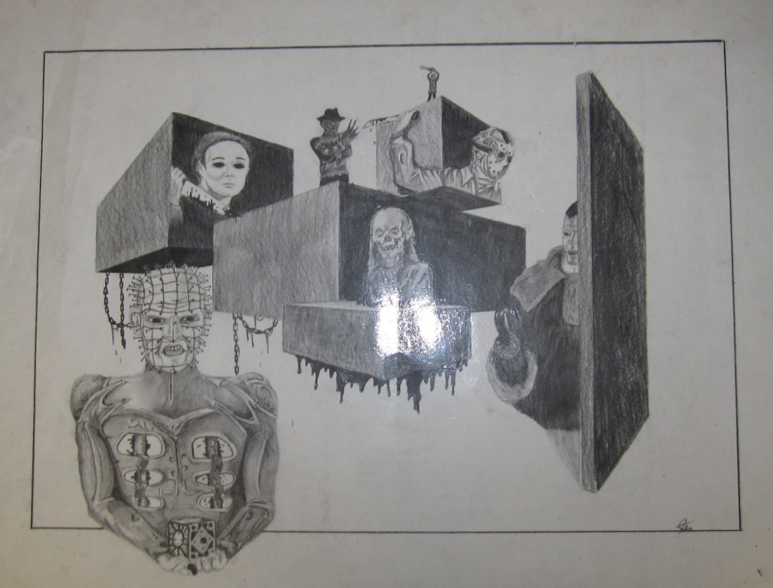
Project 2-point: Examples

Slide 12
Break Down of Each Day 5 Days to Work on, Due March 3rd Tues., Thurs., Mon., Wed., & Fri.
Create 8 to 10 forms in two point perspective
Cut out spaces in the forms in two point perspective
Add images for theme!
Finish shading(colored pencil or pencil)

Slide 13
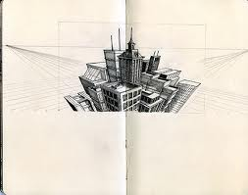
Two Point Perspective
You will need:
Ruler
Pencil
Paper(from front table)

Slide 14
Goal today:
Create 8 to 10 boxes in two point perspective
This will be for your final assignment
Watch your craftsmanship
Keep your paper as clean as you can, from smudges
Try not to make thick, dark pencil lines
Use your pencil lightly
Put paper under your hand if you need it

Slide 15
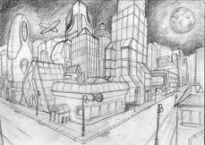
Studio Time
Start erasing all of your perspective lines, so just your forms shows
Brainstorm ideas on scratch paper from your table baskets about what you themed objects will be for this assignment

Slide 16
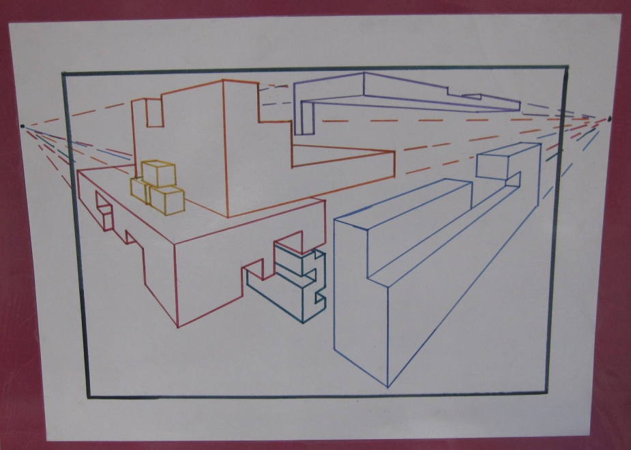
Next class…2.23.17
Cut out space in your forms
Start thinking about what your theme will be
Theme: everything relates to each other in some way
Ideas for themes:
Video games, book series, sports, airplanes, people, flowers, trees, icons, etc.

Slide 17
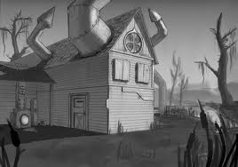
Exit Pass 2.21.2017
On a scale of 1 to 10 how confident are you with two point perspective drawing now: 1, what is two point perspective again to 10, I can teach anyone two point perspective now!
Now that you know what two point perspective is, how would you describe it to teach it to someone else. Try to write at least two or more sentences to complete this task.

Slide 18
Studio & AP
Double check grade from last term
Turn in any missing projects
Start a process drawing! Peas!

