Slide 1
Day 2 of 4 Editing Film 4
E.Lyon

Slide 2
Editing! 12.8.2014
Day 2 of Editing!
If you all finish early we can watch your films sooner, or you can add more of a plot to your film

Slide 3
Film 4 Editing
Review the check sheet to make sure you have everything in your film as you edit
The check sheet will be due with your film on Friday the 12th of Dec. (store the check sheet in your film drawer)
Make sure everyone get’s a chance to edit
Snow person Awards Dec. 16th, pick the film you would like to enter and let Mrs. Lyon know
See wall of Snowperson Award Winners by the storage room door and some of the awards on Mrs. Lyon’s desk

Slide 4
Voice Overs

Slide 5
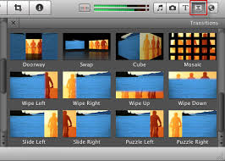
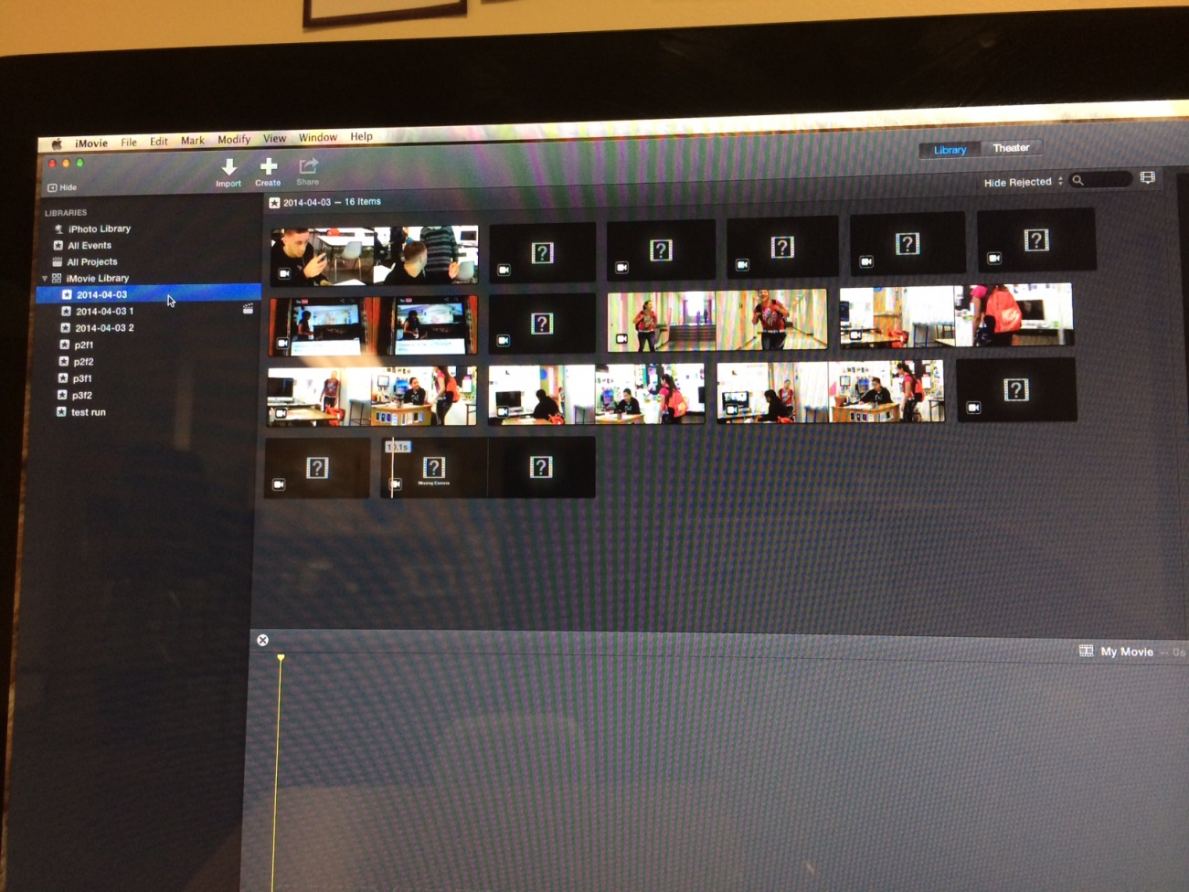
Reminder…

