Slide 1
Repetition Project #4
E.Lyon

Slide 2
Art is…?
What is art to you?
What is your favorite type of media? (remember: media in art, is the tools we use to make art)
If art is a type of mark making, what are all the art tools you can make marks with to create art?
What does repetition mean to you?

Slide 3
Review From last, last week
Repetition
2 more class periods to work on(today and next class)
Take home for home work if you need extra time on it
Winter Art Show
In two weeks Winter Art Show(same time as music concert)
Tuesday 16th
Framing and Matting works of art till then

Slide 4
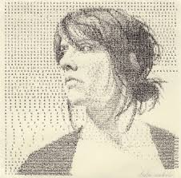
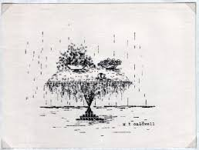
Make Art With Repetition
https://www.youtube.com/watch?v=svzPm8lT36o
Type Writer Art

Slide 5
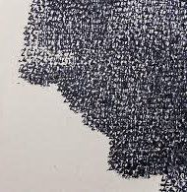
Stamp Art

Slide 6
Stencils

Slide 7
Potato Stamps

Slide 8
Repetition in Art

Slide 14
Repetition Project #4
What do you like so much that you want to repeat it?
What could you make a statement about using repetition?
What could be a feeling to provoke using repetition?
Start working on your project, due Dec. 3rd

