Slide 2
Art is…?
What is art to you?
What is your favorite type of media? (remember: media in art, is the tools we use to make art)
If art is a type of mark making, what are all the art tools you can make marks with to create art?
What does repetition mean to you?

Slide 3
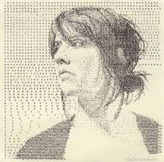
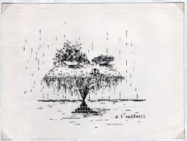
Make Art With Repetition
https://www.youtube.com/watch?v=svzPm8lT36o
Type Writer Art

Slide 4
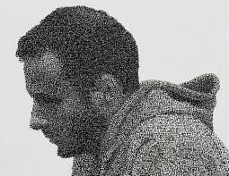
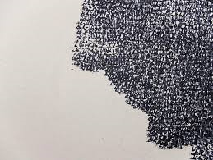
Stamp Art

Slide 5
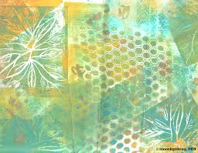
Stencils

Slide 6
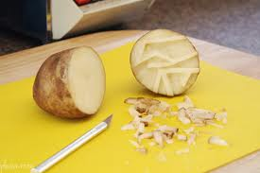
Potato Stamps

Slide 7
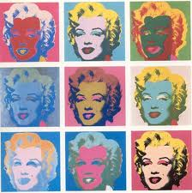
Repetition in Art

Slide 8
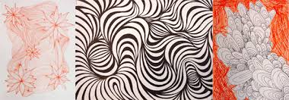

Slide 9
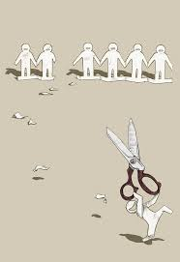

Slide 10
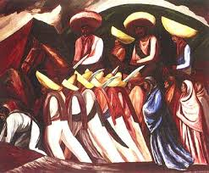

Slide 11
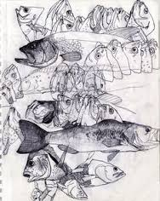

Slide 12
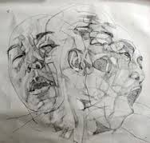

Slide 13
Repetition Project #4
What do you like so much that you want to repeat it?
What could you make a statement about using repetition?
What could be a feeling to provoke using repetition?

