Slide 1
Day 2
Watercolor Silhouettes

Slide 2
Bell Work:
Pick up your photos (3 total) and watercolor technique papers
Get a watercolor container with fresh water, a brush, and watercolor palette.

Slide 3
Agenda
Complete watercolor techniques paper and turn back in
Start gesture drawing
Learn about ratios and proportions of the human body
Gesture draw!
Transform your photos from last class into drawings
If you weren’t here last class: you can catchup with taking a picture during studio time

Slide 4
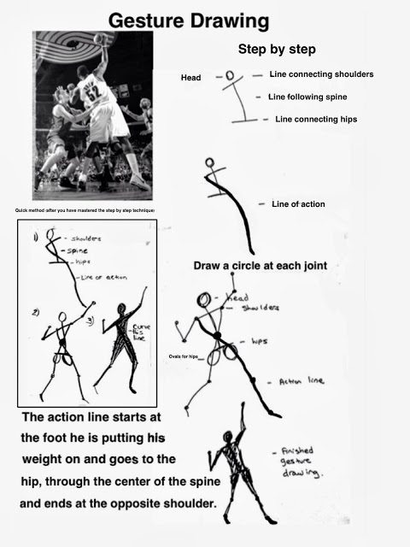
Notes:
Discuss gesture drawing, do an example on the overhead on a sheet of paper. Then I am going to have them sketch me. Then sketch each other at their tables. (see next slide)

Slide 5
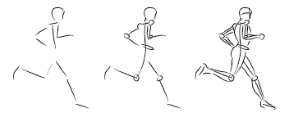
Class Practice

Slide 6
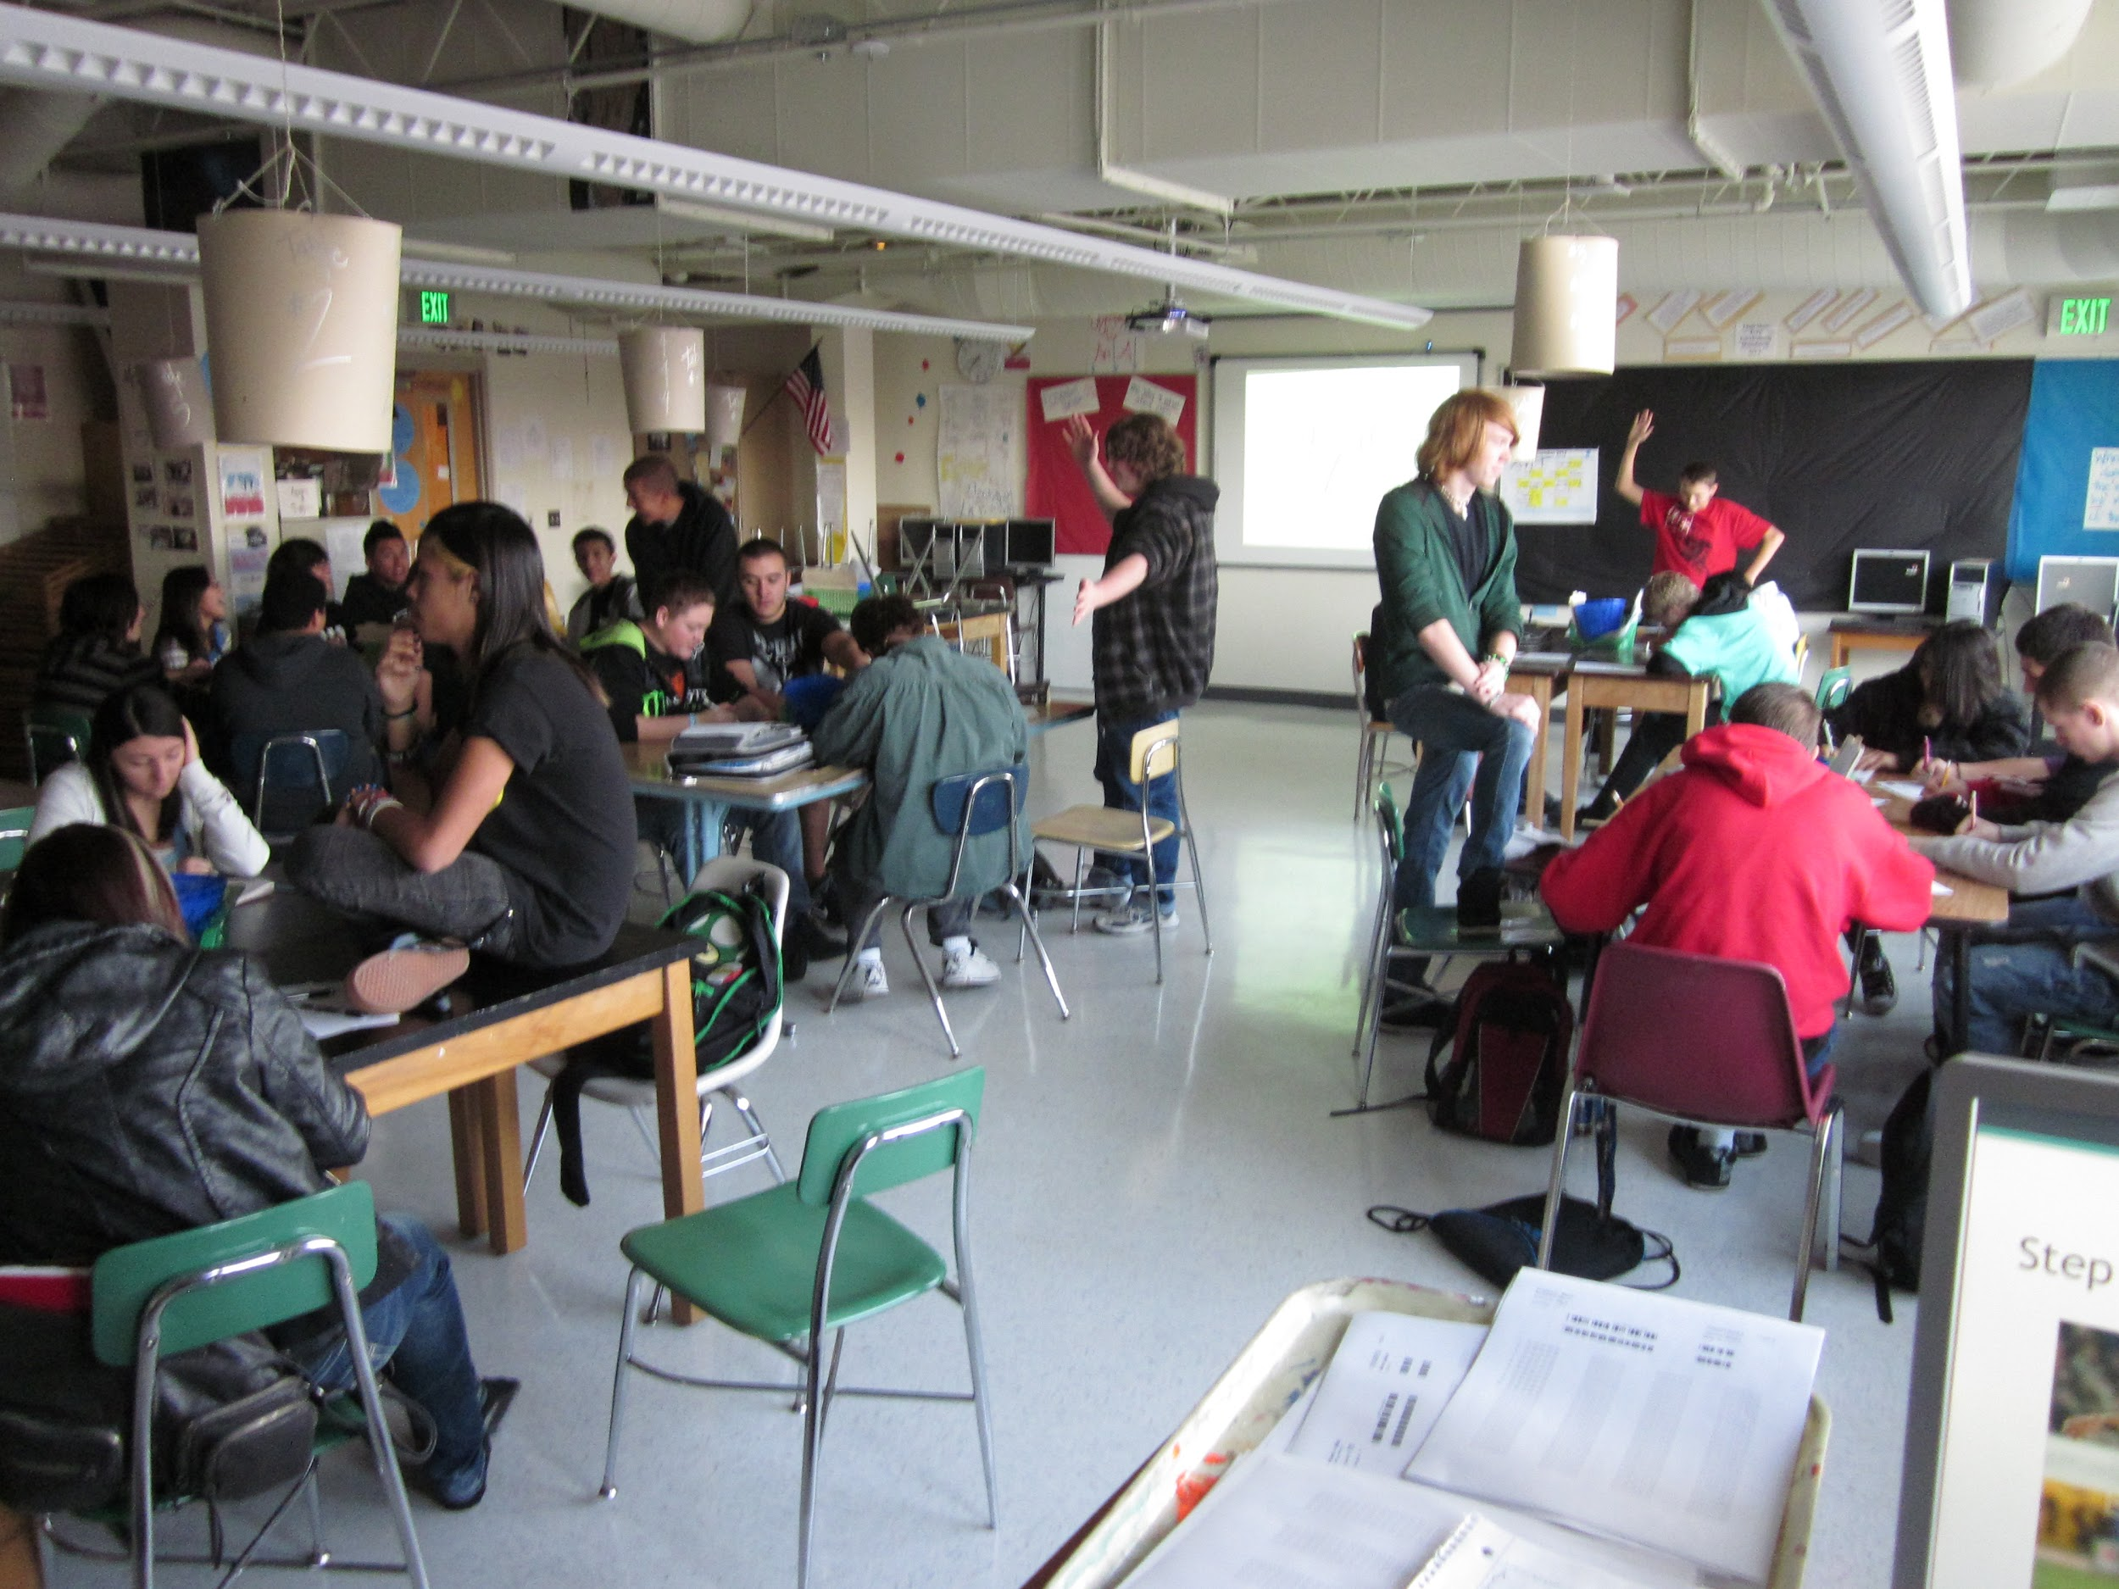
Gesture drawing
Each student will take turns posing at your tables.
Start with line
Add basic shapes
Add your detail

Slide 7
Start your silhouettes
Sketch your 3 movements using gesture
Pick up your 3 sheets of watercolor paper in the back.
Draw your 3 silhouettes using pencil
Next Time: Start your watercolor backgrounds

Slide 8
Done with silhouettes
One watercolor technique per paper
Tape watercolor paper to a board
Put your name on the tape so you know which one is yours

Slide 9
Day 3
Watercolor Silhouettes

Slide 10
11.18.2016 Bell Work:
Pick up your book and work from the past few class:
Do the bell work inside one of your book pages
What is gesture?
Draw a quick sketch of a classmate using gesture
What are your favorite three watercolor techniques?

Slide 11
Agenda for today! 11.18.2016
Bell Work
Review bell work
What is the next assignment, rubric, due dates
If you haven’t been here: make-up watercolor techniques, gesture drawings with notes, and take three action photos outside

Slide 12
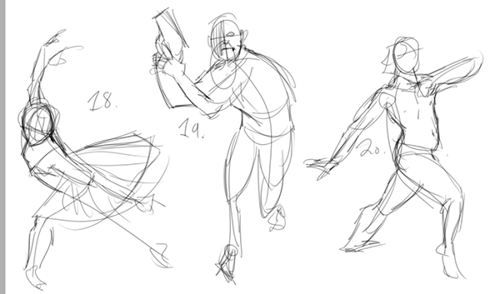
Gesture Drawing:
a laying in of the action, form, and pose of a model/figure. Typical situations involve an artist drawing a series of poses taken by a model in a short amount of time, often as little as 10 seconds, or as long as 5 minutes.

Slide 13
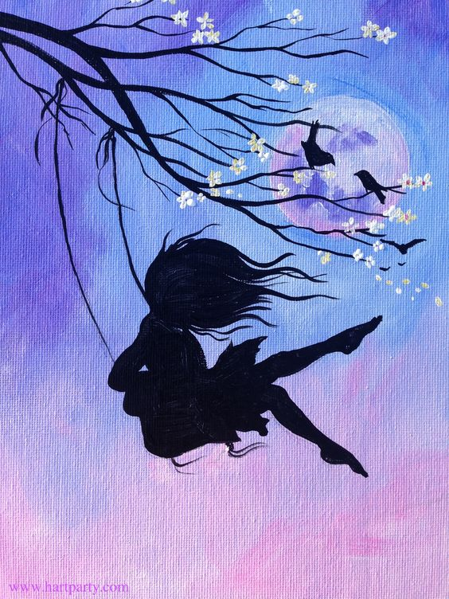

Slide 14
Timeline for silhouette and watercolor project
11/18 Friday – transfer action shots onto sketch paper in proportion
11/22 Tuesday- transfer silhouettes of action shots to watercolor paper, add watercolor techniques to the paper(let dry)
11/28 Monday – fill in the silhouettes, put your images in order of the action, reflection

Slide 15
Watercolor Silhouettes
3 pieces of watercolor paper
1 silhouette on each paper showing movement
Watercolor Backgrounds
AT LEAST 1 different watercolor technique on each painting (can combine)
Steps for today:
Drawing silhouettes first in pencil – check off your proportions and ratios – partial project score
Erase any extra lines you don’t want
Watercolor techniques
Let dry
Pen over top to create silhouette image of person

