Slide 1
Day 1 Project 3 Term 2
E.Lyon

Slide 2
Bell Work 11.14.2014
What is unity?
What is variety?

Slide 3
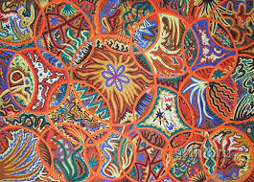
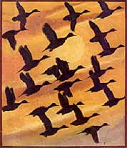
Unity

Slide 4
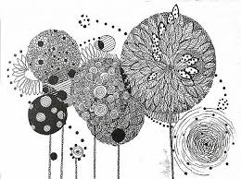
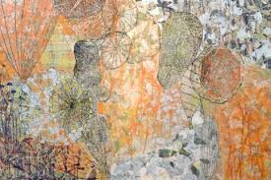
Variety

Slide 5
Ideas
Techniques
Tape and print out
Stencils
Stamping(cup)
Clear gesso(collage something)
Patterns, create with texture, shapes, lines, etc.
Go big with this project, cardboard, larger paper, canvas! Have fun!
2 Days to complete(today and next class)
It’s home work if you need extra time over the weekend

Slide 6
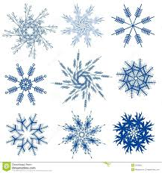
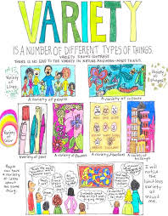
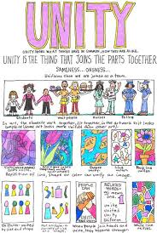
Unity & Variety Due Today

Slide 7
11/18/2014
Turn in your Unity/Variety project in the box
Include a reflection with your project
Next project Repetition
DUE Dec. 3rd

Slide 8
Pictures!
Clan Pics from AP Art today!

