Slide 1
10.9.2017 color wheels in water color
Lyon

Slide 2
10.9.2017 Color Wheels!
You will need:
Watercolor paper and a round brush from the cart
Paper towel, watercolor set, and water in a container from the back counter
Thanks for being ready with all your supplies!

Slide 3
Last Class
We completed a fruit or veggie painting for the BL competition
We will do another competition piece and spend a few more days on it when we get into acrylic paints soon!

Slide 4
Reminders
Last day to turn in any work for Term 1 October 24th
Art fees need to be paid to Mrs. O’Grady in the bookstore by the end of the semester in order to take your paintings home
We will be entering work into a few different contest and art shows, so wait to take stuff home

Slide 5
Agenda 10.9.2017
Two colors wheels!
The first one we will use the paint sets
The second one we will use selected watercolors out of the tubes
Hint for todays class: Pay attention and keep distractions to a minimum(phones, conversations, day dreaming, etc.)
If we get done with extra time you can use that to catch up on paintings or free paint
Next class painting fall leaves

Slide 6
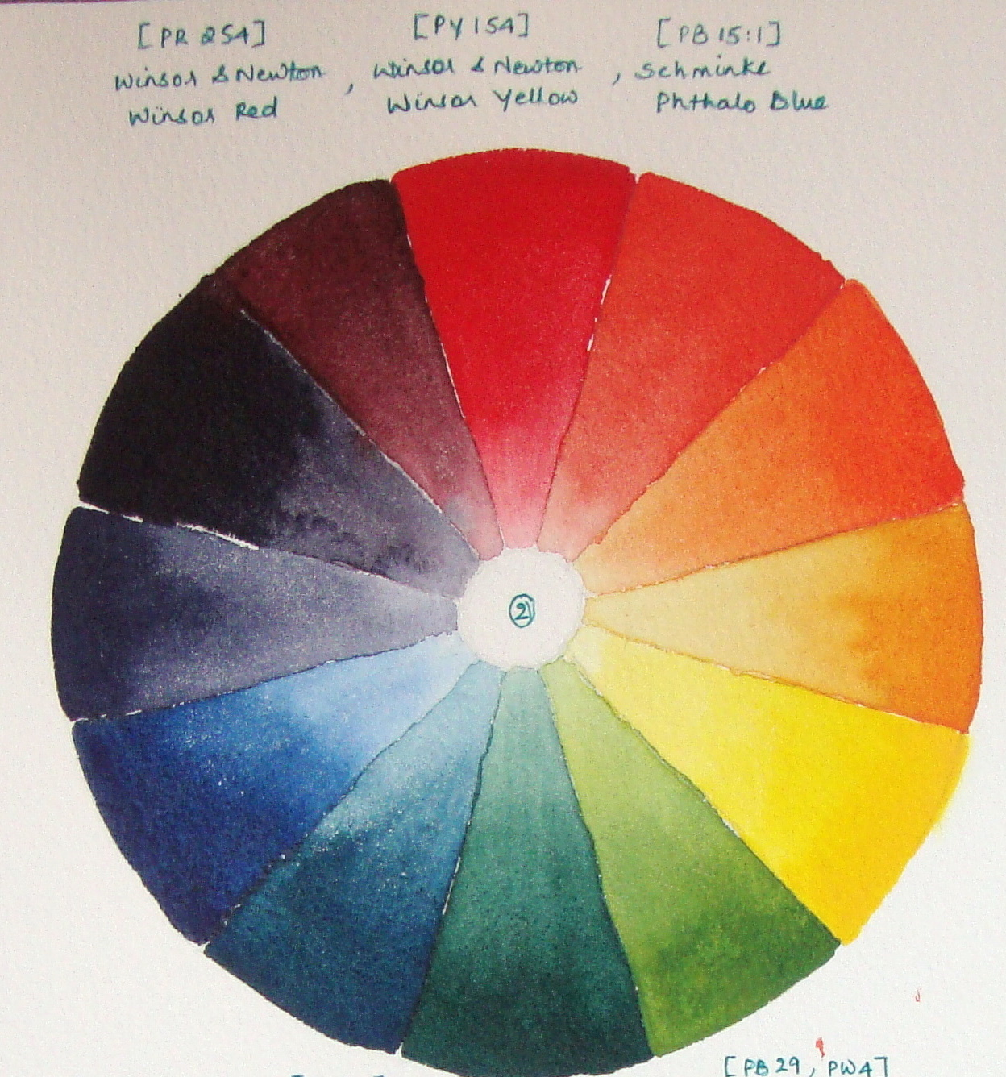
1st Color Wheel Resource: https://www.youtube.com/watch?v=FI2OYh9cn3Q

Slide 7
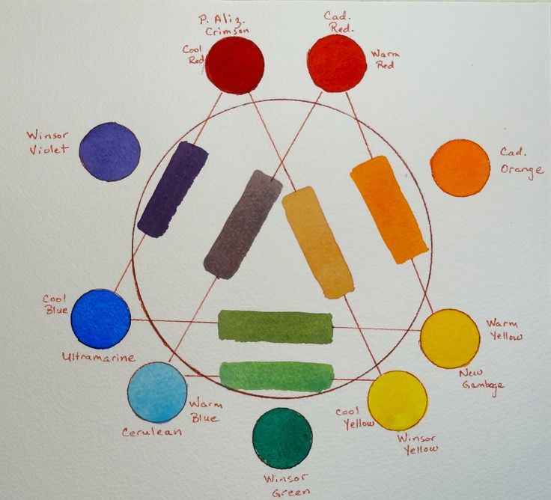
Second Color Wheel

Slide 8
Extra Time 10.9.2017
Complete any missing assignments
Monochromatic landscape
Fruit/Veggie Competition Painting
Utah Landscape Competition Painting
Anything else you are missing?
Have everything in and your grade is an A!
Free paint
Get some of the nice paper and enjoy painting ☺

Slide 9
Clean-Up
Brushes are your exit pass
Let’s give the tables a wipe down before we put up our chairs
Watercolors in the back open on the counter so they can dry out
Thanks! Enjoy your Monday, it looks nice outside today, enjoy it before it snows.

