Slide 1
Randomness
E.Lyon 2016 Art A

Slide 2
Bell Work 10.9.2017
Project Randomness for Term 1 Art A
On the next blank page in your sketchbook
When you hear the word balance, what do you think of?
What is balance in art?
Explain what your understanding of contrast is?
What is a composition in art?

Slide 3
last class
10.9.2017
We practice classical drawing skills
Notional space
Envelopes
Proportions
Masks were turned in on Tuesday
Reminder: you need to pay your art fee to the bookstore & show me the receipt before you can take your mask or any other art home

Slide 4
Agenda
10.9.2017
Some games to go with the art elements
Balance
Contract
What is the Randomness Project
Studio Time today - Sketching
3 sketches by the end of class, ideas for how your final will look
Exit Pass

Slide 5
Balance

Slide 6
Balance Game
you will need scratch paper for this,
something to write with,
and a partner!

Slide 7
Contrast

Slide 8
Contrast Game
You will need a new partner for this, a new piece of scratch paper and something to write with
write down an emotion
Have your partner come up with an opposite emotion, see how many of these you can get

Slide 9
How did that apply to art?
Let’s chat about the last game…

Slide 10
Now what…Do we know about:
-balance
-Contrast -Composition Review Bell Work

Slide 11
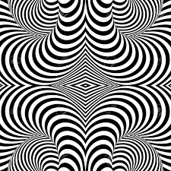
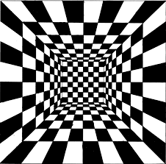
Randomness Expectations
Project #2 for Term 2 Art A
All these things need to be included in your project
➢ 6 cow spots
➢ 3 bulls eyes(targets)
➢ 4 areas with stripes
➢ Only use black and white
➢ 3 areas with checker board design
You can add anything else you want!
Questions?

Slide 12
Past student work
2016
A few examples of this project from the class website
www.classwithlyon.com

Slide 13
Days to work on this: 3
Project #2 for Term 2 Art A
Today - Monday
Next Class - Wednesday
Friday - Project #4: Randomness DUE at the end of class

Slide 14
Next class, continue working on Randomness Pro. #2. Review Shading techniques : stippling, cross-hatching, etc.

Slide 15
Exit Pass 10.9.2017
Project #4 for Term 1 Art A
After learning about contrast, what is your understanding of it now?
How would you describe balance in art?
What are you most excited about with this art project?
How many days do you have to work on it?
When is the last day to turn in late work?(hint it says on the board to the left)

