Slide 1
Painting Class Utah Landscapes Competition
10.3.2016

Slide 2
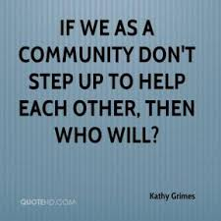
Find you Utah Landscape Painting
Please wait for instructions, before you get painting supplies
Thank you!

Slide 3
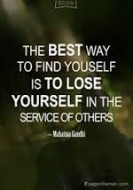
We are all part of a community
Areas of community:
School
Driving
Family unit
Friends
Social networks
Work

Slide 4
To remember we are all part of a community
Each table has something you need
You will need to ask the people at that table for the items you need
People at each table
Make sure people ask nicely for things, if someone grabs something don’t let them have it
When you return materials, make sure to say thank you
Do not accept items that are not clean, instruct the person to re-clean it

Slide 5
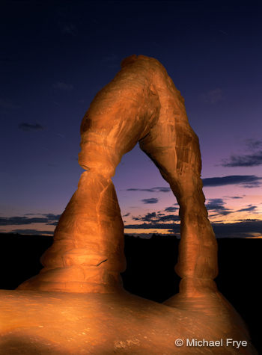
Utah Landscape Paintings
Layer your painting, add more than one layer to every part of your painting
Back ground, middle ground, and fore ground
Remember the techniques we used in class (if you need a reminder get your techniques out, from your folder or the stack of paintings by the door)
DUE by the end of class

Slide 6
Clean-Up & Next Class – last 5 min. of class
Clean – Up
Tables make sure you get everything back clean, if something is not clean, don’t give it out
Thank you!
Next class
We will start class with a tag critique make sure to be here on time
See you all Wednesday

