Slide 1
Day 1 of 3 Silent Film
E. Lyon 2014

Slide 2
Do Now 10.1.2014
Sit with your groups
If it says you can go film
Take role
Write down where you are going
Wait for instructions
If it says you need to fix your storyboard
Fix it and then follow the steps above

Slide 3
Reminders
We all need reminders…
Here are a few filming reminders before you go out and film

Slide 4
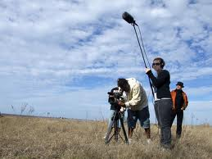
Filming
Stay together
Use a tripod
Review shots
Film in 1080p
Film only people in your group(ignore the hall wonderers)
Use as many creative shot styles and angles as you can
(you need 5 or more)

Slide 5
Working with your group
You are stuck together, it’s like family, so work out your differences and focus on the film
Review your storyboard to remind yourself what your film is about

Slide 6
Silent Film
Be thinking of songs or sound effects to go with your film
you could write your ideas on your storyboard while you are filming, so you don’t forget
If you want you can quietly play the song while filming to make sure the timing is right
Lastly:
We have 3 days to film, 3 to edit(you can check out the camera) or edit sooner if you get all your footage

Slide 7
Film!
Go out and film!
Write down where you are going
Your folder is your hall pass
Get a camera, write the number down and grab a tripod
Make sure Mrs. Lyon can find your group

Slide 8
Exit Pass 10.1.14
1) Rate yourself on filming
2) Explain why you gave yourself that rating for filming
3) Rate yourself on working with your group
4) Explain why you gave yourself that rating for working with your group

