Slide 2
Linoleum Block Prints
Art B
Mrs. Lyon

Slide 3
Study Hall 1.31.2017
Advisory Class – work one something to earn your points for the day:
Read, write, work on homework, study, organize your bag
DO NOT get on your phone and WASTE your time
Art Students
Work on your art, clean up 5 min before the bell rings @ 11am clean-up THANKS!

Slide 4
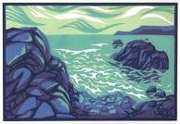
Day 1 Bell Work
1.31.2017
What is a linoleum(lino) block(guess)?
What is negative space?
What is positive space?
When you print one image on top of another, will the image in the background show all the way or not, please explain your answer?
*IDK IS NOT AN ACCEPTABLE ANSWER!!!
Guessing get’s you more places than not guessing

Slide 5
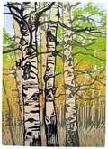
Agenda 1/31/17
Bell work – review: with class
What is this assignment?
Library/Phones/Ipad/Computer
email and print
Sketch
Studio Time
Final sketches for lino-block due next class Thursday

Slide 6
FYI
Projects have been graded
If you need to finish your project, come in after school or get a travel pass from me
Or take it home and finish it
Bell Works and Exit Passes from your sketchbooks will be added later this week
You don’t get docked points for turning work in late, but your grade will be ugly and we will move on with projects

Slide 7
What is a Linoleum Block Print?
A Linoleum Block Print is an art media/medium & printing method.
The artist carves a linoleum block creating an image with positive and negative space to be printed.

Slide 12
How is it done?
During video answer the following:
1 – What is the first step?
2 – What is the artists second step?
3 – When the artist carved the block what will print and what will NOT show up on print?

Slide 13
How is it done - Video
http://www.youtube.com/watch?v=WmLd4O2ROJo

Slide 14
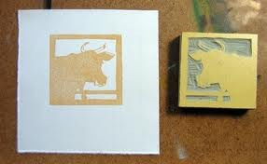
Negative and Positive Space What do you want to print and not print?

Slide 15
Where do we start?
Objective 1
Find an image or idea that you would like to print.
email it: lyone@ogdensd.org

Slide 16
Looking Up Images
email: lyone@ogdensd.org
Look up images and print off one page
Think of something you want to make a lot of!!!
Your piece will need to be:
Balanced
Have a texture to it(see the cut marks)
A variety of lines
Good use of positive and negative space

Slide 17
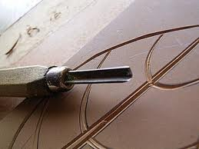
Carve a block

Slide 18
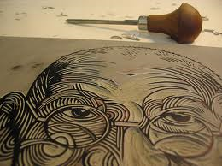

Slide 19
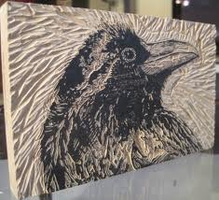

Slide 21
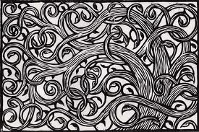
Monotone=one color

Slide 22
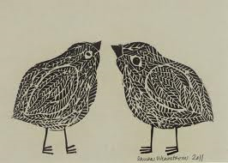

Slide 24
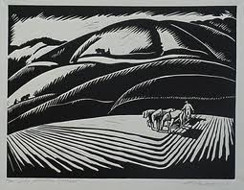

Slide 25
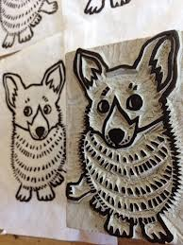
Prints backwards

Slide 28
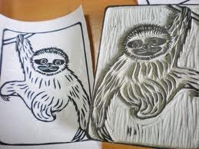

Slide 29
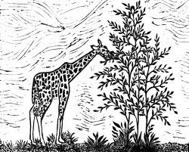

Slide 31
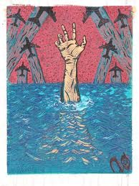

Slide 32
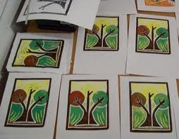

Slide 33
Process Choices
Front and Back prints
Reductive Process – print once, carve again and print on top
Negative and positive space reversal
The more detail with lines and movement you create make your print more interesting

Slide 34
Looking Up Images
email: lyone@ogdensd.org
Look up images and print off one page
Think of something you want to make a lot of!!!
Your piece will need to be:
Balanced
Have a texture to it(see the cut marks)
A variety of lines
Good use of positive and negative space

Slide 35
1/31/17
Exit Pass
1) What are you most excited about this project?
2) Any concerns you have about this project or worries?
3) When are you final sketches due for this project?
4) How many sketches do you need to have?

Slide 36
Next Class

Slide 37
Safety Test
What direction do you cut your lino-block?

Slide 38
Quiz and sketch
Complete the quiz, you have to get a 100% in order to use the carving tools
You can take it as many time as you need to in order to pass
When you are done with the quiz, sketch!

Slide 39
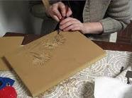
Away from you
And away from other people

Slide 40
What tool other than a gouge do you use to cut your lino-block?

Slide 41
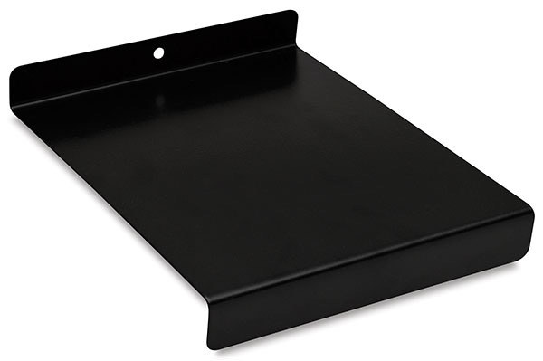
Bench plate
You always have to have a bench plate under what you are cutting

Slide 42
If you get cut, what should you do?

Slide 43
Put pressure on the cut
Walk over to the sink
Rinse it off with water
Put a paper towel over it
Get a Band-Aid from the back counter
Please tell Ms. Filiaga if you cut yourself

Slide 44
If you break a gouge tip, what should you do?

Slide 45
Accidence happen,
Tell Mrs. Lyon and she will give you a new gouge tip
If people break more than a few gouge tips, then we will wonder if it’s not an accident

Slide 46
What do you have to do to earn your lino-block?

Slide 47
You need to get a perfect score on this test
You can take the test as many times as you need to in order to pass

Slide 48
How many lino-blocks do you get for this project?

Slide 49
Everyone gets only one lino-block

Slide 50
What’s next?
Once you pass your test
Sketch(turn in to get lino block)
Carving
Printing

Slide 51
Studio Goal
Complete your two sketches for your block
Make them the size of your block so you can transfer the sketches to the lino-block next class
Think about what area you want to carve out and what area you want to leave so it will take the ink in order to print

Slide 52
One Image on top of the other = 2 blocks to print from

Slide 53
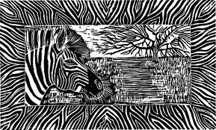
You could add a boarder

Slide 54
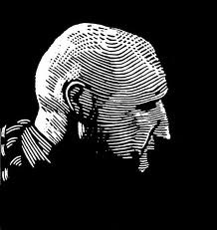
Think about the direction you carve your line to give it shape

Slide 55
Exit Pass 3/5/2013
How do you think you did on the test?
Was the test easy or challenging for you, WHY?
Is the project clear to you or is there something you don’t understand? What questions could you ask to understand the project better?
* See you next class *

