Slide 2
Bell Work 1.28.2015
1) What are some assumptions that are made about teenagers?
2) Why do you think people make these assumptions?
3) What do you already know about the human brain?
4) When is your brain fully developed?

Slide 3
Agenda 1.28.2015
Bell Work
Agenda
Review Bell Work
Some facts about the teenage brain
So why would we learn about the teenage brain in art class?
Exit Pass

Slide 4
Talk as a Group - Share Responses
1) What are some assumptions that are made about teenagers?
2) Why do you think people make these assumptions?
3) What do you already know about the human brain?
4) When is your brain fully developed?

Slide 5
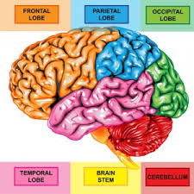
Human Brain

Slide 6
Brainstorm: The Power and Purpose of the Teenage Brain By Daniel J. Siegel, MD

Slide 7
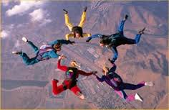
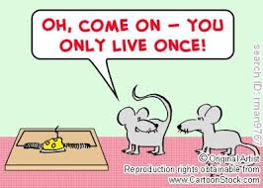
Risk Taking

Slide 8
A search for the new and novel.
This byproduct of an increased power in the brain's reward circuitry creates a natural urge to explore the world, to try new things and ways of being. While the downside can be taking dangerous and impulsive risks, the upside is being open to change and a sense of adventure.

Slide 9
A need for social connection.
The teen years are marked by the importance of friendships. If teens become too isolated from the adults in their lives, this can increase risky behavior. But the ability to make strong friendships predicts well-being and satisfaction throughout life.

Slide 10
Intense emotions.
Life quickens, becoming more vital. While this can mean moodiness and over-reactivity, this intensity creates immense energy and a zest for life.

Slide 11
Creativity and curiosity.
This openness to the new combines with the teenager's acquisition of reasoning, abstract thinking and a creative bent. While this can sometimes lead to a crisis in identity or lack of direction, the upside can be out-of-the-box innovative thinking and creative exploration of life's possibilities.

Slide 12
Studio Time 1.28.2015
Learn about acrylics at the back table
Mixing paint and using water, what surfaces are good to paint on
Work on Project #3 it is DUE next Thursday!
AP – work on your concentration, when you are done with a piece, take a picture of it and fill in one of your squares

Slide 13
Exit Pass 1.28.2015
1) What is one thing you learned about the brain?
2) Artists need to know a lot about different things, why do you think that is?
3) When is project #3 due?

