Slide 1
Day 1 Storyboards
Film 1
E.Lyon

Slide 2
Bell Work 1.27.2016
Think of your favorite film, describe how the storyline goes?
What were all the shot styles we did on the first day of class? (hint: there were 6, if you need to draw them out you can do that instead of naming them)
Get ready for a shot styles review and a storyboard video
Permission slips, disclosures, turn them in! Thank you!

Slide 3
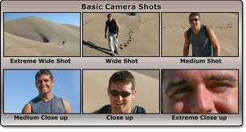
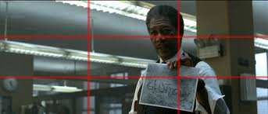
Shot style review

Slide 4
Reminders
Do the exit pass, some people are forgetting to do it at the end of class and write your name on it
If you miss the bell work, do what you can to make it up(ask a neighbor, look it up on the class website – www.classwithlyon.com)

Slide 5
Storyboard Video
Be ready for a quick YouTube video about shot styles and storyboards
http://www.youtube.com/watch?v=mYVrz5KreZc

Slide 6
Parts of a storyboard
Title of your film
Names of group members
Day you start the storyboard and the day it is due
Shot #
Where
Sounds
Shot Styles
Who

Slide 7
Grading of storyboards
You need a 100% on your storyboard before you can go film
That means you need to include all the parts of a storyboard
If you don’t have a plan of what you are going to do when you go out to film, how do I know you will actually be filming?

Slide 8
Rubric for your film!
All the people in your group need to be in the film!
At least 4 things/facts about each person
3 or more of the shot styles used!
The story needs a beginning, middle, and end
Title page, credits, transitions
Obviously…none of that ‘stuff’ we can’t film

Slide 9
Examples from past students
Start storyboarding your film ideas from last class….
Let’s watch some examples from past students(not the ones we watched last class)
Be ready to write any ideas you have down while watching the example videos

Slide 10
Complete storyboards
Turn in storyboards next class
Include:
Shot styles
A picture or descriptive words of what’s happening in the scene

Slide 11
Reminder of your time frame
Storyboards due next class at the end of class
Film – 2 days
Edit – 3 days
Watch films in class & critique

Slide 12
Exit Pass 1.27.2016
What does a storyboard need to include in it?
What is due in class on Friday at the end of class?
How many days do you have to film?
How many days do you have to edit?
See you all next class! Field trip for Sundance tomorrow, bus leaves at 8:10am!

Slide 13
Productions Crew 9.3.2015
Edit today
Hero points video – so we can add to announcements next week
Anything else to edit?
Announcements for next week…film today?
Other videos that we want to work on
Edit/Film
Healthy relationships contest?

Slide 14
Advisory
lesson

