Slide 1
Art B Day 1, Project 1
Ms. Filiaga

Slide 2
Bell Work 01/22/2014
Fill out on index card at your table :
Name
Class period
What motivated you to take Art B?
What do you expect to learn in art?
What grade do you aspire to earn in this class?
What is the best way to contact your parents? Email? Phone? Please write one down for your parents

Slide 3
How to write your bell work:
Name: Ms. Filiaga
01/22/2014
Bell Work
1)
2)
3)
4)

Slide 4
Complete Answers
What is not a complete answer:
IDK
Yes
No
Hum…
?
Text language/spelling
Complete answers:
Explains and supports your ideas
Are in a full sentence
Use proper spelling and grammar, the best of your ability

Slide 5
Why are we doing what we are doing today?
Bell Work
Break down
Who is Ms. Filiaga?
Heads up
Disclosure - Portfolios & planners & point break down
Activity
Project 1
One point perspective
Studio time
Exit Pass
Questions?

Slide 6
Who is Ms. Filiaga?
Student teacher
Earning my Master’s in Education right now, so going to night classes
Enjoys fitness, teaching, Coaching, and traveling.
New to BLHS this school year 2013-2014:
Background
Grew up in the Ogden area
Went to Weber State and earned a degree in secondary education. Majored in Art and Minored in Physical Education.
Also competed as a WSU Track Athlete for 5 years.

Slide 7
Heads Up – Save Your Work All in One Place!
Art Portfolio
Look like saving all your work in one place
Being organized
Keeping track of your progress and what you want to work on in relation to your art
Why?
College portfolio
Achieve work
Online portfolio in Google Docs
Still going to keep in class folders for larger works

Slide 8
Planners
Bring your planner every day to class
Write in projects at the beginning of the week
Keep track of what we are doing in class and when it is due
*Some days your planner will be worth extra credit, so be ready!

Slide 9
Activity
Need to move all the tables & chairs to the side of the room.

Slide 10
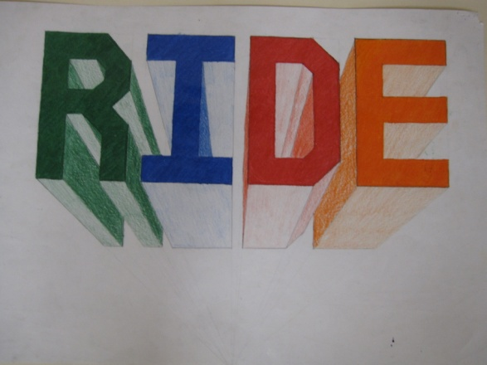
Art B, Project 1
One point perspective
In class activities about how to create one point perspective with objects
Your name in one point perspective or a word
School appropriate words only
Shadow perspective
1st draw in pencil
2nd shade with color pencils
Rubric next class

Slide 11
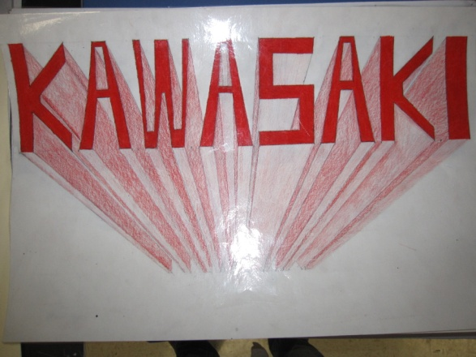
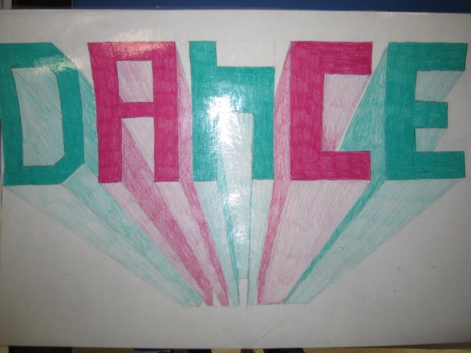
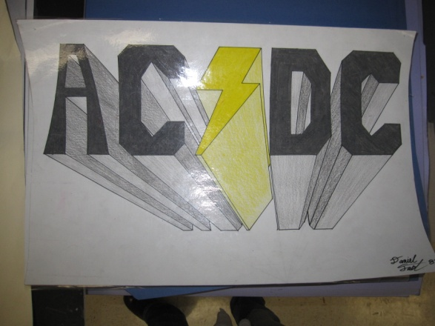
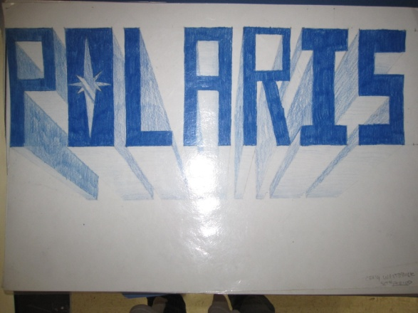
Student Examples:

Slide 12
Activity: One Point Perspective
Copy and do
Everyone needs to have a ruler, or share
Use a pencil or pen
Eyes on the board
Raise hands if you have questions
Ready?

Slide 14
Studio Time
Start one point perspective drawing of name or word
Start in pencil
You may do a rough draft or start on your final
Only one final piece of paper per person
Final paper is at the front table
Question?

Slide 15
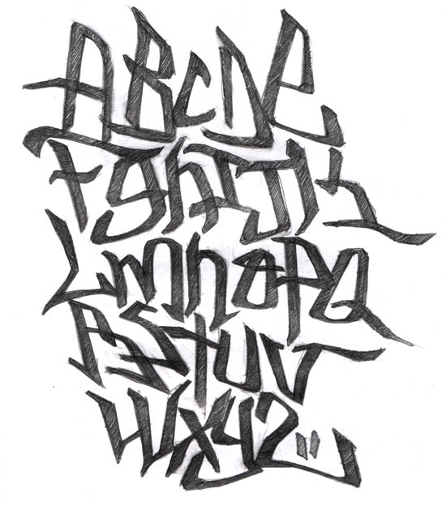

Slide 16
Point Break Down in Art B
5 = bell work
5 = participation points
10 – 15 = in class activities
50-60 = projects
100 = final project
5 = exit pass

Slide 17
Next Class
Bell Work: Tick-Tack-Toe game
In class activity:
Shading
Studio time:
Project 1: Name/Word in One Point Perspective
Exit Pass
Class disclosure statement
Art Fees

Slide 18
Format for Exit Pass
Set this up the same as the bell work
Turn in at the end of class, to be written on the bottom of your bell work

Slide 19
Exit Pass 01/22/2014
How many points is bell work worth?
How many points are in class assignments worth?
What is one things we are doing next class, besides bell work and an exit pass?
Please explain what your ideas are for the next assignment? Feel free to draw a quick sketch of your ideas.
See you all next class!

Slide 20
Day 2

Slide 21
Bell Work
Get a half sheet of the scrap paper at your table.
Write your name and Perspective Bell Work Day 2 at the top of your half sheet.
Draw and label a horizon line and vanishing point.
Draw a circle below the horizon line.
Now wait for further instruction.

Slide 22
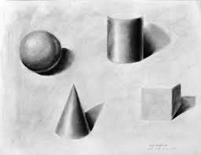
Shading a shape
Things to be aware of:
Where is the light source?
The value/shading should graduate in darkness on your shape away from the light source.

Slide 23
Studio Time
Studio Time is your time to finalize your choice of word for your One Point Perspective Project.
Decide whether you want to use Color pencil or Shading Pencil as your medium.
Get your paper from Ms. Filiaga
Don’t forget to space out your letters evenly on your page. Ms. Filiaga will be around to help you with that.

Slide 24
Exit Pass
Name one thing that I Need to bring to class and give to Ms. Filiaga ASAP?
How much is your Art Fee?
What is something we will be doing next time in class?

