Slide 1
Day 1 Storyboards
Film 1
E.Lyon

Slide 2
Bell Work 1.23.2015
Think of your favorite film, describe how the storyline goes?
What were all the shot styles we did on the first day of class? (hint: there were 6, if you need to draw them out you can do that instead of naming them)
Get ready for a shot styles review video

Slide 3
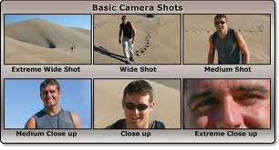
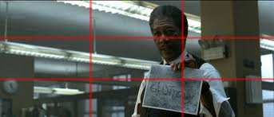
Shot style review

Slide 4
Reminders
Do the exit pass, some people are forgetting to do it at the end of class and write your name on it
If you miss the bell work, do what you can to make it up(ask a neighbor, look it up on the class website)

Slide 5
Shot styles review
Be ready for a quick YouTube video about shot styles and storyboards
http://www.youtube.com/watch?v=mYVrz5KreZc

Slide 6
Parts of a storyboard
Title of your film
Names of group members
Day you start the storyboard and the day it is due
Shot #
Where
Sounds
Shot Styles
Who

Slide 7
Grading of storyboards
You need a 100% on your storyboard before you can go film
That means you need to include all the parts of a storyboard
If you don’t have a plan of what you are going to do when you go out to film, how do I know you will actually be filming?

Slide 8
Rubric for your film!
All the people in your group need to be in the film!
At least 4 things/facts about each person
3 or more of the shot styles used!
The story needs a beginning, middle, and end
Title page, credits, transitions
Obviously…none of that ‘stuff’ we can’t film

Slide 9
Examples from past students
Start storyboarding your film ideas from last class….
Let’s watch some examples from past students(not the ones we watched last class)
Be ready to write any ideas you have down while watching the example videos

Slide 10
Complete storyboards
Turn in storyboards(next class, we’ll see how the time goes)
Include:
Shot styles
A picture or descriptive words of what’s happening in the scene

Slide 11
Reminder of your time frame
Storyboards due next class at the end of class
Film – 3 days
Edit – 3 days
Watch films in class & critique

Slide 12
Exit Pass 1.23.2015
What does a storyboard need to include in it?
What is due in class on Tuesday at the end of class?
How many days do you have to film?
How many days do you have to edit?
See you all next class! Enjoy your weekend

Slide 13
Productions Crew 1.23.2015
3rd Period 10:15 – 11:25 a.m. (70 minutes)
Announcements – for next Wed.
Edit today, finish on Tuesday
Include:
HERO footage
FAFSA adds, what we have so far
FBLA footage
Diversity Film footage
Anything else…Griffin intro.

Slide 14
Film 2
4th Period 11:30 –12:40 p.m.(70 minutes)
Complete storyboards and turn in by the end of class
Fill out the storyboard check list to make sure you have everything in your storyboard
Video, reminder about storyboards creation
Get permission slips for Sundance, turn in next class

