Slide 1
Bell Work – write on the index card 5 min. 1/14/2015
Your name: first and last & class period
Your grade level
What do you want to learn about in film making?
What do you already know about film making?
What is your favorite movie? & Why?
Contact name & number for parent/guardian to tell them something great!
When you are done, please wait for others to finish.
Thank you!

Slide 2
Agenda 1/19/2016
Bell Work
Agenda & Essential Question
Who is Mrs. Lyon & Griffin?
Who are the students?
What is this class?
Disclosure, calendar, etc.
First assignment – 7 shot styles
Exit pass

Slide 3
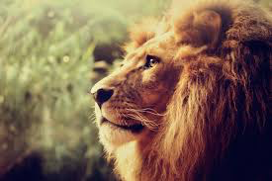
Who is Mrs. Lyon?

Slide 4
Professional Artist
www.ericalyonart.com
Three art shows up right now:
in Ogden
The Front – climbing gym
Café Mercantile – 26th St.
in Eden
Eden Spa – on other side of mountains
In Park City
The Mine – bouldering gym

Slide 5
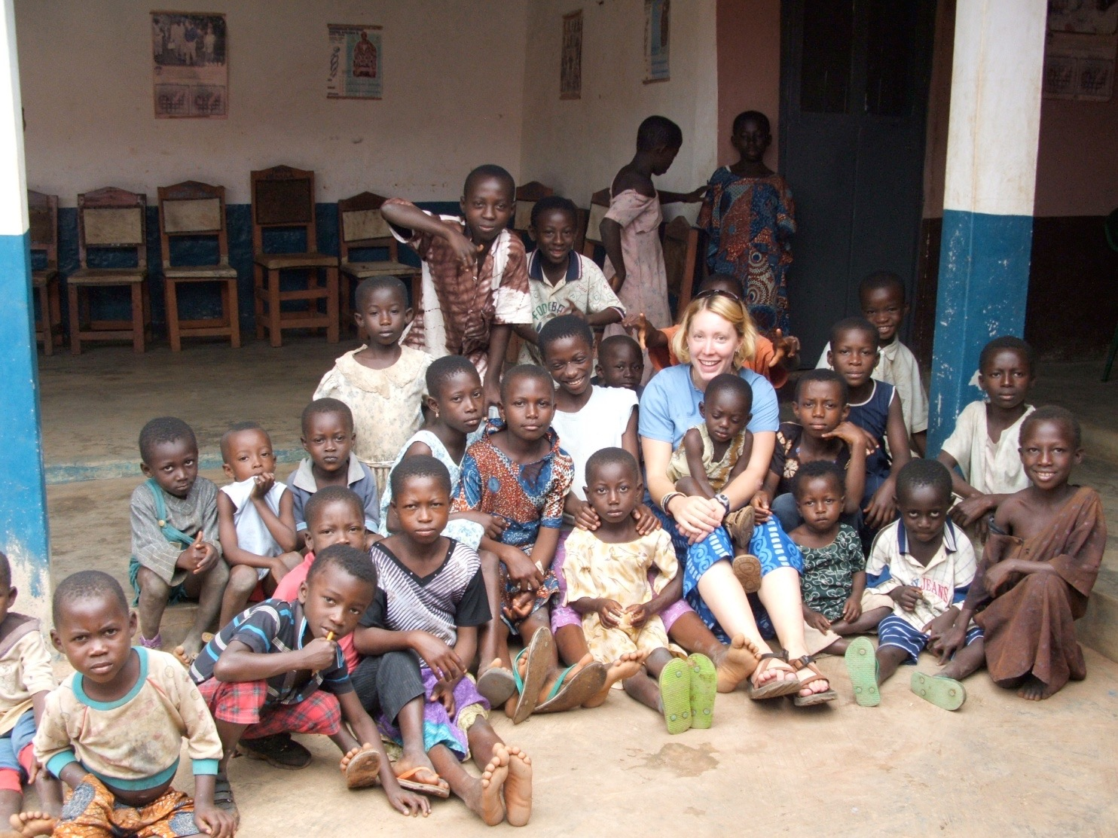
Lived in Ghana, West Africa for 2 years teaching art to Deaf students

Slide 6
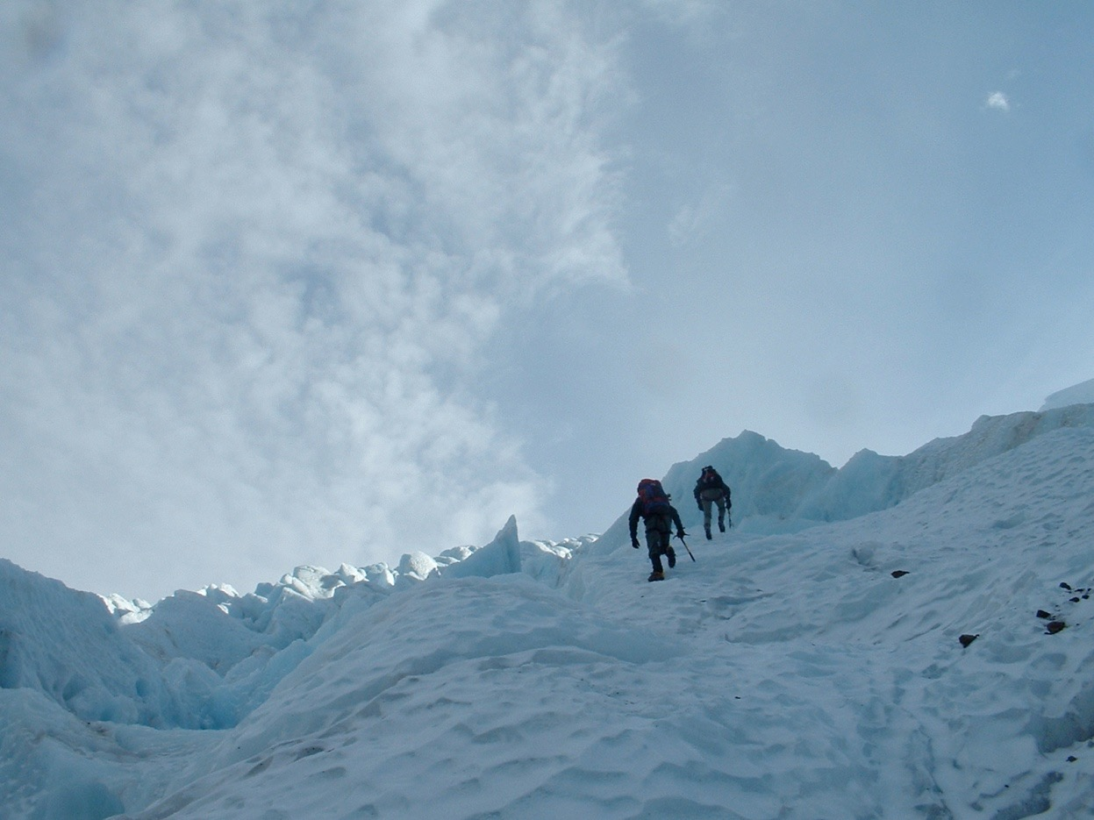
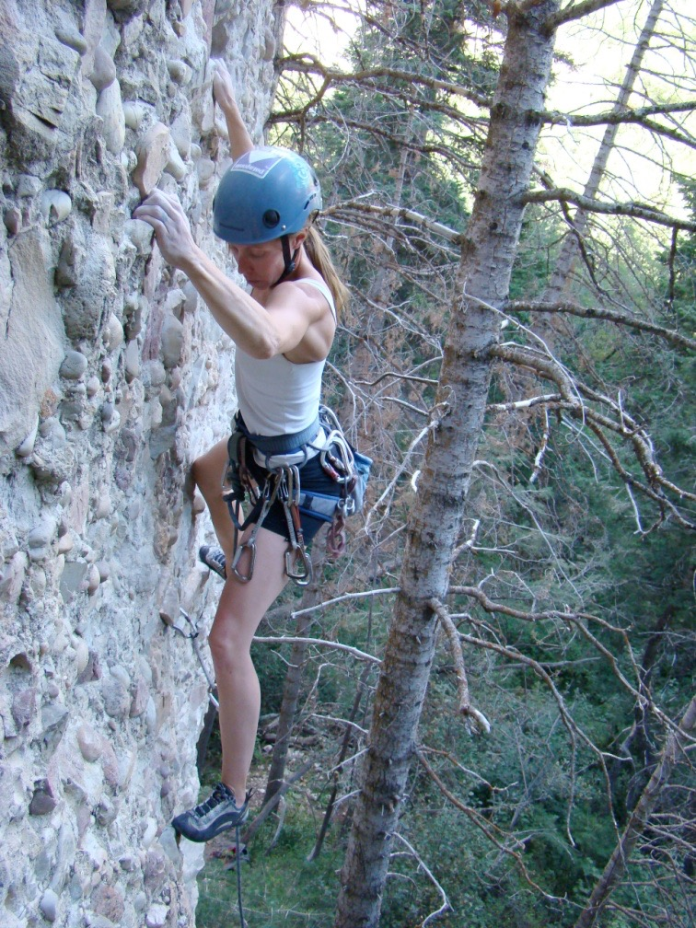
Climbing!

Slide 7
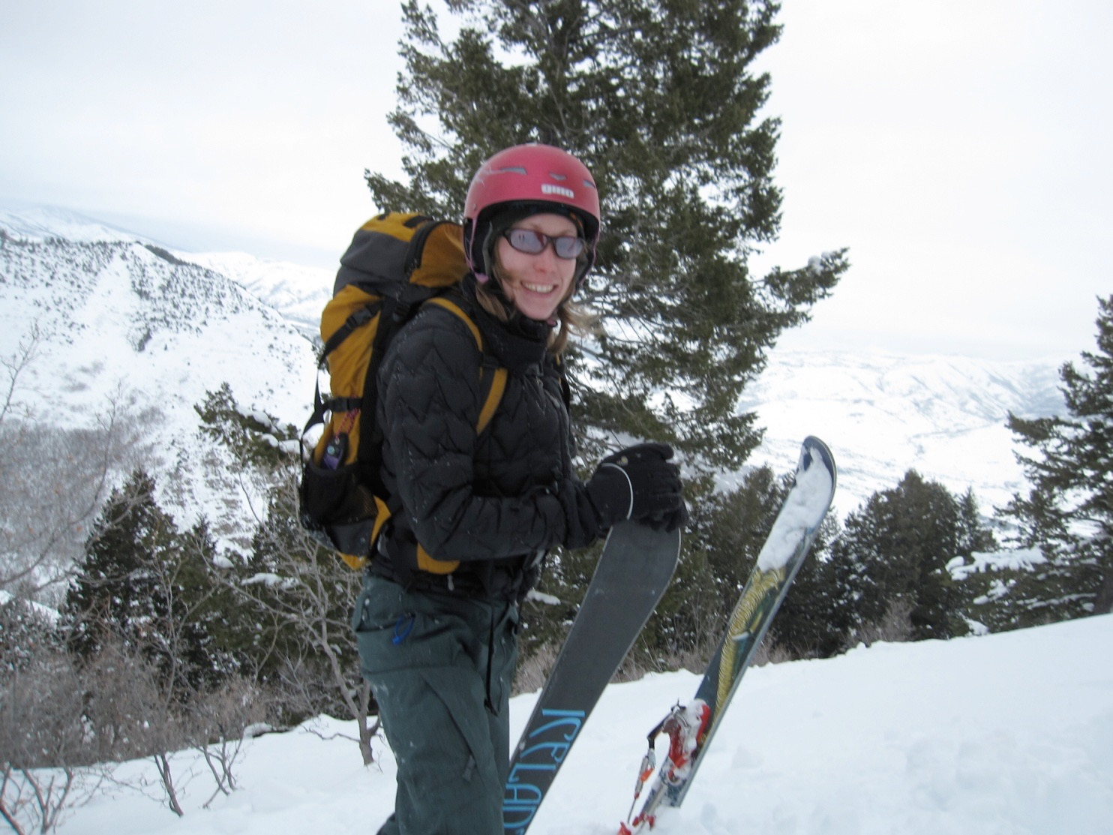
Backcountry Skiing

Slide 8
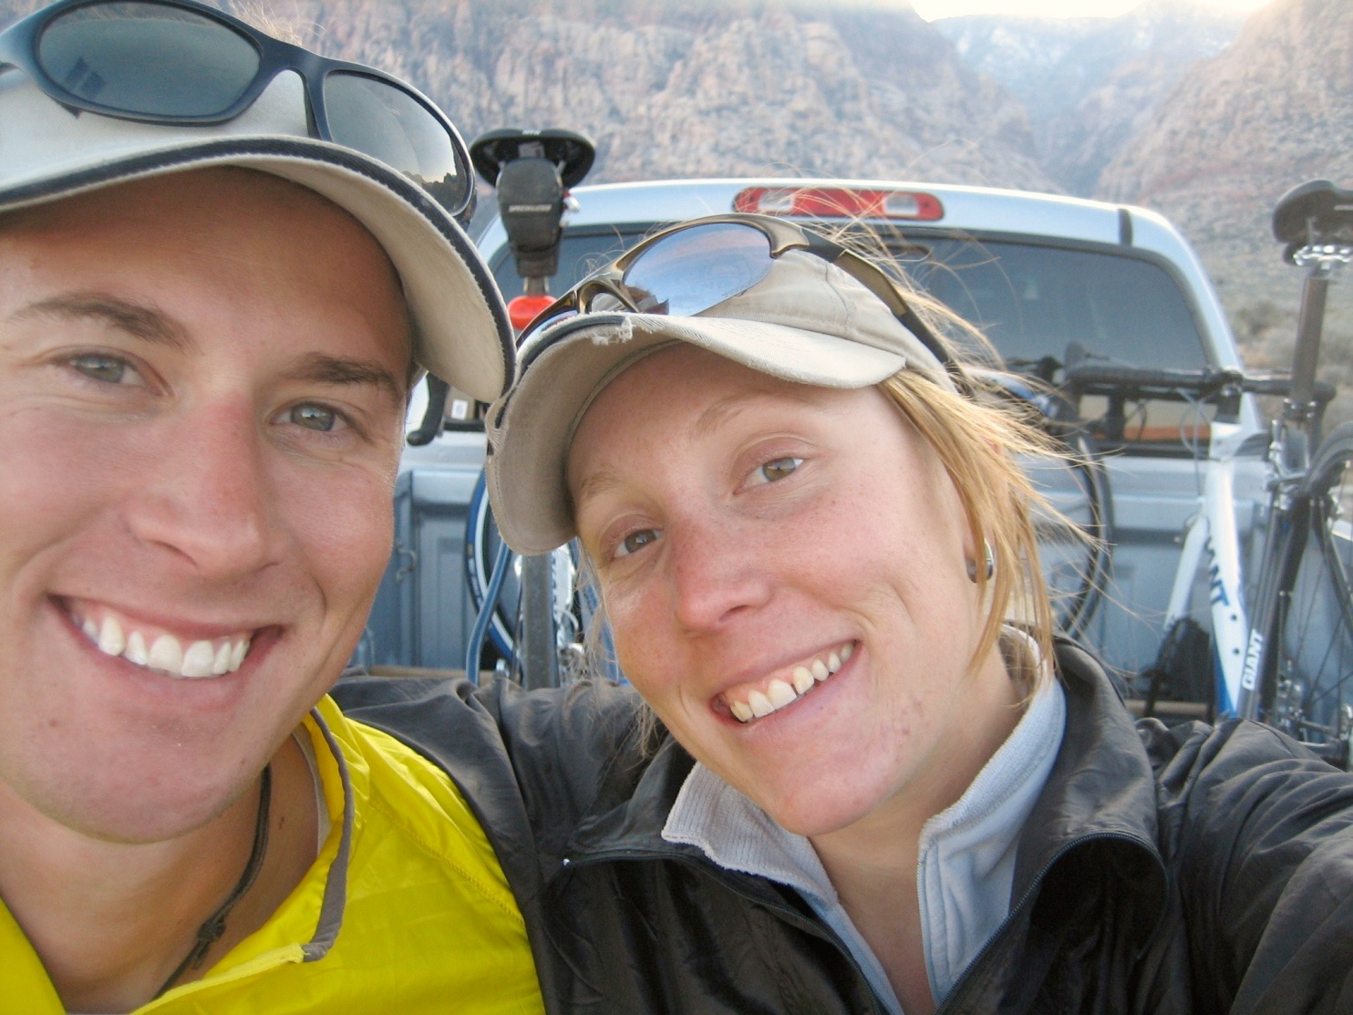
3 Ironman's completed!
2.4 mile swim, 112 mile bike, and 26.2 mile run

Slide 9
Mrs. Lyon’s Teaching Thoughts about film class
Learning needs to be fun, challenging, and applied
Everyone and thing has value, treat it as such
Group work is essential in film
Working with computers and being on camera is part of film class, get used to it

Slide 10
lyon’s faults
It’s challenging for me to spell
It take me a few months to memorize names
I am a driven person and want the best for all of you, so I care too much

Slide 11
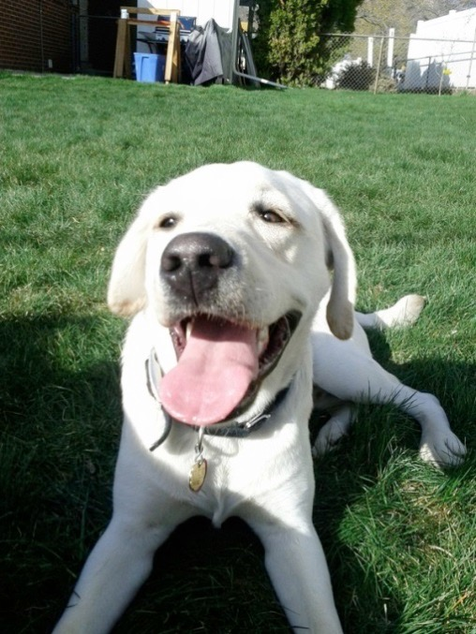
Griffin
Therapy dog ☺
No food, candy, or drinks in class
Let him chill on his matt in the back
During editing and filming he will be walking around
Greeting people at the door daily
No whistling or calling his name - thanks

Slide 12
Who are all of you?
Activity:
Share at your table answers at your table(5-10 min.)
Figure out what you all at your table have in common, it’s got to be something that is not obvious(example: we all know you are in the same class, that you go to BL, we all can see what you look like, etc.) Make sure to tell use something we wouldn’t know if you didn’t tell us
Write your response on the whiteboards at your table, with the dry erase marker.

Slide 13
Somethings to take note of in the classroom…
Calendars - Sundance!!! - permission slips next class
Disclosures - get signed and bring back = extra credit
Recycling
Everyone will have a file folder for all their papers
Tables and chairs - we move, they move
Hall Pass - next class(no hall passes today)
Not during the 1st 10 min. or last 10 min. of class
Only 3 per term, must sign back of planner
Website! – www.classwithlyon.com & Remind app(sign-up)
(5-15 min)
Questions?

Slide 14
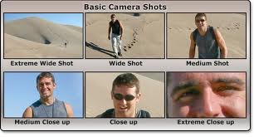
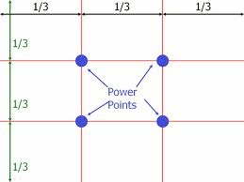
7 Shot Styles

Slide 15
Mini-Project
Shot styles – cheat sheet
Everyone must get 100%
You will need a partner
1 min. to find one
Be ready to go out in the hall
Stay with your partner
You will get a camera

Slide 16
Class Routine Each Day
Bell Work - BW
Essential Question - on the board
Agenda
Lesson - videos, filming, storyboarding, editing, notes, etc.
Review
Exit Pass
FYI: 3 mistakes in each presentation, extra credit if you find all three

Slide 17
Last few Minuets of Class 1.17.2016
Exit Pass(to get out of class)
What was your favorite thing we did today?
What are you most excited about so far in this class?
On the back of the index card
Turn it in on your way out the door
Remember to take: Disclosure to Parents/Guardians to sign and bring back next class

Slide 18
Tag comments:
Activity:
Pick one marker color
Go around and answer the sheets
Take about 2-3 min. at each question
Estimated time 30-45 min.
Review comments to questions
Establish classroom expectations

Slide 19
Critique Short Films
If we have extra time…
Who are the characters?
What happened at the beginning of the film?
Middle?
End?
What did you like about the clip and why?

Slide 20
Disclosure info for next class
The next set of slides

Slide 21
Disclosure
Take a guess what the words mean on the disclosure.
Write it in on the top line
Take 5 min.
We will talk about this as a class and fill in the correct answers together

Slide 22
Studio Production
Anything you create in class

Slide 23
Higher-level Thinking
Create
Analyze

Slide 24
Film Making-Technology
Anything to create a film with

Slide 25
Art Criticism
Giving advice to peers on how to get better

Slide 26
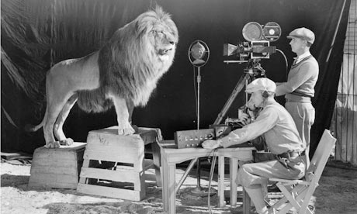
Art History
Past events in film

Slide 27
Aesthetics
The way something appears
Your opinion of beauty

Slide 28
Productions 1.17.2016
Announcements!
Add to it?
The advisory slip - can we get this done today?
New Production Crew Peps
Sundance - permission slips get signed

