Slide 1
Welcome to Art B Bell Work – 1.16.2018
Complete the paper your were given at the door – Art B Survey
When you are done there is space to sketch on the back
Thank you for waiting for others to finish

Slide 2
Agenda 1.16.18
Bell Work
Agenda & Essential Question
Who is Mrs. Lyon & Griffin?
Who are the students?
What is this class?
Disclosure, calendar, letter home, etc.
Two Book Covers!
Exit pass

Slide 3
Design Books! Goal: To complete two book cover designs by the end of class
Watercolor paints at a few tables
Markers at another table
Shading pencils
Colored pencils
Feel free to combine media(art materials)

Slide 4
While you are working…
Look up between slides
Please listen …. This info will be resourceful to you for the rest of the year.
Please work on your art

Slide 5
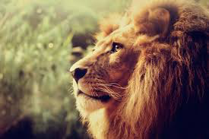
Who is Mrs. Lyon?

Slide 6
Professional Artist

Slide 7
www.ericalyonart.com
Upcoming & Current Shows :
in Ogden
Union Station Gallery – March 2018
Second Track Sports – 12th and Harrison
Gear:30 – downtown on Washington
Blooming Lotus Café – 25th Street

Slide 8
Lived in Ghana, West Africa for 2 years teaching art to Deaf students

Slide 9
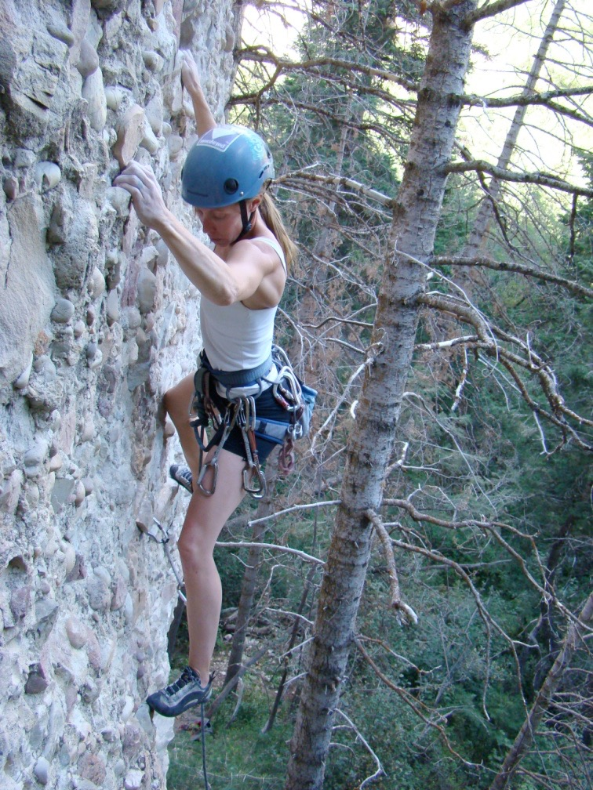
Climbing!

Slide 10
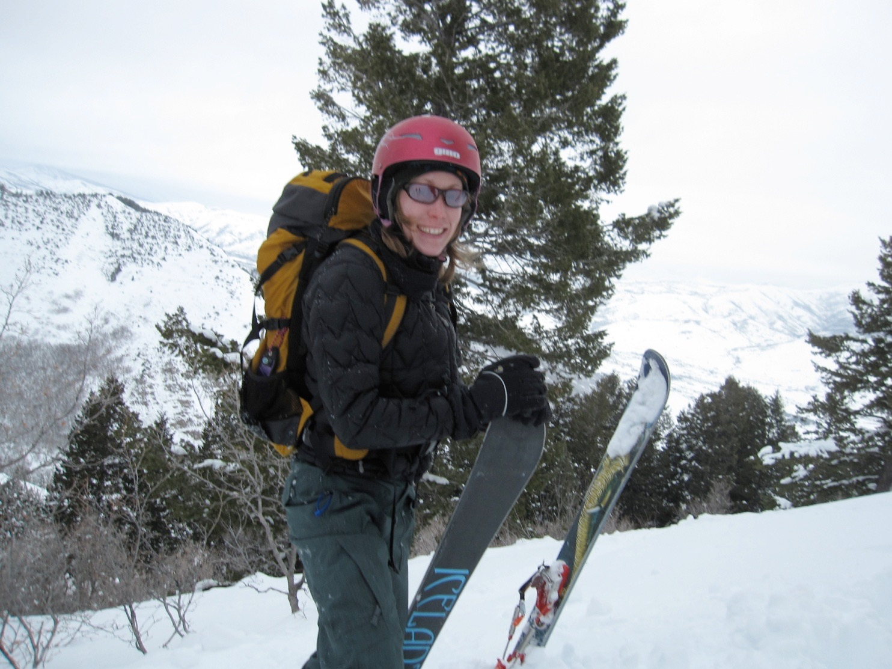
Backcountry Skiing

Slide 11
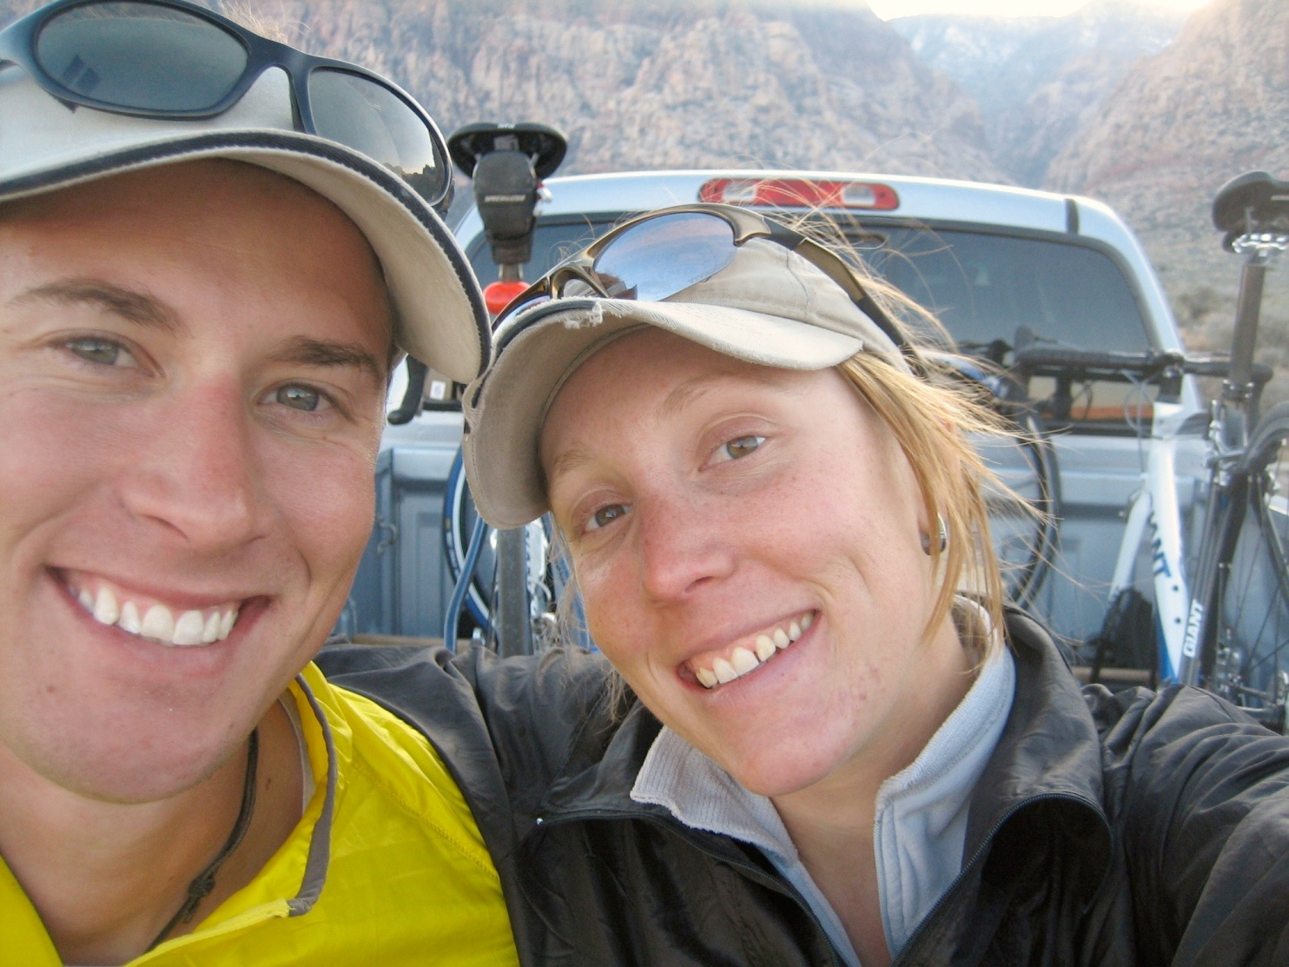
3 Ironman's completed!
2.4 mile swim, 112 mile bike, and 26.2 mile run

Slide 12
Love of my life!

Slide 13
Mrs. Lyon’s Teaching Thoughts about art class
Learning needs to be fun, challenging, and applied
Everyone and thing has value, treat it as such
Self-awareness is crucial in art, being able to take risks, and challenge yourself is key

Slide 14
Lyon’s faults
It’s challenging for me to spell
It take me a few months to memorize names
I am a driven person and want the best for all of you, so I care too much

Slide 15
What I Expect of Each of You
To be here everyday
Ready to learn
Learning means change, when you change you challenge yourself
Take risks!
In order to learn sometimes you have to try something again or try something new
Be your best self
You don’t become better in one day, you become better each day as you make small changes, then you become great!

Slide 16
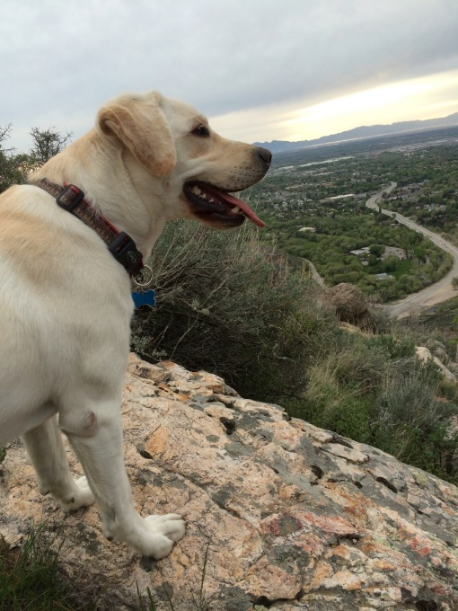
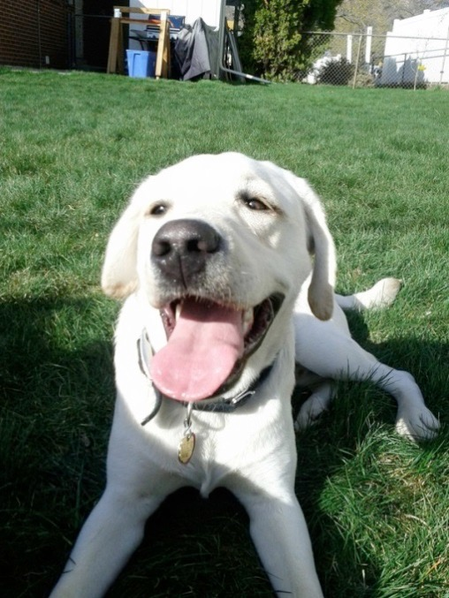
Griffin
Therapy dog ☺
No food, candy, or drinks in class
Only water
Let him chill on his matt in the back
During studio time he will be walking around
Greeting people at the door daily
No whistling or calling his name - thanks

Slide 17
Quick FYIs
Disclosures - get signed and bring back = extra credit
Recycling, sink, trash, paper towels, band aids
All art supplies you need for class will either be at your table, at the door to pick up or on the back counter
Everyone will have a file folder for all their papers
Tables and chairs - we move, they move
Art work will stay in your class folder
Hall Pass – you must have your planner to use them
Not during lecture, critique, or demo time, only studio time
Not during the 1st 10 min. or last 10 min. of class
Only 3 per term, must sign back of planner
Website! – www.classwithlyon.com
Questions?

Slide 18
Fun things
State Art Show – typically Studio and AP go, so keep taking art and get in studio next year
Art Shows ! –Art Gala(Feb.)
Festival of Arts – district wide art show!!! Spring Cash prizes and scholarship! Stewardship through Art Contest
Lots of other art contests throughout the year!

Slide 19
Class Routine Each Day
Bell Work - BW
Essential Question - on the board
Agenda, reminders, review last class
Lesson – demos, mini lectures, etc.
Studio Time! - Creating your art!
Review – what’s going to happen next class
Exit Pass

Slide 20
Next Class
Sew books and start first project
Contour line poetry
Be ready to draw next class
See you all tomorrow!

Slide 21
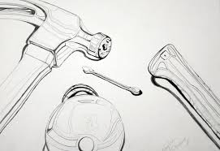
Contour Lines

Slide 22
Last few Minuets of Class 1.16.2018
Exit Pass(to get out of class)
Remember to write your name on the exit pass
What was your favorite thing we did today?
What are you most excited about so far in this class?
On a sticky note and slap it on the door on the way out
Remember to take: Disclosure to Parents/Guardians to sign and bring back next class

Slide 23
Advisory 1.16.2018
Grade checks(review last terms grades) – Wednesday(tomorrow)
Review goals, write goals for Semester 2, term 3!
Today:
Fire drill
Review:
Where do we go?
How do we line up?
What do you do if a fire happens between passing times, lunch, or during another class period that’s not advisory?

Slide 24
YouTube Example Videos
https://www.youtube.com/watch?v=oPM9FBPf7OU
https://www.youtube.com/watch?v=QiPT75pHL_8

Slide 25
Contour Practice
Cup
Doc. Camera demo
You will need a pencil and paper

Slide 26
Booklets and Rotations
Grab an object in the room
Fold a book with at least 6 pages
Contour rotational drawing

