Slide 1
Watercolor Techniques 5.0
E.Lyon

Slide 2
9.20.2018 Watercolor Techniques 5.0
Supplies:
Watercolor paints – the old ones from the drawer
Paper when you walk in the door – just one
Container with water in it
Round Brush & Flat Brush
At your table there is:
Rice – we will only be using a little and that’s all the rice we have for all the other class periods today
Watercolor pencils
Lemon juice – in a spray bottle
Chalk pastels
And table cleaner for when we are done

Slide 3
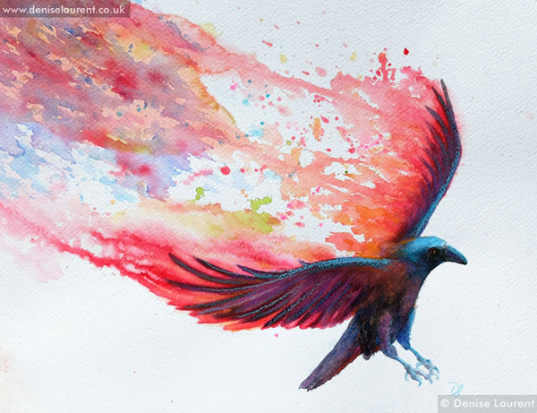
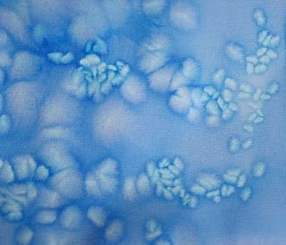
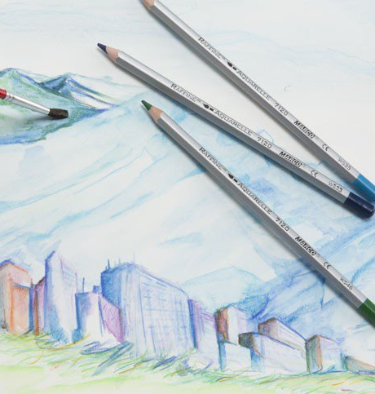
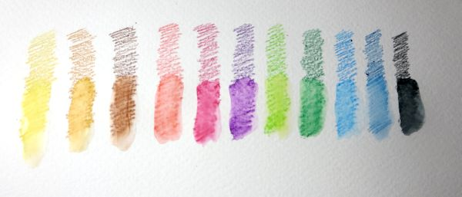
Techniques! 5.0
Rice
Lemon juice
Chalk pastels
Watercolor pencils

Slide 4
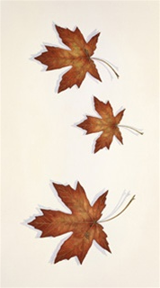
Clean-Up
Please put all supplies back where you found them on the tray
Paintings on the drying rack
Take tray to back counter, trade out with new watercolor palettes
Find leaf painting in folder
Finish leaf painting with dots(add more orange and red tones)
Add leaf paintings to drying rack

Slide 5
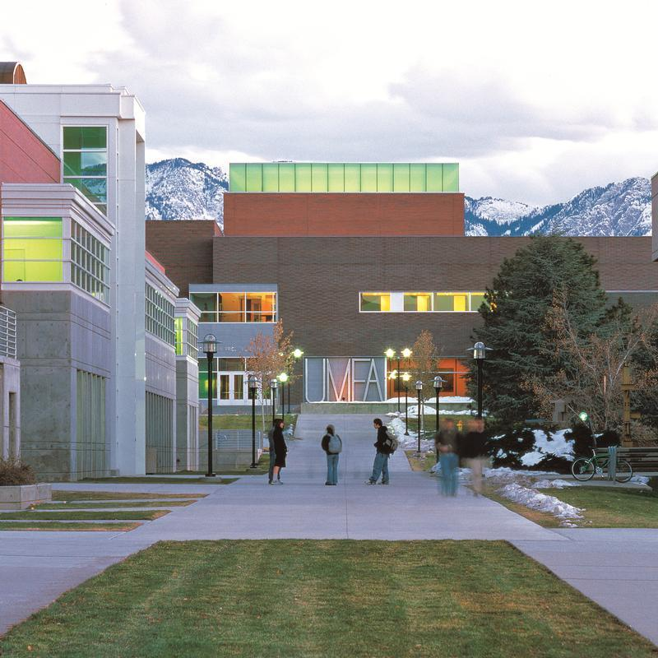
Drawing/Painting 3 9.20.2018
Guest Speaker from Utah Museum of Find Art(UMFA)
Ms. Baisley
Did you remember your signed permission slip?

