Slide 1
Water-soluble pencils
11.19.2019

Slide 2
1st & 2nd Self-Portrait 11.19.2019
Find your 1st self-portrait in your hanging file
If you came into the class later or missed some days at the beginning of the year, you might not have one ☹
Find your 2nd self-portrait – on the cart
If you didn’t turn it in, it might be in your bag or the hanging file
You will need to reflection sheet to compare the two portraits today
After you are done, turn in both portraits with your reflection sheet
If you are turning in your 2nd self portrait for the first time, please make a note on your comparision sheet, so it alerts me to make sure to grade it – thanks ☺

Slide 3
Agenda
Self Potraits Review both and reflect on our growth
Time for an art break from serious drawing – experimenting with watersoluable graphite!
Two drawings – one on watercolor paper and another on tracing paper

Slide 4
Supplies you will need
A water-soluble graphite pencil
Paint brush – ink brush
Water in a container
Paper towel
Watercolor paper
Tracing Paper
Small test paper

Slide 5
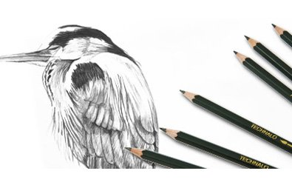
Water-soluble Graphite
If your drawing is 8x8 or smaller we could enter it into the Petite Impressions Contest at Eccles Community Art Center – just an option not mandatory
Let’s use our test paper to see what this stuff does before we start our drawings
1st drawing – watercolor paper
2nd drawing – tracing paper

Slide 6
Clean-Up 11.19.2019
Next class
2nd still life to compare to the 1st – after that we will be done with our assessment comparisons
Next week we will start our final choice projects
When we get back from the Thanksgiving Break, we will work on our final drawing project in time to have it ready for the art show at BL
Clean-up
Drawings on the drying rack, make sure your name is on them
Clean off brushes and put on back counter
Put water containers back in the cabinet
Thanks see you all on Thursday!

