Slide 1
10.29.2018 Pick Up…
Pick up all your art from your folder
After the critique
Take out your favorite 5 paintings
Be ready with a pen or pencil for instructions
Thank you!
Complete the reflection
Put your art back in your folder
Unless…you paid your art fee! Then you can take your art home! Remember we will have a winter art show, so if you’d like to bring back a piece for that show you can do so

Slide 2
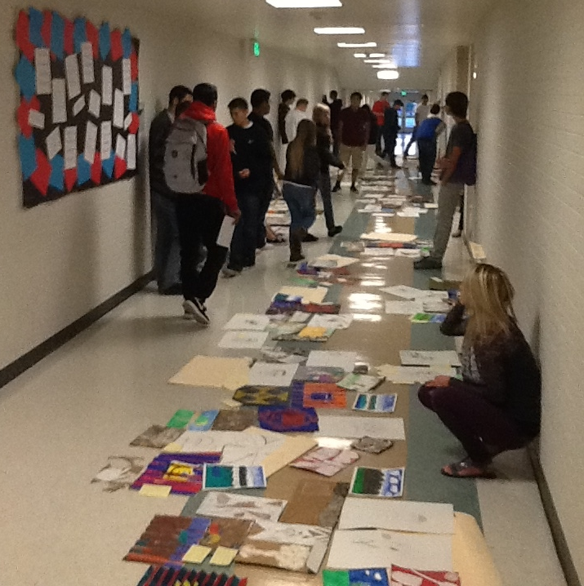
TAG Critique
Comment on two people’s art work on the sticky note
When you are done, come back in the room, put your other art back in your folder
Thank you!

Slide 3
Winter Themed Art Contest!
Due at the end of class Wednesday!
Notes:
© Copyright Showeet.com – Free PowerPoint Templates

Slide 4
District Winter Art Contest
8x8 inches or smaller
Notes:
© Copyright Showeet.com – Free PowerPoint Templates

Slide 5
Be original!
We will submit the art digitally
You will complete a form on Wednesday for those that want to enter their art!
Notes:
© Copyright Showeet.com – Free PowerPoint Templates

Slide 6
Winning Art pieces will earn a prize from the district and be featured on the annual district winter cards!
Notes:
© Copyright Showeet.com – Free PowerPoint Templates

Slide 7
Winter Art Contest
8 x 8 inches or smaller
Watercolor
Winter theme
Needs to be original art – so if you are being inspired by an image make it different
Feel free to sketch your idea first if you need too
Done early? Make two and double your chances of winning!

