Slide 1
Project #1: Symbol and Graffiti Art
Art A

Slide 2
Starter/Bell Work 8.24.2016
Pick up the worksheet at the door about symbols
Complete a response to all the questions
When you are done, you can feel free to sketch on the back
We will be sharing our worksheets, but wait for the bell

Slide 3
Agenda 8.24.2016
Starter/Bell Work
Agenda
Review Last Class
If you missed what do you do
Class website and file crate
First project
Symbols and lettering(street art with meaning)
Calendar and steps to the project
Studio Time
What that looks like
Clean-Up
Exit Pass

Slide 4
Review last class
Disclosures – did you get it signed?
Letters home – I need to give out
Found out about Mrs. Lyon, Griffin, and we all shared common interests with the class
That was about it, some classes had time to complete the exit pass
…review a few things….

Slide 5
Some thing to take note of in the classroom…
Calendars – for each project
Sinks Recycling
Desk space
Hall Pass
Not during the 1st 10 min. or last 10 min. of class, during lecture time and demo time
Only 3 per term, must sign back of planner
Folders in the front of the class is where all art projects are kept
Name on both sides
Where does it go?
Crates will be for graded work and if you need to re-do something

Slide 6
Project #1 – worksheet
Share with the people at your table your responses to the worksheet you completed for the starter
If you need to fix anything at this time please do so
As a group come to a conclusion about what you think the word symbol means, we will be sharing our definition with the class

Slide 7
Share Definition
Pick someone from your group to share the definition for symbol
Let’s come up with a definition that works for the whole class

Slide 8
Assignment #1
Symbol: something that represents something else
Example: this is a symbol for peace

Slide 9
What is a symbol?
Definition of a symbol: sym·bol (smbl) noun
1. Something that represents something else by association, resemblance, or convention, especially a material object used to represent something invisible..
2. A printed or written sign used to represent an operation, element, quantity, quality, or relation, as in mathematics or music..
3. An object or image that an individual unconsciously uses to represent repressed thoughts and feelings.

Slide 10
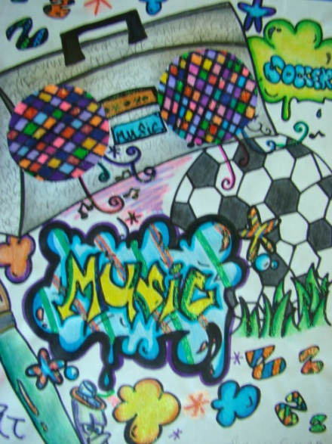
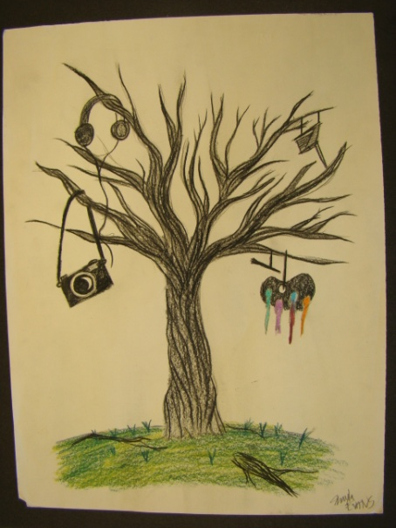
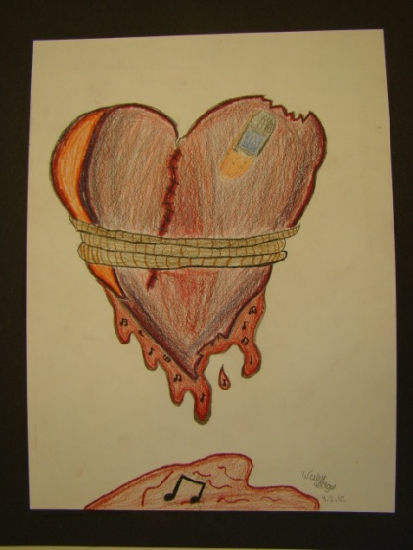
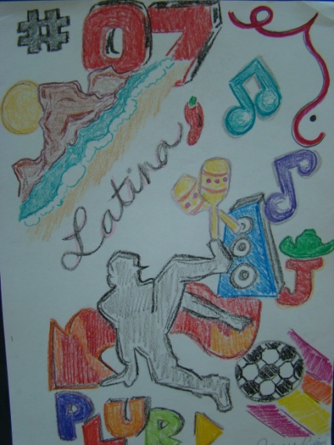
Symbols Assignment - Rubrics
Symbols in art are one of the oldest forms of visual communication and convey meaning beyond what's obvious.

Slide 11
Symbols will be combined with Graffiti
Today…
Symbols about you
Next class…Friday
Graffiti of a word that goes with your symbol

Slide 12
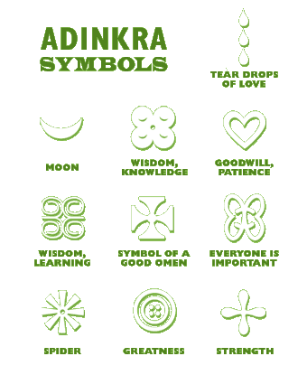
One Example of Symbols

Slide 13
Media Center
We are going to go to the media center and try to look up some symbols/images/fonts that we want to use as a resource
Remember, whisper voices in the media center
Print one page per person
Try to find at least 5 images that you can use as resources
Questions?
Leave back pack in the room we will lock it

Slide 14
Open Studio Time
3 – 5 sketches of ideas for your symbol
In pencil on the white paper at your tables
Symbol ideas can be anything that you think represents you
Be original (don’t copy symbols that are already out there that’s called plagarism)

Slide 15
Next Class!
Disclosure for Art A – go over in detail
Details about grades – 35% 65%
Rules that we will establish
Review of classroom set-up
Anything else you need to know? (2 min)
Continue working on Graffiti Symbols Assignment
Be ready for Bell Work again at the beginning of class! See you next class!

Slide 16
Exit Pass to get out of class
What is the one thing that you enjoyed doing today in class?
On a sticky note and on the door on your way out

