Slide 1
Duality Patining
E.Lyon

Slide 2
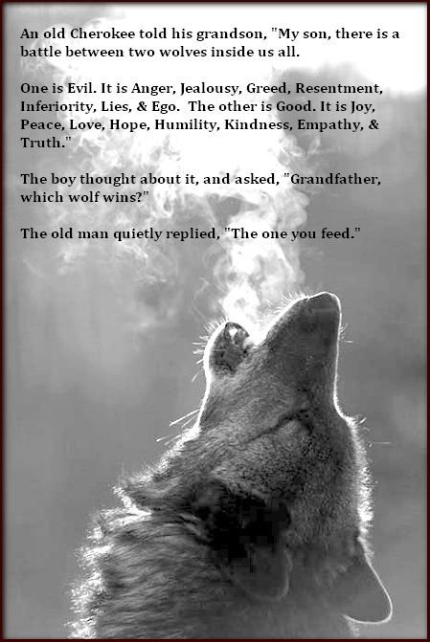
What does this poem mean to you?

Slide 3
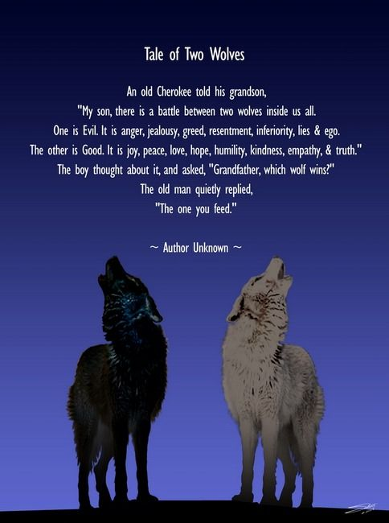
Share your thoughts with your table
Chat with each other about the poem

Slide 4
Draw a good and evil creature
Be imaginative
This creature can be anything (it doesn’t have to be a wolf like the poem)
These two creatures will form one creature (be thinking how they will over lap)
Use paints or colored pencils
Have the evil creature be warm colors – yellow, orange, red
The good creature cool colors – blue, green, purple
Or switch, but they need to be opposites (cool vs. warm)

