Slide 1
Self-Portraits 12.15.2016 art a
e.lyon

Slide 2
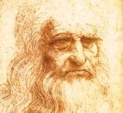
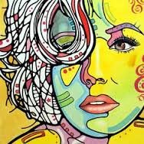
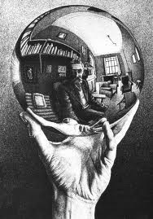
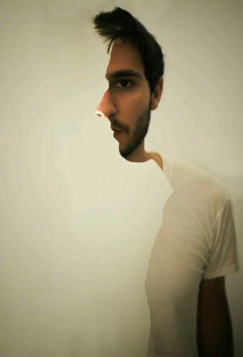
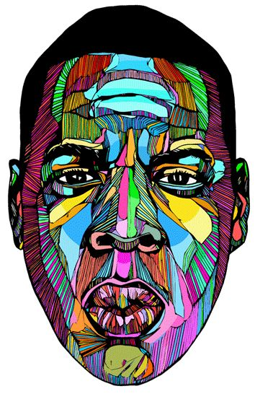
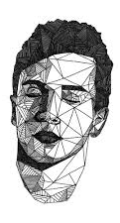
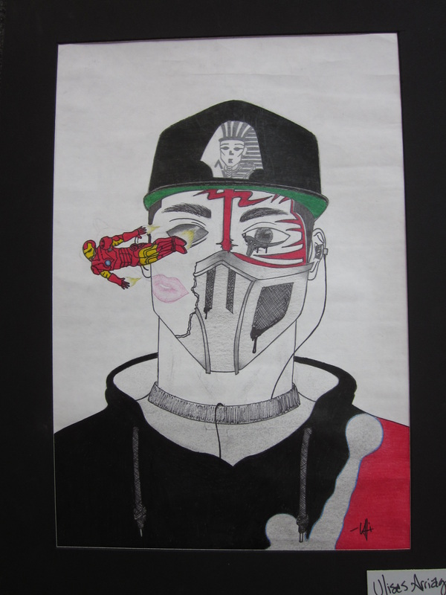
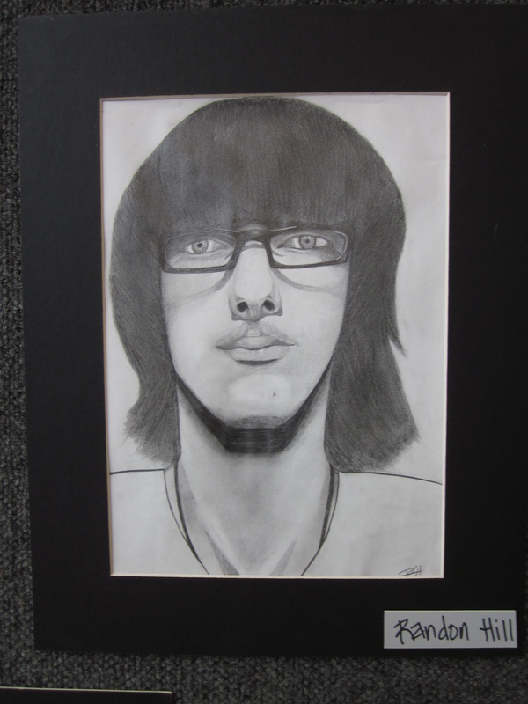
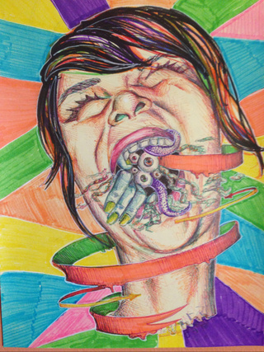
Studio Time 12.15.16
Make sure your goal for your self-portrait is on the outside of your folder
Sketches
Realistic = 1 sketch
Abstract 3-5 sketches
Combination realistic and abstract = 2 sketches
Media for final
Pencil – 5 tones of gray
Colored Pencil – at least 5 or more colors
Final paper and pencils are on the back counter

