Slide 2
Painting 2
At the door you will need to pick up:
Class survey – from last class with comments on it, read the comments, respond to any questions and add it back to your hanging file
Hanging files are organized alphabetically by last name
If you missed last class, please complete a survey and turn it into the basket on the cart
Thank you!

Slide 3
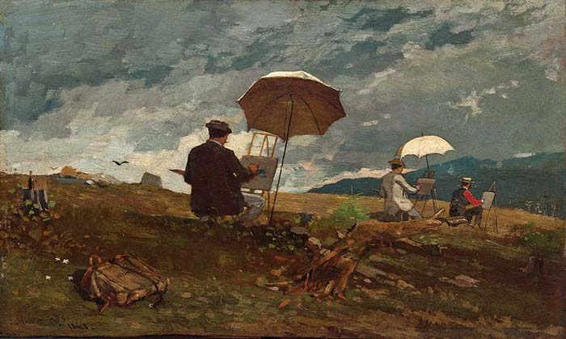
Painting 2, Day 1 with oil paints
We are going to set up a palette
Go outside with a canvas on a board
And plain air paint!

Slide 4
Clean-Up

