Slide 1
Mixed Media
Painting 2 - Day 3

Slide 2
Bell work 11.19.2019
On your way in pick up the descriptions for the techniques we did last class
Find your mixed media sample collage and texture from last class – either on the drying rack or in your hanging file
We are going to match up our descriptions with our samples.

Slide 3
Bell Work – Do 11.19.2019
Glue the descriptors on the back of your corresponding technique
Check the boxes of the items you used to create your technique piece
Fill out the questions asked on the collage descriptor paper

Slide 4
AGENDA 11.19.2019
Texture – Finish tissue paper sample
Build up a mixed media samples by adding to it with (Stencil, stamps, india ink, colored pencils and oil pastels)
Go over what is expected for your final mixed media project
Compleat worksheet about final mixed media project
Start final project

Slide 5
Finish up texture from last class
Texture – Finish tissue paper sample
Build up a mixed media samples by adding to it with (Stencil, stamps, india ink, colored pencils and oil pastels)

Slide 6
Mixed Media Project

Slide 7
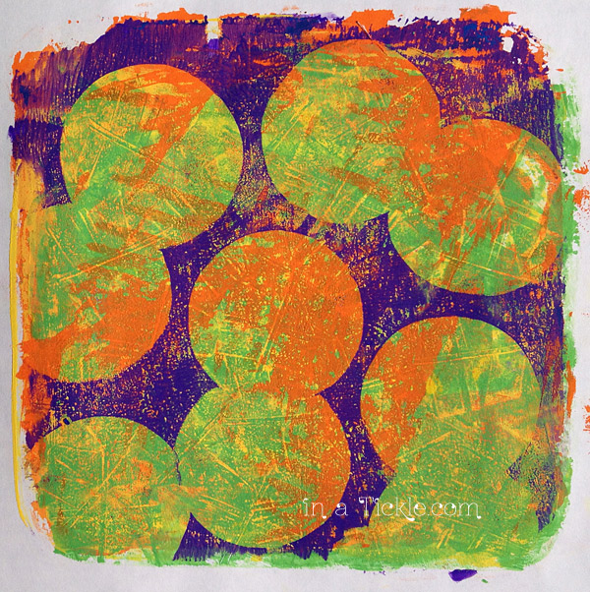
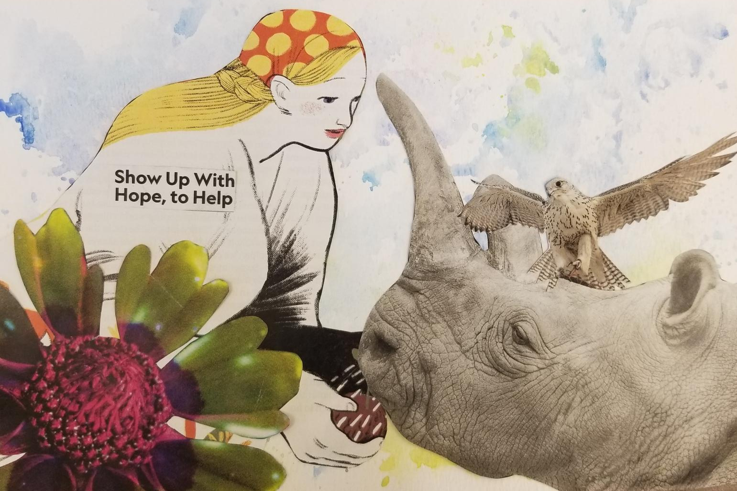
Pick at least 3 Techniques to use:
Monoprint with Gelli plate
Watercolor with plastic bag
Collage

Slide 8
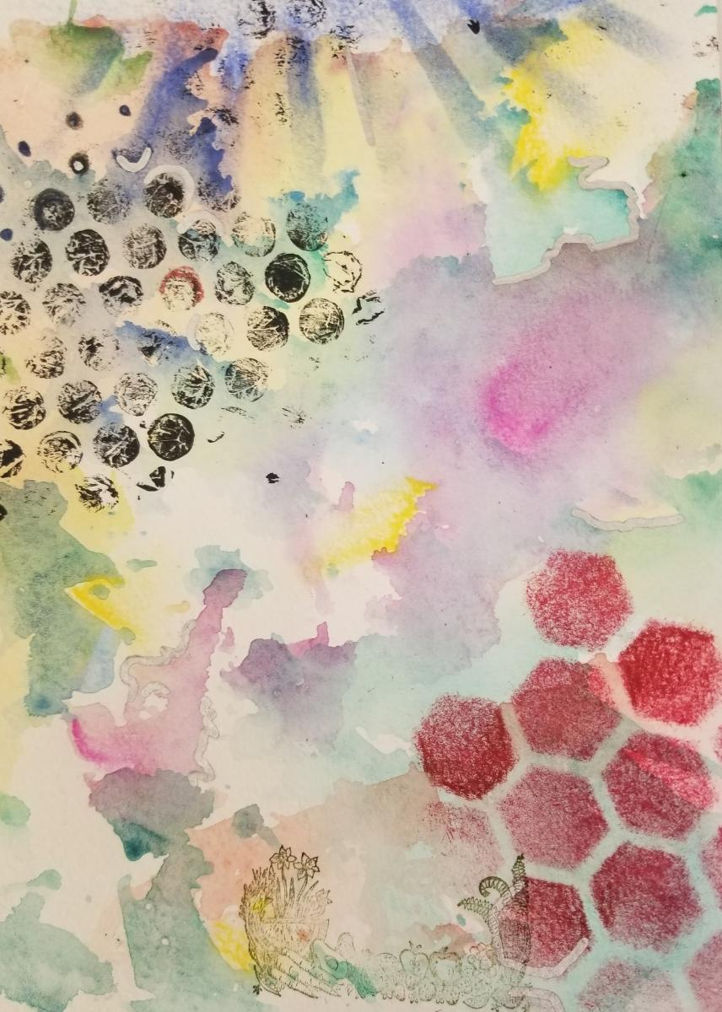
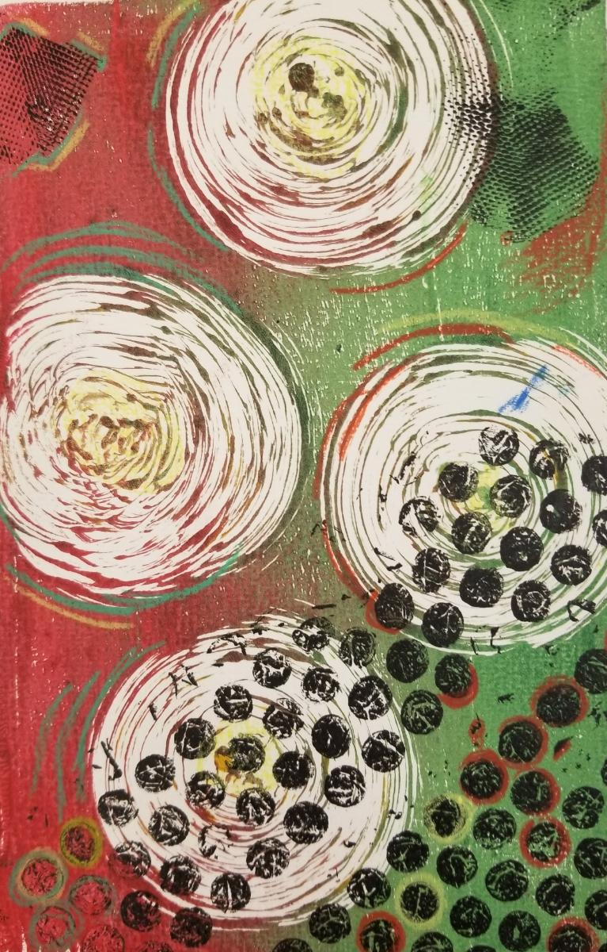
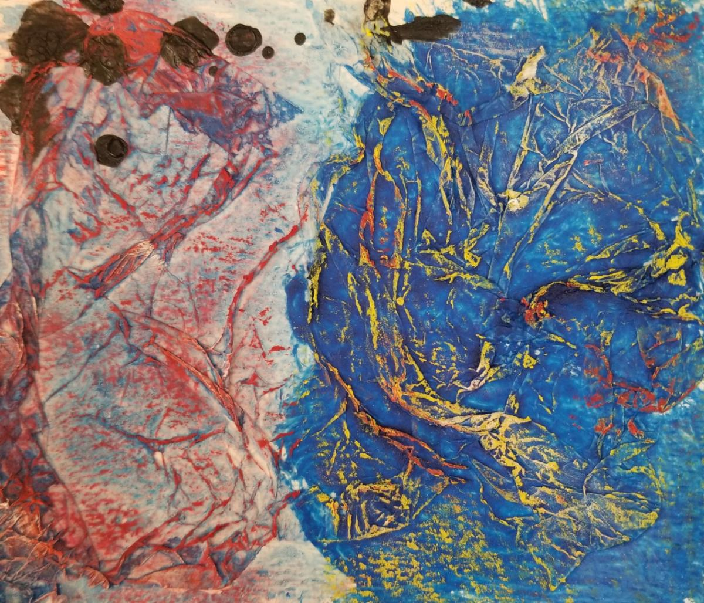
Overlay with stencils and stamps
Define shapes with colored pencils
or/and oil pastels
Texture with tissue paper

Slide 9
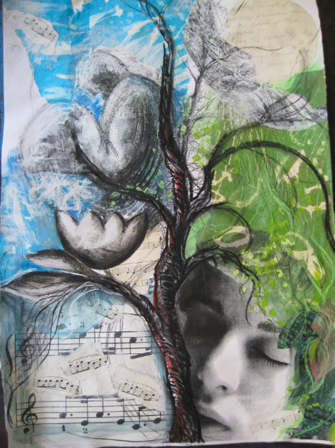
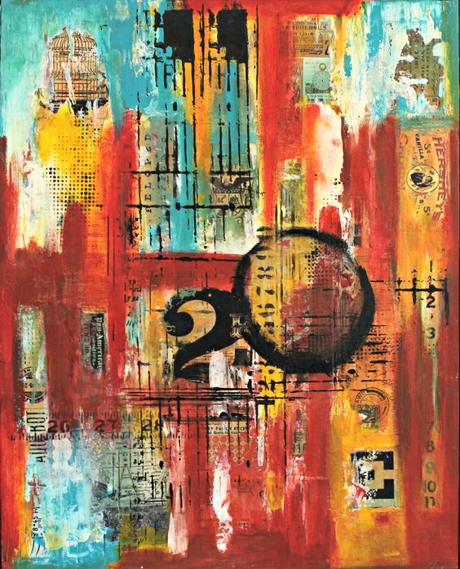
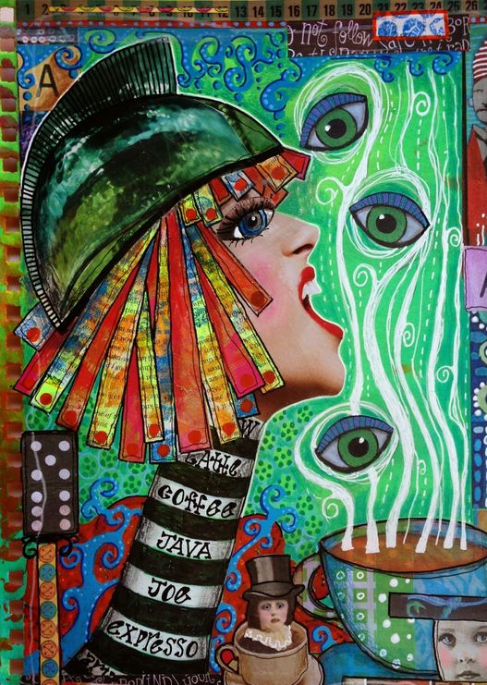
Pick a Theme for Inspiration:
Identity Movement Emotion

Slide 10
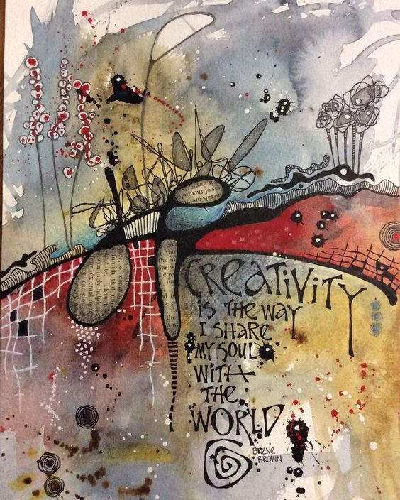
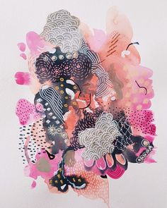
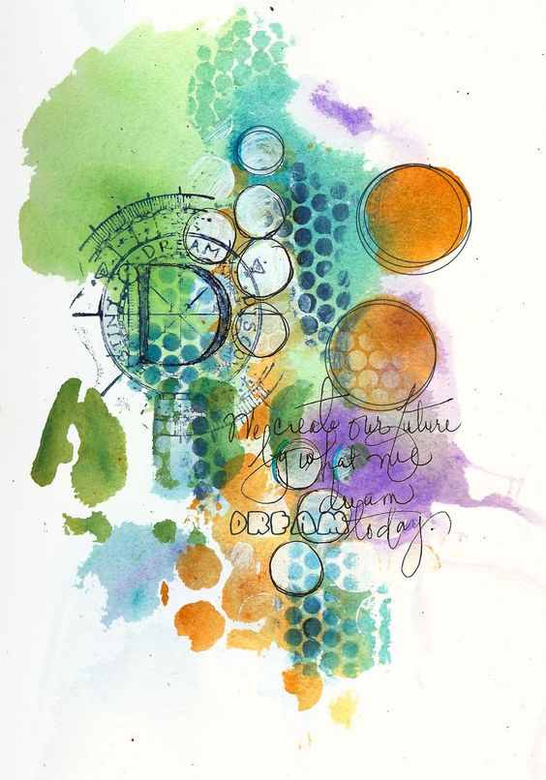
Use a Hand Drawn Element:

Slide 11
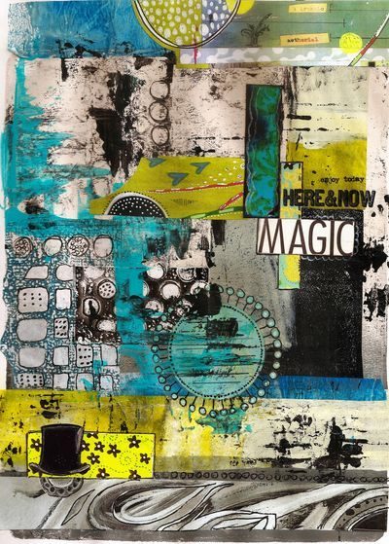
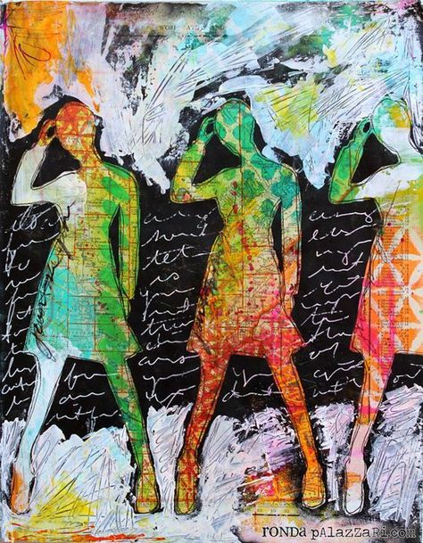
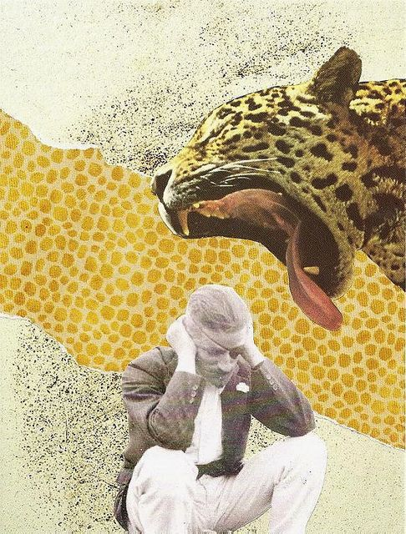
Create Harmony & Unity:
Color scheme Repetition A story

Slide 12
Challenge yourself & create something your viewers will want look at!
Studies show that the average viewer stops for only 30 seconds to look at a piece of art. The goal is to have them take longer.
You can do this by creating layers
Or by creating something interesting to look at
Our goal is for the viewers to STOP and take time looking at your artwork!

Slide 13
Mixed media Final Project
Your artwork will need to:
Use your theme you pick as inspiration
Identity
Movement
Emotion
Incorporate at least 3 techniques we learned in class.
A background layer
A second layer overtop ( more is always better).
Hand drawn or hand written element.
Create unity/harmony
Color scheme
Repetition
A story
Challenge yourself, create something your viewers will want to take time to look at.

Slide 14
Techniques:
Collage
Mono Gelli prints
Watercolor & plastic bag
Texture with tissue paper
Define shapes
with colored pencils or oil pastel
Overlay
with stencils & stamps

