Slide 2
Bell Work 1.16.2015
List all the steps of the film making process.
What do you think is the most important part of the film making process?
Why do you think ‘that’ is the most important part of the film making process?
What do you think is your greatest unique tool when telling a story on film?

Slide 3
Agenda 1.16.2015
Bell Work
Agenda
Share bell work responses
Storyboarding
Film 1
assignment
Groups
Storyboarding
Exit Pass

Slide 4
Share Bell Work Responses
List all the steps of the film making process.
What do you think is the most important part of the film making process?
Why do you think ‘that’ is the most important part of the film making process?
What do you think is your greatest unique tool when telling a story on film?
Be ready to share as a group to the class about one of these topics

Slide 5
Sharing Responses
Each table will focus on one of the bell work questions
Depending on the card you pick, will tell you which question to focus on
Write down your groups thoughts about that question on the blue paper
Be ready to share with the class in 5 min.

Slide 6
Storyboarding Video
https://www.youtube.com/watch?v=LgDwNxGIuCQ
Storyboard – why make a storyboard

Slide 7
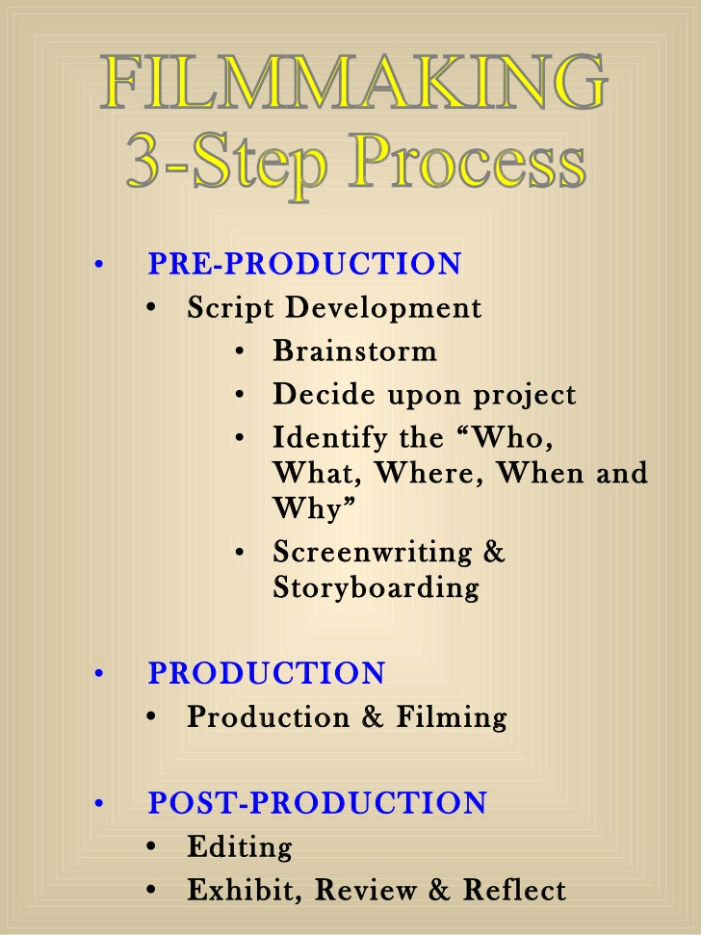

Slide 8
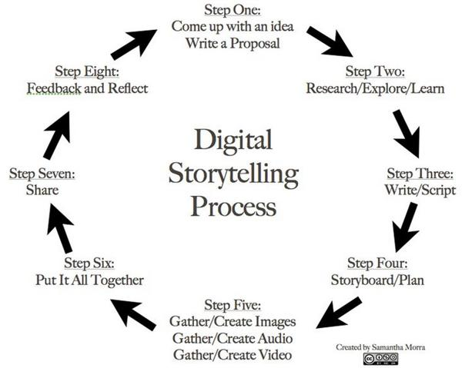

Slide 9
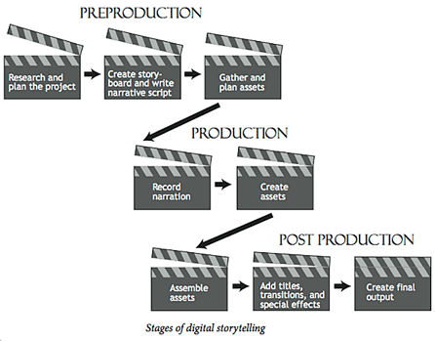

Slide 10
Film 1
8-12 shot styles and angles
At least 4-6 people per group
Everyone must be in the film
Title, credits
Clear establishing shot in the into, a full storyline(beg., md., & end)
Audio is clear and loud enough for us to hear
Shots are stable and focused
It needs to be a narrative

Slide 11
Narrative?
What’s a narrative film?
Simply put a Narrative film refers to the types of movies that tell a story.

Slide 12
Groups & Storyboards
Get in a group of 4-6 people
Start working on your film, storyboards will be due next class at the end of class
We can get out the whiteboards so people can brainstorm
Please no whining, I won’t listen to whiners

Slide 13
Exit Pass 1.16.2015
Did you learn anything new about the film making process, if so what was it?
What is one thing that you are looking forward to in this class?
What was the best part about working on your storyboard today?
See you all Wed. storyboards will be due at the end of class

Slide 14
Productions Class 1.16.2015
HERO Video
Film what we storyboarded last class
FAFSA
Edit, what else can we film today
Announcements
Start, air on ?
Add FBLA, diversity film, sports footage?
Anything else?

