Slide 1
First Day Drawing/Painting 3
8.21.2018

Slide 2
Welcome Back to Drawing/Painting 3 8.21.2018
At the door you will need to pick up:
Class survey
A letter & a disclosure – if you weren’t here yesterday
Start on survey for Drawing/Painting 3
Thank you!

Slide 3
Supplies you will need
Scissors
Glue stick
Paper – pick out different papers that you like
Cardboard
Take your supplies back to your seat
Please be ready with all your supplies and wait for instructions once everyone has found their way back to their seat

Slide 4
Ready
Looks like:
Eyes forward
Materials picked up and in front of you
Phone away(preferably in your bag so the vibration doesn’t distract you)
Sounds like:
Lecture environment to start so that we all can hear instructions
Questions, please ask, someone else probably has the same question as you

Slide 5
Agenda
Survey – bell work
Gather supplies
Reminder of what being ready in class looks like and sounds like
Who’s Mrs. Lyon and Who are all of YOU!
Quick FYIs about the class
Disclosure – we did last class
Class Routine
Start first project - HIVE
Dem & visual notes
Exit Ticket
Questions about today?

Slide 6
Who is Mrs. Lyon?

Slide 7
Professional Artist

Slide 8
www.ericalyonart.com
Art Shows
in Ogden
The Front – climbing gym(Dec. 2017)
Café Mercantile – 26th St.
Second Track Sports – 12th and Harrison
Blooming Lotus Café – 25th Street
Gear30 – on Wall Street
Wasatch Roasting Co.(Nov. 2017)
Eccles Community Art Center State Show – 2 pieces 27th and Jefferson
Eccles Community Art Center will be celebrating their 125 anniversary on Saturday!

Slide 9
Lived in Ghana, West Africa for 2 years teaching art to Deaf students

Slide 10
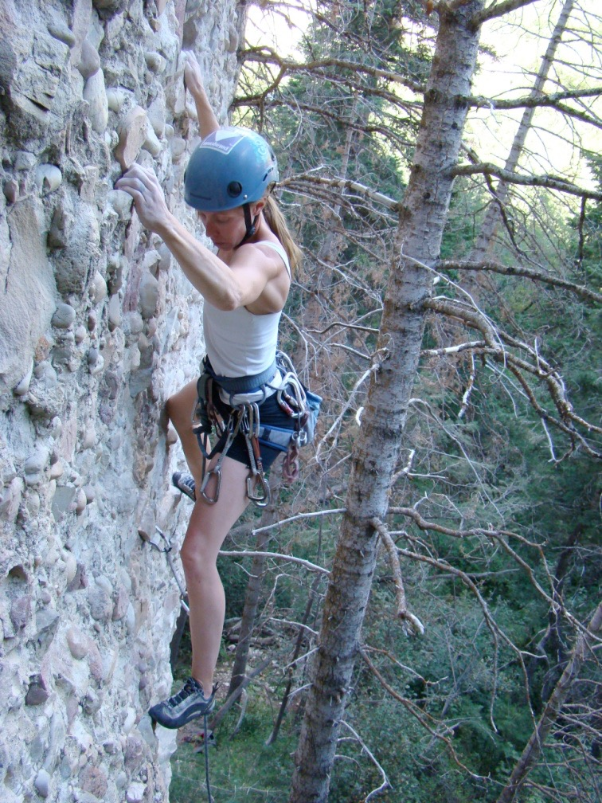
Climbing!

Slide 11
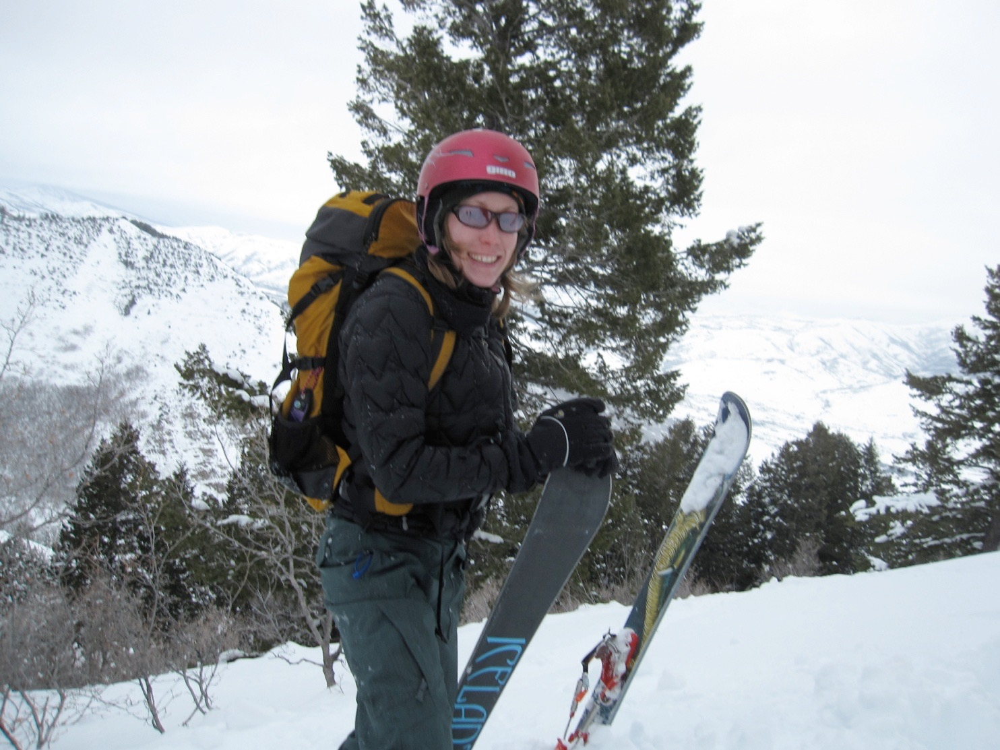
Backcountry Skiing

Slide 12
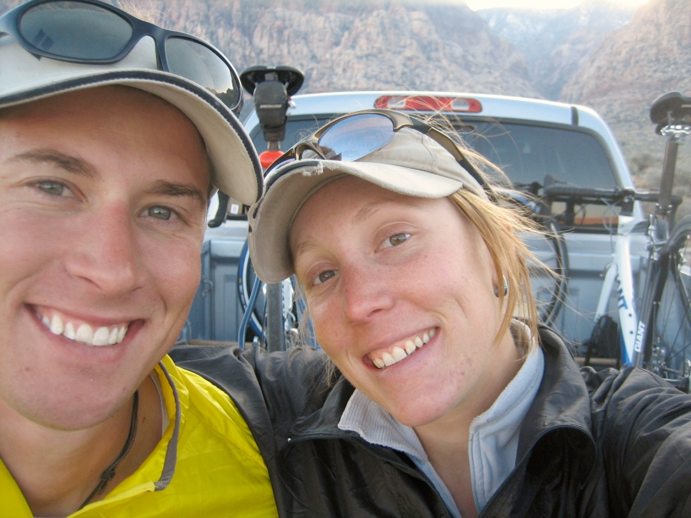
3 Ironman's completed!
2.4 mile swim, 112 mile bike, and 26.2 mile run

Slide 13
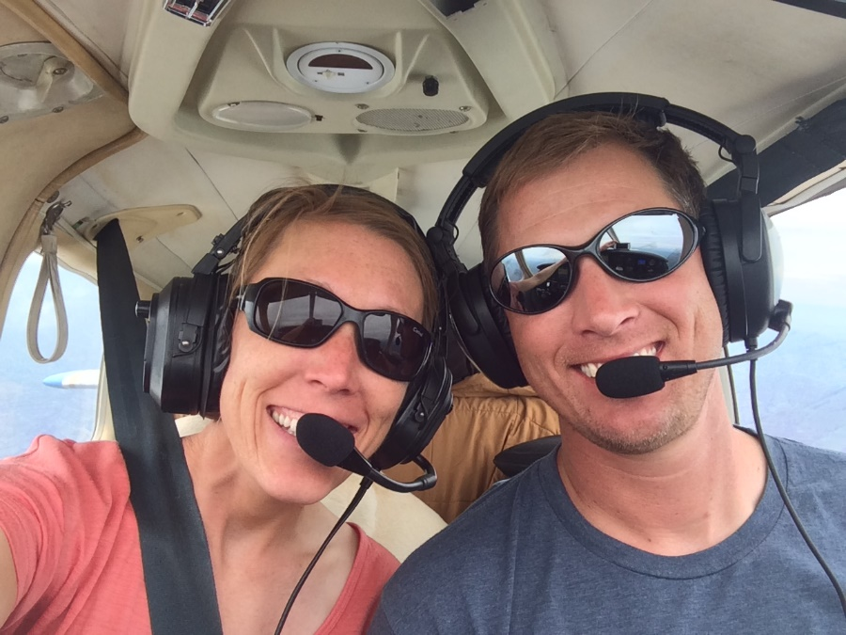
Love of my life!

Slide 14
Mrs. Lyon’s Teaching Thoughts about Art Class
Everyone and thing has value, treat it as such
Learning needs to be fun, challenging, and applied
Self-awareness is crucial in art, being able to take risks, and challenge yourself is key

Slide 15
Lyon’s faults
It’s challenging for me to spell
It take me a few months to memorize names

Slide 16
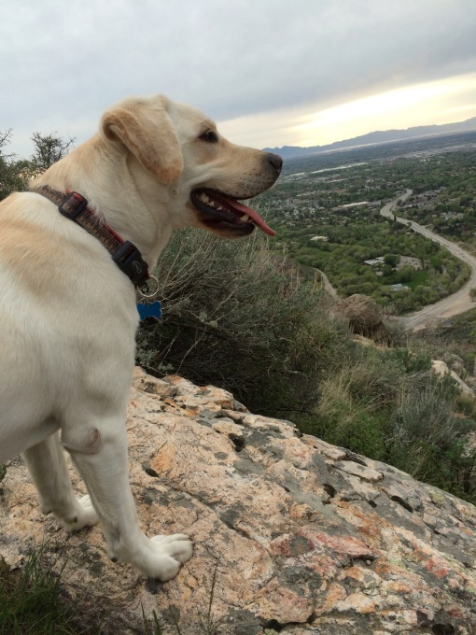
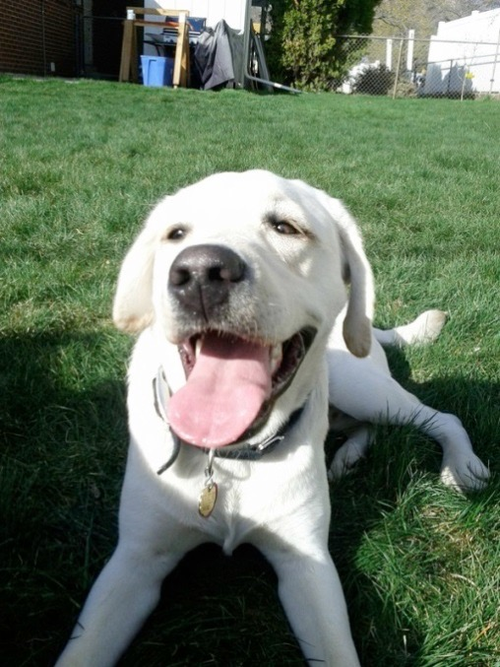
Griffin
Therapy dog ☺
No food or candy
Let him chill on his matt in the back
During studio time he will be walking around
Greeting people at the door daily
No whistling or calling his name - thanks

Slide 17
Who are all of you?
Activity:
Find something in common with everyone at your table
Write it down on the whiteboard
Pick someone to share it with the class

Slide 18
Quick FYIs
Disclosures - get signed and bring back = extra credit
Recycling, sink, trash, paper towels, band aids
All art supplies you need for class will either be at your table, at the door to pick up or on the back counter
Everyone will have a file folder for all their papers
Tables and chairs - we move, they move
Art work will stay in your class folder
Hall Pass – you must have your planner to use them
Not during lecture, critique, or demo time, only studio time
Not during the 1st 10 min. or last 10 min. of class
Only 3 per term, must sign back of planner
Website! – www.classwithlyon.com & Remind app(sign-up)
Questions?

Slide 19
Art Shows
Art Competitions 2018-19
Face Painting Fundraiser – help AP pay for their exam and work at the football games painting faces for donations
First Friday Art Stroll – The Local Artisan Collective October and December 2018 6-8pm
Winter Art Show & Music Concert in the Commons at BLHS December 18th
Scholastic Art Competition due Dec. 4th, 2018 for more information go to: https://www.artandwriting.org/what-we-do/the-awards/categories/
Eccles Petite Impressions (under 8x8”) at Eccles Art Center in Dec. For more info visit: http://www.ogden4arts.org/competitions/
Utah State Senate Art Contest TBA
Utah State Art Show mid-Jan. 2019
Ogden Trails Network 3rd Annual Art Competition February 2019
Weber County Health Department Art Competition February/March of 2019
HOPE Art Competition around February or March of 2019
Art Gala in the commons at BL
Festival of Arts Beginning of April 2019 at Eccles Art Center
Recycled Art Competition Beginning of May 2019 at Eccles Art Center
Painting Competition at Eccles Art Center for more information: http://www.ogden4arts.org/competitions/

Slide 20
Disclosure
Review Disclosure together – did last class
Turn in

Slide 21
Class Routine Each Day
Bell Work - BW
Agenda, reminders, review last class
Lesson – demos, mini lectures, etc.
Studio Time! - Creating your art!
Review – what’s going to happen next class
Exit Pass

Slide 22
HIVE
Drawing/Painting 3

Slide 23
HIVE

Slide 24
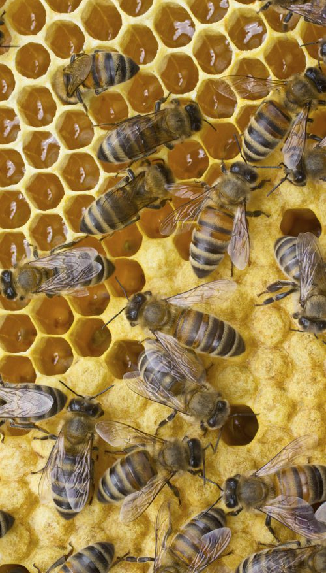
HIVE
In a honey bee community, one can find a level of cooperation and collaborative teamwork that exists nowhere else on earth. Each bee has an important role to play to guarantee the survival of the hive.
In the human world, there are people who keep the community humming along. Think about people who keep you humming along. Each cell will represent a person, place, thing that helps support you. The connections your cells make can represent the connections those people have in your life.

Slide 25
Hexagons
Hexagons are the most efficient share. They are strong and create a consistent pattern. They require the least amount of bees wax to make, because each one shares a wall with its neighbor. Each has a purpose and function.

Slide 26
List
On an index card, make a list of people in your life. Write next to them how they are a part of your life. You could even write how they are important to you.

Slide 27
Cutting paper for the hexagons
Cut strips lengthwise from a 9 x 12 sheet of paper. Vary widths of paper from ½ “ to 2”.
Create multiple hexagon shapes using either process:
A) measure with a ruler and mark 1-1 1/2 “ sections along each strip. Make a fold on each mark.
B) Follow the process below:

Slide 28
Gather paper you like
Gather paper you like
Draw something(inside the hexagon shape) that represents each person on your list
You could also draw something that represents who you are to add more to your HIVE
Glue all your pieces together when you are done – you might need to attach it all to another piece of paper or cardboard

Slide 29
End of class 8.21.2018
Place all the materials you found on the back counter
Use a folder to put all your supplies in – we can label them with sticky notes
We will finish this project up next class
See you all on Thursday!
If you need extra time on it you could work on it Wednesday after school – today I have mountain biking clan practice

