Slide 1
Day 2 Realistic Self Portraits
Drawing Out Your Face in Proportion

Slide 2
Bell Work 11.7.19 – in your sketchbook True or False?
The eyes on the face are 1/3 from the top of the head. True or False
The width is 2/3 the height of the face. True or False
The nose is 1/3 down the face from the eyes. True or False
From the top of the nose to the corner of the mouth forms a triangle. True or False
The space between the eyes, nose and mouth are all 1/6. True or False

Slide 3
Why for today?
Learn the face proportions so we can draw our face
Smooth transitions shading on the face

Slide 4
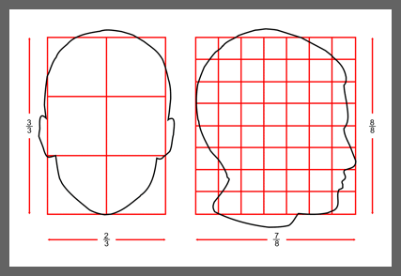
Human Head Proportions

Slide 5
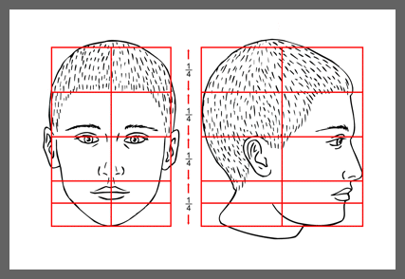
Proportinos of the Face

Slide 6
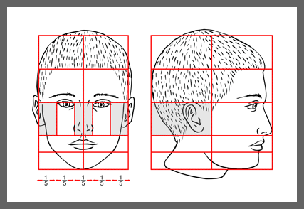

Slide 7
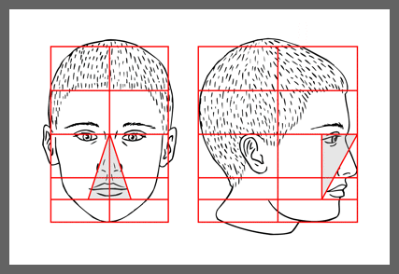

Slide 8
Bell Work 11.7.2019 True or False?
The eyes on the face are 1/3 from the top of the head. True or False = 2/4 or 1/2
The width is 2/3 the height of the face. True or False
The nose is 1/3 down the face from the eyes. True or False = 1/4
From the top of the nose to the corner of the mouth forms a triangle. True or False
The space between the eyes, nose and mouth are all 1/6. True or False = 1/5

Slide 9
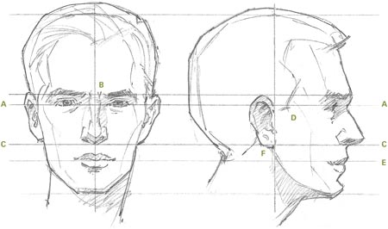
Drawing yourself in proportion
On a nice piece of drawing paper and looking in the mirror

Slide 10
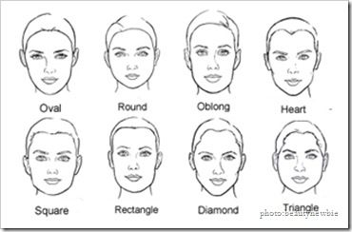
Look at your face, what shape face do you have?

Slide 11
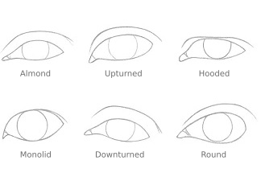
Look at your eyes what is the shape?
Your eyes will be half way down your head
Eyes should be 5 across.

Slide 12
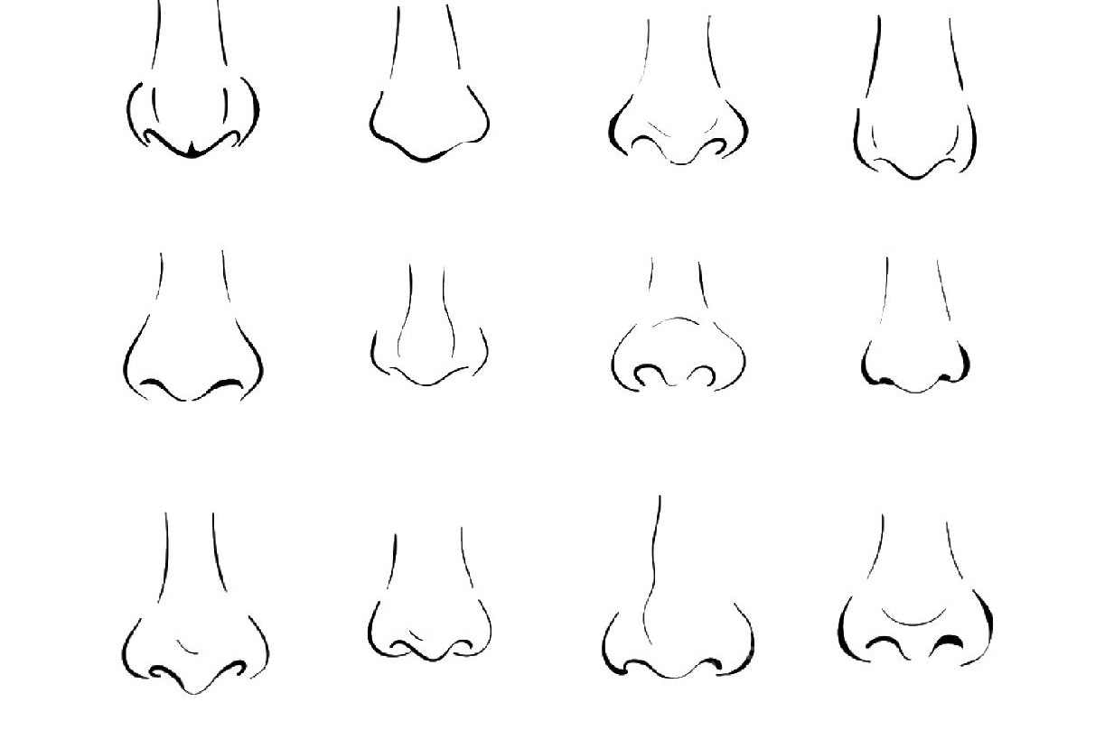
Look at your nose, what shape is your nose
Your nose is half way from your eyes to your chin.
It should be as wide as an eye.

Slide 13
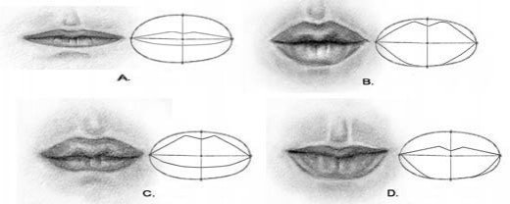
Look at your mouth what is the shape?
Mouths should be half way from the nose to the chin.
They should be as wide as the center of one eye to the center of the other eye.

Slide 14
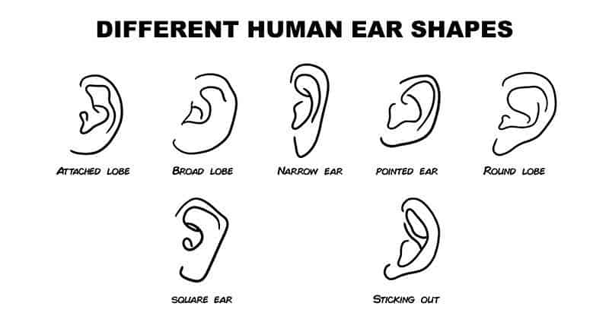
Look at your ears, what shape are they?
Your ears are the from your eyes to your nose.
They will vary on how much they stick out, so look at them.

Slide 15
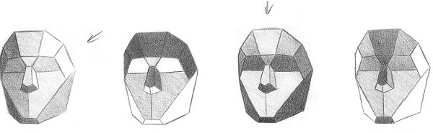
Planes of the face & how to shade
First you need to draw the planes of the face.
Second you need to determine the light source.

Slide 16
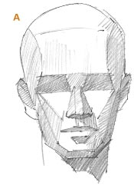
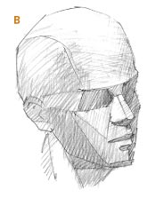
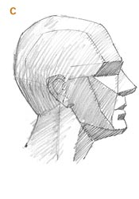
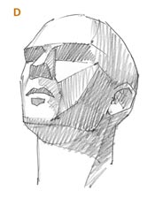
Divide the area from the cheek down to the jaw into three basic planes: light, where the light source is brightest; darker, as the form starts to turn from the light; and darkest, as the form turns farthest from the light.
The way light is revealed on the planes of the head tells us how the head is shaped.

Slide 17
Agenda 11.7.2019
Bell work
Correct our true/false statements
Work on self-portrait, looking in the mirror
Questions?
Rough Draft of self-portrait is due at the end of class
Use your time wisely
Exit Pass

Slide 18
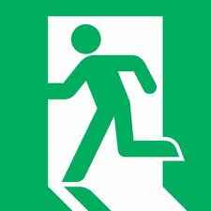
Exit Pass 11.7.2019
1) Write on the back of your self-portrait, what are you most satisfied with about your self portrait and why?

Slide 19
AP 11.7.2019
Portfolio Review – this Saturday from 9:30 am – 1 pm
Senior Art Show at ECAC have a piece ready to frame for that by December 10th(sorry, seniors only)
Scholastic Art Submissions – online – DUE December 3rd, 2019
Congressional Art Competition – Anything about Utah(people, place, culture, etc.) – online – DUE 11.8.2019(tomorrow)
Sterling Scholar Applications – due Nov. 20th, application on www.classwithlyon.com go to the AP link, at the top of the page
AP portfolios – should be on piece 5, if not let’s get focused on our art – need extra time? Open studio hours after school once a week?

Slide 20
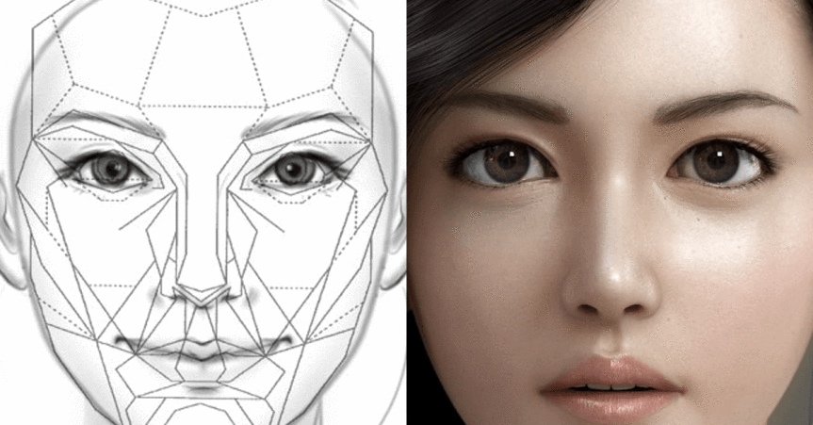
Look at your face, how would you break down the planes?

